Slide 1

The Doctrine of the Holy Spirit – Old Testament Sightings
Panoramic
The Story of God
as seen through
The Great Christian Doctrines

Slide 2
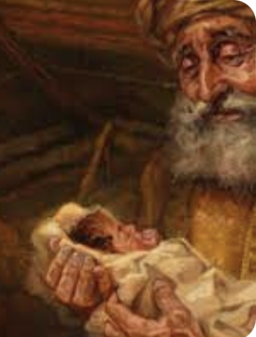
OLD TESTAMENT ACTIVITY - The Holy Spirit was certainly active in salvation history before Christ and the church. His was the power behind the great miraculous feats of some of the Old Testament saints of Israel! For instance, He worked the surprising circumstances surrounding the birth of Isaac [Gen. 18:10-15; Gal. 4:29]. Many of you know the story, of how Sarah was 90 years old and Abraham, 100, when the Holy Spirit recreated her long dead womb, a womb that even when it was functional had remained barren throughout her child-bearing years. And then God used His powers of creation to, in this seemingly peculiar way, to show that this race, whose purpose was to be the gene pool from which the Christ would come, was an act of God, not an act of man! At its very roots, at its very formation, the plan of God to bring salvation to the world was going to be a specific, ongoing, act of God in its entirety, across the board, from beginning to end! This miracle birth was just the opening volley! The Holy Spirit was operating under the great plan of God! The plan of salvation was to be God’s endeavor and God’s alone! ~Approximately 500 years later, or so, Moses ran headlong into the God of Abraham, who spoke to him from a burning bush that was not consumed by the fire! God sent Him straight into Egypt and into a head-to-head matchup with the headstrong Pharaoh [*Ex. 4:15-17,21a]. He was the instrument of God’s judgment upon Pharaoh for practicing genocide on the Jewish people in His land as a means of population control! So then came great miracles of judgment - the ten plagues of Egypt! The Holy Spirit and His power was undoubtedly engaged in that catastrophic time in Egypt’s history! Only God could have made the Pharaoh give up and grant Israel permission to exit the country, and God did it in spectacular fashion – epidemics of stinking blood-water, frogs, biting gnats, flies, a plague on Egypt’s valuable domesticated animals – (flocks and herds, beasts of burden, and a recognize source of personal wealth). Then, boils afflicting people and animals alike, hail blanketing the land - pulverizing ice ball raining down - destroying the season’s crops, and after that, locusts to finish off what remained! Then there was blinding darkness for 3 days, and then, finally, the plague that broke Pharaoh’s resistance – the death of the first born son of every human and animal in Egypt! So everyone packed up and left! Then, unbelievably, Pharaoh changed his mind back again, and sent his army to bring them back! The cloud of God that they followed had led them into a seeming dead end, trapping them at the shores of the Red Sea and that’s where Pharaoh’s army caught up with them. The pillar of cloud went behind them and turned into dense fog, stopping the Egyptians from going any further! All this, so far, was the judgment of God sent, or directed by, or powered by the Holy Spirit! For the last plague, we know that the death angel was employed for that ugly job! As Moses was Holy Spirit empowered, so too the angels that would have been used on this job.

Slide 3
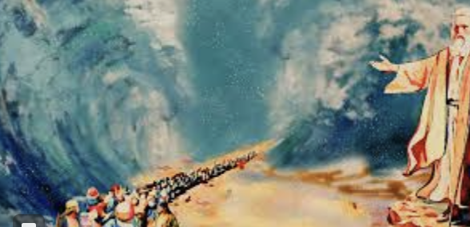
Then Moses, again led by the Spirit of God, commanded the seas to open and they did [Ex. 14:15-18]! The waters parted down to the seabed, and a wide trail opened up. The next morning, with the fog protecting them from the advance of the Egyptian army, the Israelites and their carts of goods and their great herds of animals, slipped through the middle of the Red Sea and traveled all the way across, with towering walls of water on their right and left (can you even imagine)! The fog of God then lifts on the far side then, where they’d begun, and the Egyptian army sees the strange gap and decide to pursue through the middle of the Red Sea, where the walls of water collapse and the huge Egyptian army is drown! It is a huge story, and enough Egyptians are left alive to tell and retell it endlessly, as you might imagine! Approximately forty years later, the Canaanites still knew all about the God of Israel and what He had done to Egypt! When Israel was poised to enter the land of Canaan, they sent spies into the land to see what their state of mind was [*Josh. 2:8-11] - good morale, or bad? Good morale translates into courage/confidence/strength, whereas bad morale translates into a lack of courage/weakness, meaning less formidable opposition! At that point it becomes apparent that God had known that His great acts of judgment against Egypt would be told and retold until the story reached Canaan! This was important to God! In His great mercy, it was His desire to warn even the wicked, wicked Canaanite nations who were slated for an even more terrible judgment than Egypt! So, they could have surrendered, repented like wicked Nineveh in the prophet Jonah’s day, and they would have undoubtedly been saved from God’s wrath, for God does not punish the truly penitent! But they did not! But,.. the point is that all the great acts of God in the Old Testament times – acts of wrathful judgment, or acts of rescue and salvation for Israel, were generated by the Holy Spirit! And they always made a point! It has all the hallmarks of His activity - of His power having been directed and engaged!

Slide 4
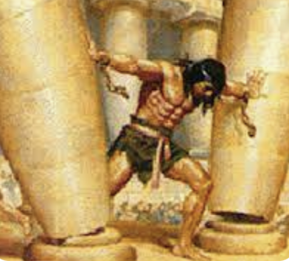
~It was His strength that coursed through the muscles of Samson [*J’g. 13:25 / 14:6 / 15:14,15]. EXPLOITS: killed a lion with bare hands; in a fit of rage caught 300 foxes, tied them together 2x2 by the tail, tied a burning torch to each pair and turned them loose, destroying crops in the entire area; when bound, he broke chains and heavy rope like dental floss; killed a 1000 attacking armed men with the jawbone of a donkey! And finally, he decimated the ruling class of Philistia by bringing down the temple, where they had him on display, down upon all their heads! Not a good man but useful to God in keeping the Philistines down! ~It was the Spirit’s power that was manifested so strongly in the great prophet Elijah, and doubly so in his understudy, Elisha [*2 Kings 2:7-22]. Those two did some amazing feats with the Spirit’s power! ~There were also the amazing champions of Israel’s armies who could singly vanquish hundreds of enemy soldiers when the Spirit came upon them [2 Chr. 32:7,8 / *J’g. 3:31; 6:34 / 2 Sam. 23:3-18].
~The Spirit of God was directly involved in these and all the other Old Testament incidents where the great power of the Creator/God was brought to bear upon the preservation of His chosen people, Israel, or in bringing the judgment of God down upon His avowed enemies! It was God’s will that Israel might be preserved, their enemies driven back or exterminated in judgment, and in the process, God’s reputation and glory was purposefully spread to the world, that the world would know enough about Him to at least fear him if not seek Him! The Spirit’s ultimate purpose was that God might be known, feared, and worshipped everywhere [*Ex. 9:13-16 / Josh. 2:8-11]. It was the Holy Spirit who was heavily enlisted within the Godhead to accomplish these watershed events that were shaping and guiding human and salvation history toward the cross of Jesus Christ! He is revealed as the powerful force of God’s direct will! ~It is this same Holy Spirit that today resides within the Christ-follower! Think about that!

