Slide 1
The Doctrine of the Holy Spirit – The Transformer
Panoramic
The Story of God
as seen through
The Great Christian Doctrines

Slide 2
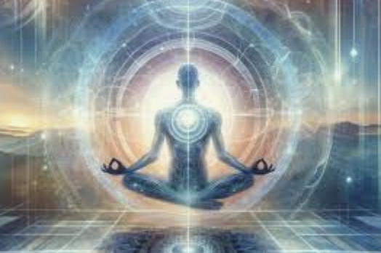
REBIRTH / A “NEW CREATION” – Every living thing on this planet has a birth. Babies, puppies, kittens, cubs, chicks, guppies, larvae, seeds, and so on, and so forth. All different forms of life have a beginning. So it is with spiritual life. But - there is no spiritual life until one is connected with the True Creator of the earth and this universe. There is false spiritual life, of course. I call this ”spirituality”. You’ve surely heard this term thrown about. It is a blanket term that means you could be into almost anything, from the horoscope, to healing rocks, calming colors and smells, to algorithms, to yoga, to AA where you are praying to some undefined “higher power”. Some people practice superstition, or even turn to Satanism! None of that brings spiritual life. It’s a speculative, mystic, openness to the idea that there is something more than just this life. That’s all it is! It interests, even fascinates some people! Others make a very good living selling “spirituality” off the gullibility of a certain percentage of the people. But most of it is not real! It’s fake! It’s fantasy! It doesn’t open one up to spiritual truth, or spiritual life! It’s people making stuff up, like people are so heavily inclined to do - and it is other people wanting to believe it so badly that they find reasons to – reasons that are not actually there! These are the same people that claim that they cannot believe in Jesus Christ – but of course they could if they wanted to! They have proven that they can believe by the outlandish things they DO believe in! They simply don’t want to believe in Jesus! They instinctively sense that He is a threat to their sovereignty - sovereignty over their own lives [*Jn. 3:19]! So, sadly, they stay deluded and so - spiritually dead – unconnected to their true Creator/God! [*Eph. 2:1-6] ~But there is a Creator/God that identifies Himself in this book, the Bible! Now, someone might prefer crystals, and palm readings, and fake fantasy alternatives - but wanting them to be real does not make them real. But this Creator is real! He accounts for what we see around us. Even science is coming around to the idea of intelligent design! He is that vast intelligence and power! And He has, with unbelievable grace, patience, and courage, provided a way for people separated to come together with Him! He went through elaborate and lengthy and historical preparations, chronicled in the historical book (the Bible) to give us opportunity to be changed from our natural state of spiritual death by being under God’s condemnation against rebels, and to bring us into an unnatural and relatively rare state of reconciliation with Him, and thus spiritual life! I refer to this state of spiritual life as “the life of God”! God is trying to bring us into a new and different life that is both provided by Him and which is powered by His Spirit! If that sounds intimidating, it probably should! It’s quite foreign to our way of thinking. A life of dependence is not our way. So our greatest challenge as followers of Christ it to humble ourselves and let it happen. To say “yes” to everything that resembles the fruit of the Spirit, which are the manifestations of the character of Christ! That is when we become a working part of God’s new creation and become truly useful to Him!

Slide 3
But I’m jumping ahead. What I was getting at is that spiritual life happens only when a human being becomes connected to his or her Creator! [[Acts 4:12 - How can a person have true life without first being “saved” from the consequences of our sin? And how can we be saved from our sin without Jesus?! Answer: we can’t!] “Spirituality”, on the other hand, skirts around Christ, and happens apart from God and is human centered. While it may bring change in a persons life, spirituality brings no connection with God! There is no forgiveness and therefore no coming to life in religion, or superstition, or philosophy, because it completely misses connection with the Creator. Sin is not paid for through cheap alternate spirituality! It is people’s attempt to play at being God, to try to keep control, and avoid the True Creator/God, which is original sin! But the life that we are talking about today is about the life of God! This life has a beginning, as all living things do (I began with that this morning) and this life begins with a supernatural birth which theologians call regeneration [Jn. 1:13 / *Jn. 3:5-8 / 1 Pet. 1:23 / Eph. 2:1,5 / 1 Jn. 3:9]. “Regeneration” refers to the dead coming back to life. God’s regeneration is a great improvement on what we previously were [*2 Cor. 3:17,18]! We were quite spiritually dead – which means unresponsive to, apathetic toward, or even hostile to the Creator - and therefore without relationship with Him! He cares for people, but people have not cared for Him without reason! But when we heard of Jesus, and to those who placed their faith in Him, we are brought to spiritual life – “born again” Jesus called it a rebirthed by God’s Spirit, just as we just read in Jn. 3:5-8 ~So, to sum up; spiritual life, as opposed to “spirituality”, is a matter of coming into relationship with our Creator [*Col.2:13 / Eph. 2:1,5]. As Col. 2:3 says, it comes through faith and trust in Christ! A sequence of events is then set in motion. 1] our sins are forgiven and cleansed from us [1 Jn. 1:9]! 2] We are placed “in Christ”, and Christ’s righteousness is “imputed” to us [2 Cor. 5:21], and thankfully, we are able to approach a pure and holy God based upon Christ’s righteousness, goodness, honor, merit, earnings, action, and not our own! 3] Our future is ”sealed” unto life eternal by the Holy Spirit [*Eph. 1:13]. 4] Our names are written in the “Lamb’s Book of Life”. And 5] simultaneously, God causes His Spirit to live inside of us [*Jn.7:38,39 / 14:16,17 / Gal. 4:6 ]! Our bodies, including our brains, are actually described as “the temple of the Holy Spirit” [*1 Co. 3:16,17 / 6:19 / Eph. 2:22]!

Slide 4
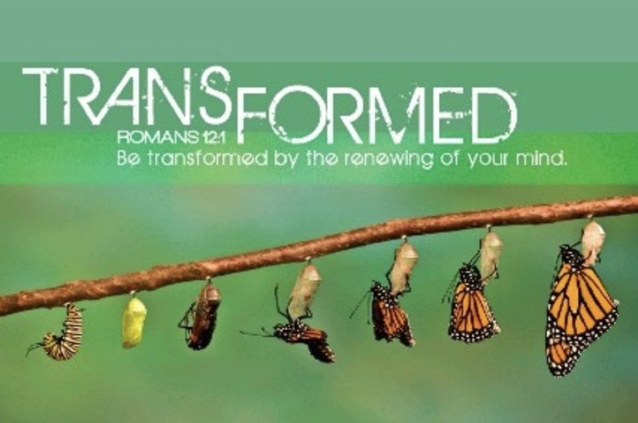
~Thus begins the recreative process of the Spirit, and the life of God. As I began today - all living things have a beginning, and beginnings of life are beautiful. But then they must grow, and keep growing to maturity, or they become a pathetic thing, a sorry sight, even a horror! Likewise with spiritual life! The beginning is “regeneration”/”quickening” - a powerful experience/ a “conversion”, despite usually being a quiet beginning - a soft or gradual awakening, a “quickening”(KJV), a rebirth, and a first step into a new spiritual life – into the life of God! For all these who are “born again”, we are being “transformed”, growing in the grace and knowledge of God, and in the fruit of His Spirit! This is what the Spirit of God excels at!

