Slide 1
The Doctrine of the Church
The Worship of Praise, and of Fellowship
Panoramic
The Story of God
as seen through
The Great Christian Doctrines

Slide 2
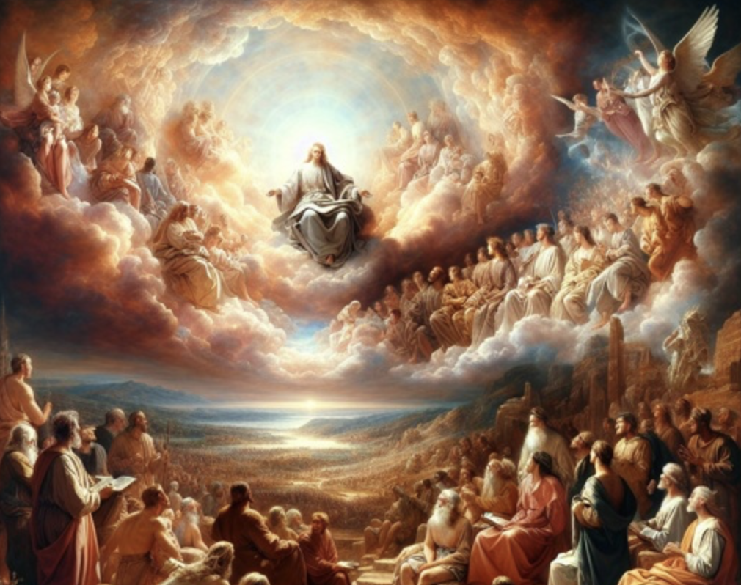
Everyone seems to love a good love song. Songsters have tapped into that human trait from time immemorial, and they have been authoring love songs according to the styles of the times and the cultures in which they happen to live. They have learned that there is money to be made with in a clever love poem, and more so, with an ear-catching tune to sing it to. The Song of Solomon in the Bible’s Old Testament springs to mind – of an ancient example of a love song. Pretty racy too - if you ask anyone who reads it! There was probably a tune with it, or parts of it, but, of course, that was lost to time. Solomon’s father, David, wrote many a love song, but the ones from Him that we have preserved in the scriptures are love songs written to God. [Ps. 42:1,2 / 43:3,4 / 63:1-8]. The Psalms of David, and of the other psalmists, are magnificent examples of love letters and love songs to God!
There is a strong connection that will always remain between the lovers of God in the Old Testament, and the lovers of God in the New Testament. The people that comprise the church today continue the love song to God that the ancients began so well! Not only that, (and this is amazing) we are equally connected to the lovers of God who worship Him in eternity – future saints [Rev. 14:2,3]. I mean - isn’t that cool! John is trying to describe the indescribable sights and sounds of heaven never before experienced by mortal man! He does a pretty good job of it, too! The apostle Paul said that he went to heaven, he saw things he could not, and would not talk about, but John, being “in the Holy Spirit” got to take his time, and was given a guided tour by an angel - observing and recording heaven in action! There, he saw the saints of Old Testament times and New, worshipping, singing, chanting praises to the God who sits on the throne – the throne that rests on an expanse of what looks like a sea of glass [Rev. 5:9ff]! To John’s credit, he does not try to describe God, since no one can see God and live. But this was a vision. John was not there bodily, so he is not destroyed by lazer-like brilliance of God’s glory! But knowing that humans, even in the church, were forbidden to make images of God, John left no solid clues as to what he had actually seen. And we cannot tell for sure what is an objective observation and what is couched in the over-the-top hyperbole of apocalyptic language. As I have explained before – apocalyptic language was a literary device that was expected by the people when prophets prophesied! So that type of over-the-top language was common in the literature of that day – many examples of which ended up in the Bible! The problem is that half the time, or more, you can’t figure out what its real meaning is! ~So now, when the people of the true church comes together, it is out highest function to carry on with the worship of God! Although most churches follow an old formula, the order of service, for corporate worship, this consistent order is not wooden forms and worn out traditions, but they are useful for God to, by familiar means, work in different ways! Worship SHOULD begin with a basic structure and order. People need markers that they know and can expect.

Slide 3
*If the worship Team brought you new songs every Sunday, or did the old songs in a completely different way – song after song – people would get lost, and would not be able to fully enter into the worship. So we do the songs we know, and throw in a new one every once in a while, and that becomes part of a long rotation of songs . This is what people come to expect. It is okay to expect a familiar order to the schedule and the way we have a habit of doing things here on Sunday morning. Right now, things are sort of topsy-turvy, with the auditorium upstairs getting a facelift. As a result, we have to meet down here for a few weeks until the work is done and things are in place so that we can take it upstairs again. But it leaves most people with an unsettled feeling – me included - because it is out of the routine! That is just basic human nature at play. But as I began saying, we are creating a weekly opportunity for people who truly know and love God, to joyfully express their love, gratitude, and respect for who the Lord is, in a corporate setting! There is something very special about worshipping together with others - regaling God in that spine-tingling moment of song, experienced by the true church everywhere as Christ-followers come together on Sunday and worship in song.
Worship can be broken down into six types of worship. So let’s switch gears here and talk about the worship of FELLOWSHIP. Jesus, the Holy Spirit, and the apostles (that learned directly from them), designed Christianity to be a team sport! *Let me make an analogy. In the game of baseball, who would fare better in a BB game – a game between a team of one player and a full team of nine? Stupid question, right? In reaching the world for Jesus, which He gave the church as it’s ultimate goal, what do you think would be the winning strategy – a bunch of unconnected loners sent out into their wider community to reach the people for Jesus,… or a team of people who can encourage each other, who are teaching by word and example, who are pooling their resources, their time, and talents; who are finding strength in each other to be obedient to the mission, who are secure in each other’s friendship and in community; who are brainstorming together, discussing plans, debating, taking positions, defending positions, compromising, and finally reaching conclusions and taking actions? Well, that is God’s winning strategy! If we want to accomplish our mission, we must be perpetually building ”team” into our church! So how do we build a church to be a team?
We mainly have to emphasize FELLOWSHIP. Fellowship is the sharing of friendship. So we give opportunities for friendship-building at church. This should be happening in the time before and after the church services. It also is happening before, during, and after a midweek small Bible study group – we call them ACES groups (Adult Christian Education and Support groups). It also happens when people take on responsibility for a particular task in the church via being part of a committee, where in cooperation others, they use their gifts, expertise, or experience to complete the tasks the committee has been assigned, and they work together, and they learn to play nice, and get along, and enjoy the others in the group! Or it happens when people pitch in together for a project.

Slide 4
*Three Sundays ago, for instance, I put out a call for help, and we had at least 15 people or more helping us to unfasten and carry out the pews in preparation for the auditorium refresh project that we have been talking about for over a half year. It was great to see how the morale of that group of people was lifted by that simple physical activity together! We expected it to take all afternoon, but it was mostly done in an hour! In all these different ways, people rub shoulders, are sharing the experience – seeing each other in action, talking together (about anything), cooperating with each other, working as a team, laughing, joking, and so on! It is all the good stuff of building fellowship, and building the body of Christ.
Now, if you are a recent arrival or brand new at our church, if you really desire to be a part of the church, what I’m telling you has to happen at some level for you to feel a part of things here. You have to put yourself out there! I know it seems risky, and hard for some who might be more introverted/tentative and anxious about how to keep an encounter going/flowing with someone you do not really know. I used to be that person, so I know all about that feeling. I have gotten better over the years, with practice. But I knew when I started out in the pastorate that Christ wanted me to come out of my shell to show that I really, genuinely care about people! I discovered early on that it is not really very risky, and by doing it, you can’t help but get better at it! It is a actually an important basic social skill that will stand you in good stead, anywhere you might be, with anyone you might be with in the community, at work, at school, job interviews, etc…! Now, I know that not all people at any given church are the welcoming sort, because people come in all types - but most people at church, (and I know at this church), are welcoming and inclusive. But, putting yourself out there, risking yourself, is how your become a part of any church! You hang out, shake hands and introduce yourself to strangers! The best way is to not wait for them to come to you. You introduce yourself, you ask about them before they ask about you. Questions like - how long they’ve been in the community – the church - - etc…. -~Now, on the other hand, from the other side of this - if you have attended this church for some time, and at least generally consider this your Sunday morning destination, Christ (not me) has given you a mission when you come. Church is not just about you, and connecting with your friends! That is an important part of it, but it is also a place and time where you have a basic “every-time-task” – an obligation to Christ to minister to others. But you also should not wait for someone you don’t know to come to you! You should take it upon yourself to go up to them and introduce yourself – especially if you I.D. them as new, or at least unfamiliar, and see that they are just standing there with no one around them! People feeling isolated should not happen at this church, and you should take upon yourself the obligation of a Christ-follower, and team member, to not let it happen! Put yourself in their position and remember that being a visitor in a church can be like attending a wedding where you were not invited! It is brave of many people to attend a new church. But you, and you, and you, can be a welcoming committee of one and make it so much better for these people!

