Slide 1


The Doctrine of the Church
The Worship of Giving, Learning, and Praying
Panoramic
The Story of God
as seen through
The Great Christian Doctrines

Slide 2
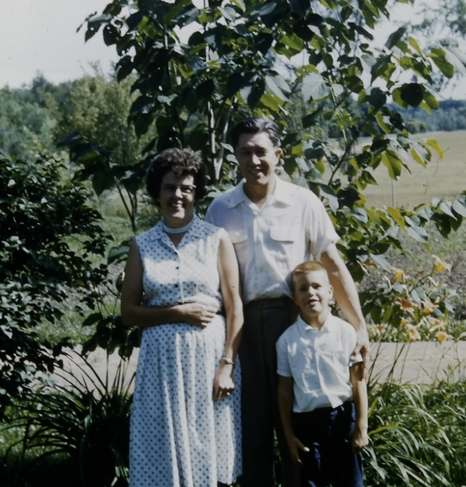
~Two years ago, the day after Mother’s Day in 2022, my siblings and I lost our mother. A mother is usually hard to lose, but this mother was so good at loving all of us, for so long, that when suddenly that wasn’t there – well, it left an especially big hole in our lives! But as much we felt her love, we always knew that she loved God first! & She loved to worship Him in any way that was available to her at our church. She sang alto by reading the alto notes in the hymn book, and she had a strong and accurate alto voice. So she sang in the congregation, and she sang in the choir, (if there was one), and I remember sitting on her lap at church for the first two or three years of my life, absorbing her worship in music. From her singing alto, (and nothing but alto), I learned to sing alto by ear! I found that I could just hear it in my head and so I was singing harmony effortlessly by the time I was three! My family got the biggest kick out of me singing harmonies with them, when no other child they had ever seen could do that – at least that early in life! On my part, I didn’t even think about it. I took it for granted, thinking it was normal, because it was normal for my mother – who I didn’t know it at the time (and would not have understood) was reading the alto notes in the hymnbook. She could read the alto part and follow the notes, and she could memorize the alto part, but she never could sing it by ear – (just know it intuitively). So the fact that I ended up being able to sing harmonies by ear, was my mother’s influence, just by being close to her during her Sunday worshipping . Jesus made my mother into a worshiper, but the church also did its job and gave her the opportunities to worship in tandem with other Christ-followers – and worship, she did! She participated fully in every aspect of worship at her church because the church is design by Christ, the Spirit, and the apostles, for powerful and authentic worship experiences! ~To all of you mothers out there - just be worshippers! In my experience, there is nothing so powerful, so influential, as the strong, authentic worship of a mother whose #1 love is God! I salute you mothers who are worshippers! I encourage all to apply yourself to learn to excel at it! Sing and do your acts of worship to an audience of one! BUT,.. know that the power of that act is transferred to your children in many ways – and not just the ability to sing. Worship is comprised of 7 essential parts: 1] – Worship by means of the ordinances of communion [Acts 20:7 / 1 Co. 10:16,17 / 11:23-34) and baptism (Acts 2:41 / 8:12 / 18:8 / Gal.3:27] 2] – Worship through praise – love songs to God [Ps.107:31,32 / Acts 2:42-47 / Eph. 5:19,20 / 1 Th. 5:16-20 / He. 13:15]. Singing of songs, corporate reading, chanting 3] – Worship through loving fellowship [Acts 2:42,46 / Eph. 2:14-18 / He. 10:24,25 / 13:1,2]. ************************************** 4] –Worship in the giving of tithes and offerings toward the support of the ongoing work of the church is also a part of worship [Acts 2:45 / 4:32 / 1 Cor. 16:1,2 / 1 Tim. 16b-18 / He.13:16]. 5] – Worship in response to the proclamation of the truths of God’s word [De. 27:1-4 / Acts2:42 / Eph.4:11-15). 6] – Worship in prayer, where a group of Christ-followers are led in prayer, so that all in the church are petitioning with one voice, one mind, one heart [Zec.8:20-22 / Acts 1:14 / Eph. 6:18 / 1 Tim.2:1-3,8]. 7] – Service – time and gifts

Slide 3

Worship is a verb – an action word! It is a response – specifically, a response to God! Worship is a response to the Spirit’s felt Presence, to His truth, to what God has done for us, which tells us a lot about who He is – His nature – His attributes! So, at church, we remind ourselves of these things about God – and our hearts (soul), our brains (intellect and emotions), and even our bodies respond in ways that they don’t respond for virtually anything else! There is an unspoiled purity in worship. How could we possibly overstate who He is, or over-respond to who He is? So we lose ourselves in the wonder of knowing things, wonderful things, that most people will not acknowledge are the truth. But we exalt in these truths, and it hits the pleasure centers of the brain, because we are reminded just like how much we need to breath air to live, similarly we could not live without worshipping Him! And we call that “worship”! Worship is expressed in the way we observe the ordinances, in the manner in which we Praise and Worship in song, and in the way we love each other and desire and foster friendship. Today we will try to include the last three elements of worship when the church gathers.
Worship through Giving – Tithes and Offerings. The worship of giving has always been a part of the structure of worship. But, interestingly enough, it is the least favorite for pastors to teach on and for congregations to listen to. How a person responds to this topic really depends on where they are at in their walk with God. Tithing is defined in the Old Testament scriptures as giving to God of ten percent of our income. The last book of the Old Testament, Malachi, makes it clear that God considers that 10 percent His own. Now, praise and worship is wonderful, and costs us nothing. Praise and worship is spine tingling – an emotional high. But worship through the giving of tithes and offerings costs us something! In these days of inflation and tight family budgets, tithing can feel a bit oppressive for some. But it is actually, when done right, a joyful action. The true worshipper cannot NOT do it. Now, Israel was constrained by law to tithe their 10 percent to the temple, but without worshipful giving - giving is painful, it is drudgery, it is going through the motions, it hurts! But when giving is accompanied by worship, it becomes our most consistently fulfilling act of worship! We GET to do this vs. we HAVE to do this! It allows us to give joyfully! [2 Cor. 9:6,7]

Slide 4

Worship is also a response to the truth! We receive the teaching that the pastor has prepared, and we respond to it with enthusiasm! If there is no worshipful listening, then we are just,.. hearing words and understanding concepts. There is no wonder to it, no gratitude, no Holy Spirit’s encouragement or rebuke! Personally, without the ingredient of worship through the truth, I don’t understand why anyone would come and suffer through a 40-45 minute sermon/lecture every week, or even every other week, for that matter! Learning is a good thing, but just learning is just not enough! We are to respond to the truth – emotionally, and practically! We LOVE the truth of God and thrive on it! We can’t live without a regular intake of scriptural truth! How could it be any different? In this world there is such a steady diet of pure, unadulterated intellectual garbage, fabrications, out and out lies – that a brief Sunday morning encounter with the truth is a refreshing, energizing relief – a beautiful oasis in a desert of dumb and destructive ideas! Scriptural truth is a delicious food to us and in taking it in and responding to it in an appropriate way, there is worship! Even in God’s rebuke in scripture or in the prophesying of preaching, there is joy because God has spoken – not the pastor – but God! Whatever He says we are waiting to receive – even if it is confronting us, we receive it with worshipful and grateful hearts. Otherwise, without the element of worship, the confrontation of preaching is just plain hurtful! We are wounded, humiliated, and are made to feel out of sorts by the truth! The preach quite preaching and went to meddling! We resent it. *I’ve had people complain to me after church, that my sermon was too negative that day! I know that means I hit a nerve! I TRY to hit nerves, because that is what the Holy Spirit is trying to do also! They should properly have rejoiced, for God has held up a mirror to their face! But without worship, they are only insulted! The Pharisees reacted that way to the confrontations of Jesus, and hated Him for it! They were not worshippers! But if we worship, we take the truth and mull it over, and over, and even when wounded by it, we are glad to see what God sees and knows about us!
Finally, there is worship through prayer. As Ralph Shallis points out in his little discipleship book, “From Now On…”, conversation here on earth is always horizontal – between people. But prayer is our only vertical conversation. It is our personal portal into the heavenlies! It is our instantaneous connection with the ear of almighty God! It is the most personal part of a personal relationship with Him, through Jesus Christ! When Christ-followers talk with God, it is always personal. Now,.. I think He knows what we want to communicate with Him before a word forms in our mind, or passes our lips, but He wants our desire for Him, so He tells us to pray. Prayer is simply talking to Him. It is nothing particularly formal. We talk to Him like we talk to each other. It is just that we are talking to the Designer/Creator of the universe and that brings us to our knees in worship! We will have to finish this up next time.

