Slide 1
The Doctrine of the Church
The Unity of Christ
Panoramic
The Story of God
as seen through
The Great Christian Doctrines

Slide 2
A message to fathers –
No classes
Learning from observation
Hands on Learning - by making mistakes
The manual on how not to hurt our children
Raising children whose problems are only their own
Jesus - breaking free - the sorry human cycle

Slide 3
Experiencing the concepts on the job
perfecting our faith by practicing - experiencing it in real time
*PC faith – conceptual faith!
The Unifier [Ph’p. 2:1-5]

Slide 4
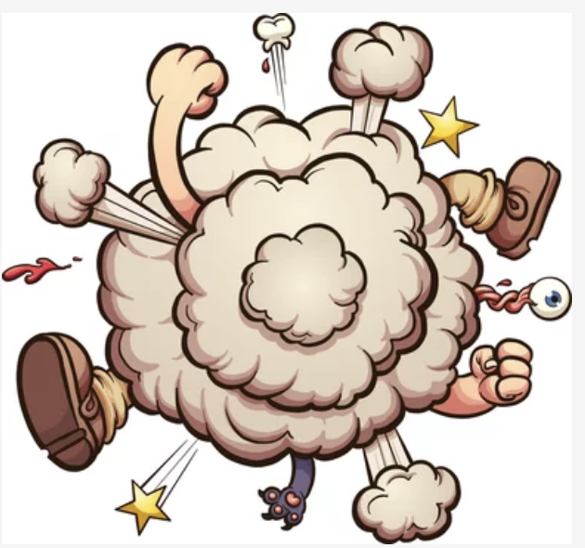
Throwback - Fighting our chaotic nature that threatens the mission
God’s gift to the church – the Influencer
Learning to follow ever more closely
Resolved conflict!
The practical nature of love – the mark of heaven
Getting good at love – [*Col. 3:13] – resolving differences well
The will of God – and its practical application
[*1 Tim. 4:15,16]

