Slide 1
The Greatest Command July 21, 2024

Slide 2
Matthew 22:34-40
Vs. 37-39: ‘“You shall love the Lord your God with all your heart, and with all your soul, and with all your mind.’ This is the greatest and foremost commandment. The second is like it, ‘You shall love your neighbor as yourself.’”
OT reference – Deut. 6:4-5
- Lev. 19:18
1 John 4:7-11
God is the ultimate source of love
Knowing God and loving others go together
Thankfulness to God
God is our Creator and Creator of all that exists – the Great Designer
Gensis – 1:1-2
Colossians 1:16
John 1:1-3
Rev. 4:11

Slide 4
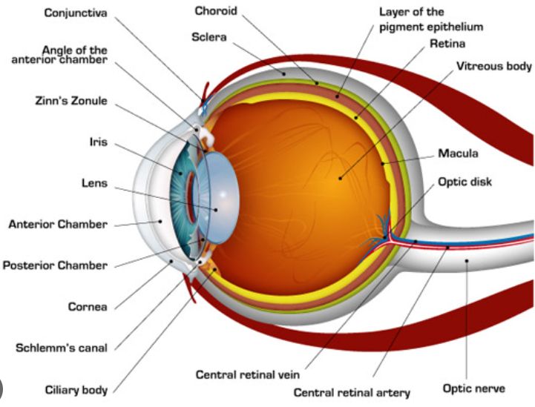
Human Eye

Slide 5
Obedience to God – Know His word to know and what it means to obey Him
John 14:21
1 John 5:3
Isaiah 1:19
Trusting God – Relying on Him to love you & provide for your needs
Prov. 3:5-6
Psalms 62:1-2
Psalm 62:8
Hebrews 13:5,6
Luke 12:24
What are characteristics of true love?
1 Cor. 13:1-8
Does not seek it’s own – not self-centered
Does not consider being wronged – forgiving
Rejoices in the truth
Looks to and for the best

Slide 6
Accurate self-love
Narcisism – selfishness, involving a sense of entitlement, a lack of empathy, and a need for admiration.
Biblical – accepting oneself as a redeemed person, even with flaws. Seeing oneself as God sees us, as a sinful, guilty human who have been made righteous through our faith in Christ.
You are FULLY ACCEPTED by God, but He also wants to change you to be more like his Son.
All have inherent value before God – He made us and everyone a miracle and loved us so much he sacrificed His Son for us.
Who is our neighbor?
Family members
Co-workers
Brothers & Sisters in Christ
Physical neighbors (e.g., next door neighbor)
People we meet and interact with in our daily lives (e.g., cashier at store, person next to me in line, etc.)

Slide 7
Phil. 2:3-4 – Look at others as more important than ourselves. Look out for their interests as well as our own.
Everyone has a story to tell – ask, listen and investigate other’s stories to better understand them
Summary
Greatest Command – Love God, love others
Loving God
- Being Thankful
- Obeying Him
- Trusting/Relying on Him
Accurate Self-Love
- Accepting oneself, since we’re loved & accepted by God, through Christ, even though sinful/selfish
Loving Others
Moving toward my ‘neighbor’
Looking out for their interest
Learn and know their story

