Slide 1
The Doctrine of the Church God’s House – Not Brick or Stone, But Flesh and Bone
Panoramic
The Story of God
as seen through
The Great Christian Doctrines

Slide 2
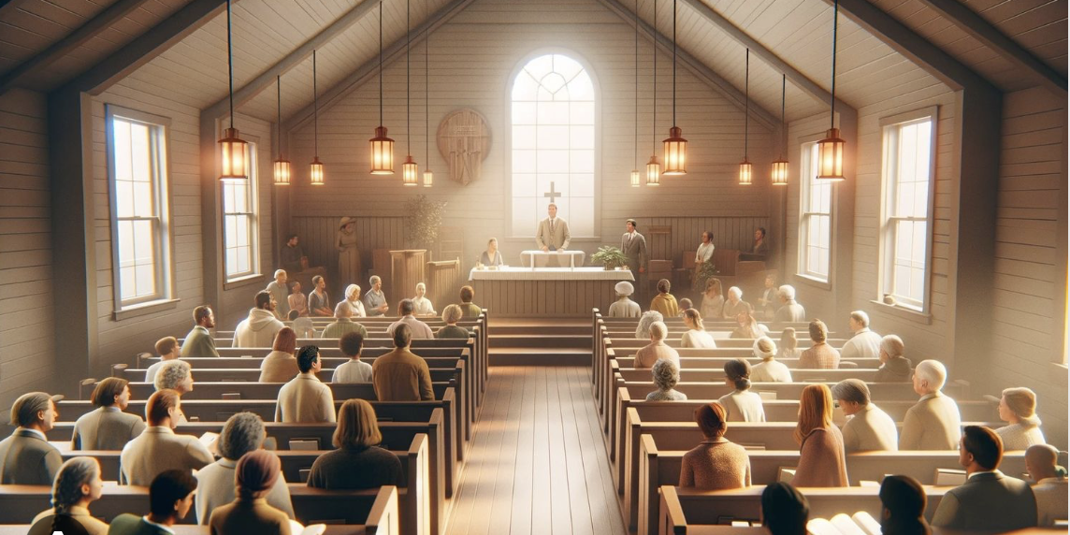
~It is very interesting to me about the timing of this particular topic for this special day in the history of Bethany Church. Today is that last Sunday that we will be in this auditorium as we see it now, and as it has been since the newer part of this building was built back in 1987! Due to contractor availability, we had to move our start date up about a month and a half. We begin with repairs to the ceiling and with painting of the entire auditorium, and with some modifications to the stage, all starting tomorrow. And actually, this afternoon we’re assembling a crew to take the pews out of here to give this process a jumpstart. So, take a last look around! Take pictures for your before and after memories. Next week we will begin meeting in the only place we can – our lower level / “Fellowship Hall” / or maybe you just want to call it the basement. We are figuring on about 3 to 4 weeks before we can get back up here for our worship services. It will be a “novelty” to meet down- stairs, and there will be challenges, surely. But we will try to figure things out as we go to make it as “tolerable” as we can. There is so much planning, and figuring, and meetings, and discussions, a phone calls to happen,.. but we beg for your patience and grace during this time of transition. We will not be streaming our services while we meet in the lower level, but we hope that you can and will attend and not miss out. By the way, these pew are available to anyone who wants one (or more) – but they have to be picked up and taken away this afternoon before the big trailers leave. Otherwise – what doesn’t get taken will be hauled away by days end today! ~Then, beginning next week, like I said, we will meet downstairs for our worship service. We will be using the metal chairs down there for seating, so, if you don’t have the “natural padding” you need to sit for an hour-15 on metal chairs, you need to bring a pillow, or padding for your chair. Or, if it will help, bring a patio chair or folding chair, if that would be more acceptable to you. Okay let’s get started.
Contrary to popular opinion, nothing regarding the Church of Jesus Christ has anything to do with any particular building! The association of the Presence of God with any kind of building ended with the destruction of the Jerusalem temple in AD 70 – although – the prophet Ezekiel records that God’s Presence had fled the temple (Ez.11:33) 100’s of years before! Since the church was begun, the building where local Christians meet is not where God lives at all, but is simply a place to gather for worship, and a place of learning, and/or for the activities of the local church in which people serve Christ together; or, where the church gathers for activities that lead to fellowship or to evangelism. So, the facilities are an important tool! Maintaining nice facilities are also a cultural expectation! People in a community associate a church with it’s facilities! In fact they don’t call it a church building or church facility - they call the facilities “a church”! Therefore, if a church building is neglected, it will be very hard to attract anyone from the community to go and and check out the church! Churches really do get judged by the appearance of their facilities by a large percentage of people. So it is important for a church body to make the needed repairs as things break down over time, and the needed improvements

Slide 3
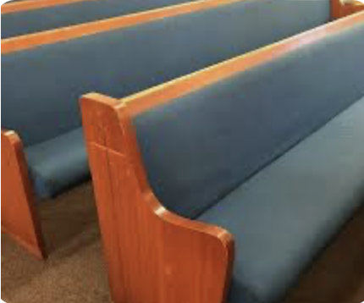
~*I remember my brother telling me about going into a church, about 12 years ago, as a consultant. They were without a pastor at the time and were looking for a good man to accept the position. But they needed some advice as to what they should do to prepare themselves to attract the right candidate to come and take the job! My brother told them right off that when he had stepped into their church building for the meeting that night, it was like stepping into a time capsule! That’s what he said, and it was the truth! Nothing had been touched since the facility had been build in the early 1960s, and it was the first thing he noticed when he walked in! Now, that’s no changes in over 50 years! But, unfortunately, the board members were actually offended by his observation, dug in their heels, and ended up doing nothing about his recommendations. But, after a long search process, they were able to hire a good man as their next pastor. Not too long after, their new pastor told them they needed to remodel! Their outdated look did not speak well of their body. So, finally, they got the job done – and it was beautifully done!
~That is exactly why WE are presently beginning our own remodel of our auditorium! We need to look our best for the sake of meeting even the superficial expectations of the community! Paul said “I become all things to all men, that by all means I might reach some!” So we try to meet societal expectations and norms and put our best foot forward in the community. Thus we update our auditorium! ~BUT, having said all that – the facilities are not the church, and it is important to note that there is nothing especially “holy” about these facilities, except that they represent us, even as we represent Christ! These buildings of ours are dedicated to the gospel of Jesus, and are inhabited by the Holy Spirit when “the Church”, or “The Body of Christ” is present in them. He promises that where even “two or three of you (His people) are gathered in His Name, He is present among us” in a special way [Mat. 18:20]. Since Pentecost, God has resided in His people, not their buildings! When God’s people leave the building they meet in, they do not leave God behind in that meeting place, but rather they take His Spirit with them wherever they go, for He has made His home in Christ’s followers! So then, we, together, or apart, are the church of Jesus Christ [*1 Co. 12:12 / *Eph. 4:15,16]! *Here’s something many of you may not know about in this church’s history. About 32 years ago, when I first came to this church as an interim pastor, the church was in a lawsuit over these very pews. These pews were terribly expensive at the time, but the entire amount of money needed for them had been donated to the church by a very generous man who was a few years later convicted of fraud and who went to prison because of it! But then the government wanted all that money back that he had given away – every penny of it! So Bethany, (before I came here), had joined a lawsuit of a number of large Christian organizations to NOT have to pay that money back! The governments action seemed unprecedented. They didn’t want a percentage back, like usual, but all of it, and, we didn’t have it! We spent it on these pews!

Slide 4
I remember telling the church leaders, shortly after beginning to preach here, that the church is not a building – but people – and that even if the government confiscated our building we would go on! It would be okay! There were many vacant buildings in the city at the time, and we could rent one of them to meet in. But we didn’t have to worry and wring our hand over it! What would be far more serious is if we were having a church split – a congregation that could not get along! Now that’s serious! And so the church stopped even talking about it for the most part. Really! It became a kind of a non-issue! We put it in the Lord’s hands and relaxed. Then, we lost the lawsuit and had to come up with $30K right away! But by that time, at around the middle 1990s, interest rates had dropped to an unprecedented low! So we were able to refinance the entire church loan, adding the 30K into the loan, at the new rate, and ended up with a substantially lower monthly payment!! It was a truly PTL moment for this body! But we learned through that little adventure that if push comes to shove, the building is not the church! We are! Now, someday, down the line, if political/cultural trends keep moving the way they are, the government may be coming after our facilities because we won’t hire trans people, or active gay people. That is already happening you know – in Minnesota, our neighboring state, they have passed legislation that churches cannot discriminate if a trans person applies for a staff position at the church. If this new Minnesota legislation survives the court challenges, big, rich, city churches will lose their 100 million dollar campus facilities if they do not conform to the new law! But, the TRUE church will not be intimidated or deterred by the loss of its facilities, because the church is actually the people! If we have to go to doing church in homes, we can do that, and it may even strengthen the over-all body of Christ!
WHAT DOES GOD WANT FROM THE CHURCH? The church was chosen for the task of continuing the ministry of Jesus Christ on earth! This ministry, passed on to His church, is mainly to fulfill the “first and greatest command” [Matt. 22:37,38] to love each other and to love people in general, and to love and be devoted to God and His purposes! Our mission is to live in loving, caring, cooperative community with each other [Jn. 13:34], and to proclaim the Truth of the Living God to a lost and dying human race [“the Great Commission” – Matt. 28:18-20].
When the church comes together, it is their primary function to love God together and to worship Him! Corporate worship is important for recognizing who God is, praising Him for who He is revealed to be by and what He’s done. We giving of thanks to Him [*Eph. 5:19,20]. We prayer together and offer God our petitions [*Eph. 6:18 / 1 Tim.2:1-3,8]. We also worship through of the proclamation of the truths of God’s word [*Eph.4:11-15]. Included is giving of tithes and offerings toward the support of the ongoing work of the church is also a part of worship [*1 Cor. 16:1,2]. Also we continue the observance of the ordinances of communion [1 Cor. 11:23-34] and baptism [Acts 2:41 / 8:12 / 18:8 / Gal.3:27], along with loving fellowship and mutual encouragement in growth [*Heb. 10:24,25 / *Eph. 2:11-17 / / 13:1,2].
These are not wooden forms and worn out traditions, but they are useful in creating regular opportunities for people who truly know and love God to joyfully express their love, gratitude, and respect for their Lord and their desire to serve Jesus in a corporate setting when they come together for worship. We get better at being who are to be, and doing what we are to do

