Slide 1
The Doctrine of the Church
The Worship of Serving
Panoramic
The Story of God
as seen through
The Great Christian Doctrines

Slide 2
The books about marriage tell us that people feel loved through different means. There is a certain type of person that responds to loving words. “I love you”; “You are a great husband/wife”; ”You are so handsome, or you are so beautiful”! The heart of a person with this personality type might be captured by a love poem written to them, or a love song. But some people are not impressed by pretty words at all. They are impressed if you do something for them – like going through the effort of cooking them a nice meal, and cleaning up afterward. Or, an act of kindness, like volunteering to do a job that you know they do not like doing, just to show them your love. Other people will fall in love with a person with a great sense of humor. Others will respond to someone they feel secure around – someone who can successfully protect them if need be. The thing, they say, is to find out how your spouse truly feels loved by you. It may be very different from the way you prefer to feel loved from them.
~God, too, has a way that He wants to be loved by His people. David loved to write love poems and love songs to God – “As the deer thirsts for the streams of water, so my heart thirsts for you, Oh God”. “The Lord is my Shepherd, I shall not want. He make me to lie down in green pastures. He restores my soul”. Beautiful words that move millions upon millions to praise and worship God! BUT, words are meaningless to God if they are just words! Humans are well-known for their tendency toward flattery. Flattery is giving compliments that are not really meant – where, for instance – you just want to get on someone’s good side. So you tell them how pretty, or handsome they look, or how smart they are, or how talented – or that they have great fashion sense. But if you say those words of praise without really meaning them, then you have spoken insincerely – and even people are pretty good about being able to tell the difference between flattery, and when it is real, heartfelt, (and well-deserved) praise! ~God certainly knows the difference! He knows our hearts, and read our motives like a book! When people are just saying the words without really meaning them, or when they are exhibiting a strong show of feelings, but if is just a show – God, as you might expect, identifies that and despises it! In [Isa. 29:13;], the Spirit of God calls out His people through the prophet Isaiah - “These people come near to me with their mouth and honor me with their lips, but their hearts are far from me.” Jesus quoted these same words to the religious elites of His time in [Matt. 15:8]

Slide 3
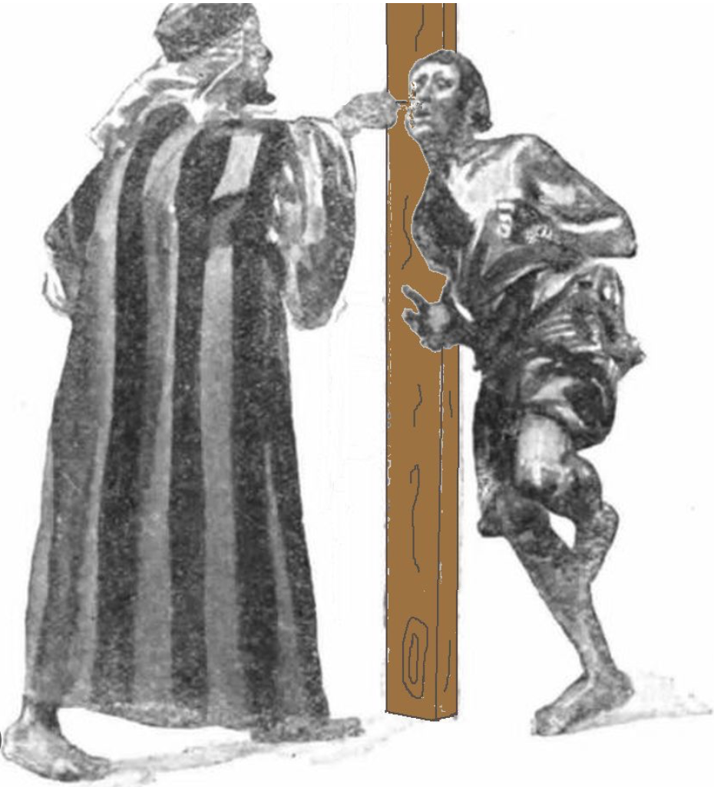
~Everything we do in and around the church is an opportunity to turn it into an act of worship! The church is here for sincere worship in its many forms! We worship God through song set to poetry; we worship Him through the teaching and preaching of His word and the declaration of God’s truth. We also worship Him with giving of our financial resources for the support of His work in the church and in the world! We worship Him through the fellowship, that we share; and we worship Him through prayer. And finally, this morning, we worship Him through our SERVICE. ~When we give our lives to Jesus, we become His slave, servant, bondservant. The Greek and Hebrew words for this is – “Doulos” in the Greek, and “‘ebed” in the Hebrew. Both words can mean slave, bond slave, servant, or bond servant – even though there were different types of slavery or servanthood in those primitive times – the same word sufficed for them all for some reason.. These two words used in the two original languages of the Bible for these forms of institutionalize servitude, just didn’t distinguish what kind of slavery or servanthood. Now,.. most servitudes of the ancient time, were involuntary. They were forced upon people – captives taken by the victors from a country that had lost a war, or perhaps someone who owed a large debt of money that they could pay off in no other way. Some were slaves. Slaves were owned. In most cultures, Their lives belonged to their owner/masters, who could even take the life of a slave with impunity - without any repercussions! A position of servanthood was not as harsh. The life of an indentured servant, belonged to themselves, but they owed their service - their efforts, energies, and time, to do things that their master wanted them to do for Him and his family. It could be to till, plant, tend, and harvest the master’s fields. Or, it could be to dig a well, or draw water from a well for the master’s herds, or to muck out the barn. It was like a job, only they didn’t get paid except in food, clothing, and a roof over them. But in the ancient Hebrew culture of Moses’ day and much later during the Roman empire during the times of Jesus and the early church, there was a type of slavery or servanthood that was voluntary. If you were treated kindly by a master you could make a decision to become a slave or servant to him for the remainder of your life! [Exodus 21:5,6] - This was how it was done in Moses’ day, in the Hebrew culture. An “indentured servant” could become a bond servant in this manner. That usually meant that He or she loved and trusted their master enough to make him their owner. In exchange, they were taken care of for the rest of their life. I’m betting that it was at least partially borrowed from the Egyptian culture that they had so been a part of for 400 years. It was the accepted practice in that time and place. Donald Barnhouse – a first half of the 20th century pastor and theologian, observed that the law of Moses allowed for indentured servanthood to pay off debts. But at the end of 7 years, they were to be released from their debt and allowed to go free. But if the servant had found the master to be kind, and if he liked his job in the master’s estate, he could offer to become a bond servant – to literally pledge to give himself to give the rest of his life to serve His master! If he was accepted, as we read, his ear was pierced as a visible mark of his commitment to, and love for, his master. Wherever/whenever, that servant was seen in public, from then on, his ear-mark proclaimed to the world his love for his master, but even more importantly, it proclaimed that his master was kind and generous – that he was worthy of another man choosing to devote the rest of his life to serve him! Likewise, God is honored and loved and worshipped when we truly give our lives to Him and devote ourselves to His service! ~The great heroes of the faith were self-proclaimed servants of God. Abraham was a distinguished man – a man who at one time had over 400 servants to tend his flocks and herds and family members. He had almost the power of a king in those days, [Genesis 26:24]. He did what God wanted Him to do. He was an obedient servant! The great general and early leader of Joshua was also referred to as a servant of the Lord [Josh. 24:29]. The great Samuel, prophet and priest, referred to himself, early on, as the a servant of the Lord! David also [2 Sam. 7:5]; Isaiah, a major prophet [Isa. 20:3]. In the New Testament, even Jesus took on the nature of a servant to serve the purposes of God [Ph’p 2:7], and Paul repeatedly declared himself a servant/slave to Jesus [Rom. 1:1].

Slide 4
~In doing so, he was placing himself far underneath God, and it was an appropriate and sincere class-act of humility, and an acknowledgment of God’s ownership. [Ps. 24:1]. Being God’s servant is an honorable position. It does not make you lower, but elevates you much higher than you would otherwise be on your own! The person that does not recognize the ownership of God and the superiority of His ways and His agenda over our own, is a person of pride and of a questionable foundation. During this period of the early church in the Roman empire that we call ”the apostolic age”, slavery had become so prevalent, that about 2/3rds of the people either had been slaves or currently were slaves – divided about evenly into each category – former/current. The poor and unfortunate served the rich, who only got richer and more sedentary off the almost free labor of their work force of slaves, servants, and poorly paid hirelings. ~But, God, on the other hand, has not/will not ever use, abuse, defraud His servants! He is not like we are in our pathetic fallen state of toxic selfishness! Our status of servanthood is not for Him. He can make servants out of stones! Servitude before God, is for our benefit! We need the knowledge of our freedom balanced with the knowledge of our own insignificance. We are nothing, and our lives amount to less than nothing if Jesus is not our Owner and Master! He give us value! Otherwise our life is just a downy feather in the wind - here today, spins around a few times, and tomorrow is swept away - and unremembered within a generation or two! ~Serving God, with the full knowledge, and full agreement, and in celebration of the fact that you are His servant is, (or should be), a status symbol! If serving Him is an unwanted chore, a resentment, and you chafe under service to Christ, or else refuse your opportunities for service, then you probably do not know what privilege is yours! Acts of service should be acts of joy and opportunities to worship God – “God, I’m so happy to be able to apply myself this task! Thank you for offering me a job! You approval of a job well done is all I need! I will do this with all my might! I will do this better than if I were doing it for myself.” *I remember cleaning our church with father, starting already probably when I was nine or ten. He would check my work, and especially in the beginning, when it wasn’t up to par, he would instruct me that this wasn’t just any ol’ job! This was for the Lord, and it required better than normal efforts! I watched him live that belief himself! He was consistent, every week everything got dusted, vacuum, washed! I would question him, ”Dad, why are we dusting everything again this week. It doesn’t look it needs it!” And he would respond that we never wanted it to look like it needed it! He truly had it in his heart of hearts that this was an important part of his service to God, and no one would ever made the church cleaner than he/we would – EVERY week! I felt like it was part of the worship of His Master! It greatly elevated what most people would have considered a lowly job, and as I got older, I appreciated his perspective more and more, as well as his example! God loves our service when it is an act of love and devotion and when we love Him not just in pretty words, but in fine deeds!

