Slide 1
Eschatology - The Doctrine of the End
Intro - The End of Things As We Know It
Panoramic
The Story of God
as seen through
The Great Christian Doctrines

Slide 2
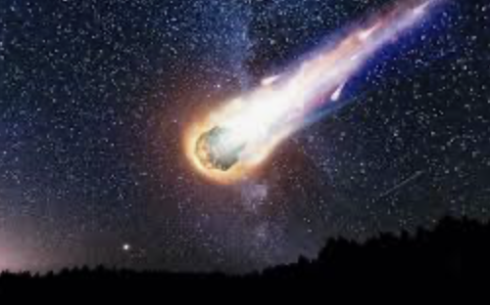
The apocalypse – the end of the world as we know it - has become big industry these days! There are dozens of Hollywood movies on the subject – from zombies taking over – to a big asteroid hit (a “blasteroid”) that kicks up dust into the upper atmosphere that obscures the sun for months or even years, killing the crops off, starving billions globally. Another common scenario is that of global nuclear war doing basically the same thing – clogging the atmosphere with dust and radiation – creating all manner of ravenous man-eating monsters! There are also movies where the plot is of a killer virus that cannot be stopped and which devastate the human population with waves of terrible plague! So these movies examine a world in which governments are gone, communications gone, law enforcement non-existent, no justice system, no school system, electrical grid gone – (which means no computers, no phones, no internet, no Facebook or X, refrigerators filled with rotting food, no washing machines, no stoves, no medicines being manufactured, etc…). No fossil fuels (no gasoline being manufactured - with all refineries being unmanned); no trucks to haul goods from there to here or from here to there, so no grocery stores; no jobs and no paychecks and no checking or savings accounts because the banks have all closed! What little economy remains between the few survivors would be based on the barter system – what you have in non-perishable food items, or clean water, or tools, or blankets, or clothing items – things that you might have a surplus of – things people need to survive, could be traded for things that someone else has that you don’t have, but that you need to survive! Horses, mules, donkeys would become important again as the only means of transportation! But, of course, since there is no law, there are only bandits and gangs that are a threat to everyone that has anything to steal. Anyway, you get the grim picture! Now,.. it seems to me, that people around the world are expecting something catastrophic to happen, and soon,.. and so many are digging underground survival shelters in their back yards, or out on their hunting lands. Survival food and tools are a multi-billion dollar industry these days. There is a veritable library of survival books – how-to books, or an endless supply of science fiction end-of-the-world survival novels, and there are inexhaustible numbers of survival videos on YouTube and other internet venues!
Well – even the Bible has an end of the world scenario. In fact, it records the beginning of Creation, and the end of it. It tells how the Creator is intending on,.. well,.. I wouldn’t call it “ending it”, but perhaps a better word would be “transitioning” it. The Bible account is not fiction. You see, this creation was not intended to be permanent! Since the fall of humanity in Eden - when humans mistrusted God and rebelled - God has always intended to close the book at some point on this sorry part of earth’s history. So the Bible doesn’t exactly tell us how that is going to happen but it sure provides a lot of clues! Any word from God about the future is called “prophecy”, and prophesy is usually stated in a form/genre of ancient literature that has been labeled “apocalyptic language”. *Now,.. when I was in college, I took a class on poetry writing. I discovered that there are all different forms of poetry, and it is very hard to be good at! Apocalyptic language was a very sophisticated use of language to both foretell of the future and to hide it/disguise it - master riddle!

Slide 3
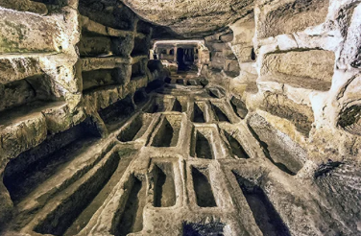
Prophetic Bible passages are usually couched in apocalyptic language. It is hard to impossible to understand. But there are key take-a-ways! One of them is that the earth in its present state cannot and will not continue forever. In fact the Bible indicates the Earth probably does not have much time left before the Creator brings an end to this period in human history - this period that began shortly after creation, has been marked by the the rebellion of humanity against their Creator, and all the sorry repercussions that followed that great, sweeping tragedy! The greatest of the repercussions of the human rebellion was that the Word of God and Son of God had to come and offer Himself as a sacrifice [Matt. 24:32-34 / 2 Pet. 3:3-7] so that some could be saved back to God! ~After that epic central event, the New Testament of the Bible refers to the time since the cross happened, as “the last days”. The last days, then, is the age of the church [Heb. 1:2; the beginning of the church - Acts 2:17]. The apostles, at first, maybe even for a couple of decades, did not expect that time to last long. They expected the imminent return of Jesus to happen during their own lifetimes. Even they did not realize that God the Father had other plans. As the time went on, a couple of decades passed, and some Christians were dying before Christ had returned – the apostles sought to reassure their loved ones that they would not be left behind but would be taken from the earth with the rest of the church! That is one of the reasons why the early church - for instance in the greatly persecuted church in Rome - took such care of their dead! The Christians in Rome had to meet in secretly carved-out tunnels and rooms” underneath the city, , called “the catacombs”. It was in these underground rooms where they could worship more freely, sing in full voice, and hear the sermons without the risk of being heard and arrested! They even laboriously carved out deep niches into the rock, or hard packed dirt to store the bodies of the dead Christians. whose bodies then awaited the soon-to-happen return of Christ and subsequent resurrection of the dead! It couldn’t have smelled very good down there, I would think! *I mean - not long ago, a squirrel died in our crawl space underneath the house! We could hardly stand to open the basement door! The decay of death is one of the worst smells ever! Yet, the early church was faithful to put up with the smell, and hold the bodies for Christ’s return. But Jesus did not return. God chose to wait, and wait, and wait! But not forever! Jesus is coming for His church - most probably very SOON! ~Now - I have to qualify what I will be teaching you about eschatology/the end of the end times, with the understanding that the doctrine of the end times is not universally agreed upon even in evangelical circles. I think my viewpoint may still be in the majority, due in part to the ”Left Behind” Christian film series that is based roughly on the rapture of the church, and the events of the following seven years. I would normally question the popular view, except that I ran into an excellent German theologian named Eric Sauer, and he explains his believe in a pre-tribulation rapture of the church to my satisfaction, and that is the view I have adopted, and which I will primarily share with you. Just know, though, that there are many learned men that I respect that would disagree and have a somewhat different opinion. This is one of those doctrines that will not have any bearing upon a person’s salvation, so it is okay to have differing opinions.

Slide 4
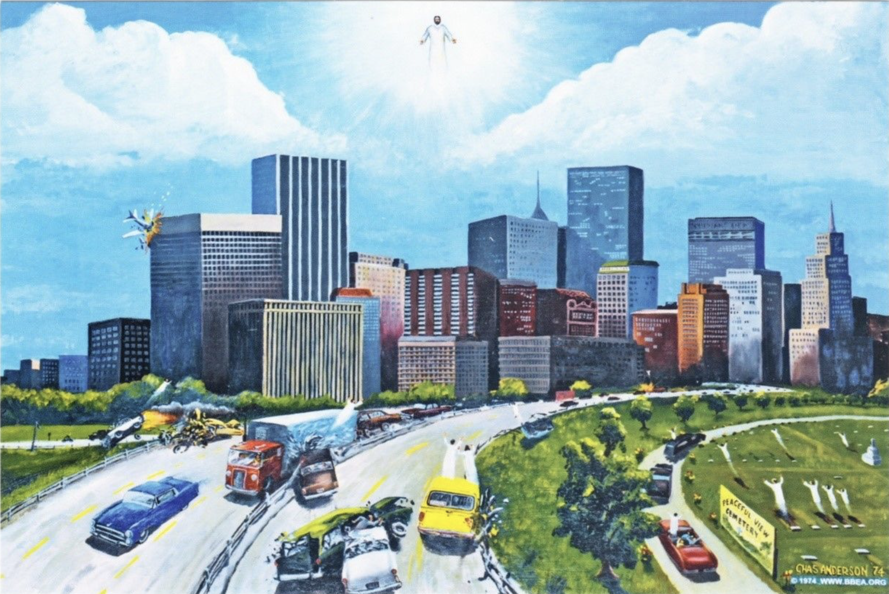
~So, you’ve probably heard that, from the beginning, when humankind rebelled and the Earth came under the curse of sin and death, the Creator/God has had a plan that He has been methodically working to fulfill through all the twists and turns of human history. [Ge. 3:15 / 12:1-3 / 1 Jn.3:8c / Isa. 9:6-7 / Zech. 9:9 / Isa. 53]. That plan had a beginning, and it has an end, and God chooses to let us in on it! ~There was a time – about a thousand years after creation, when God’s judgment and wrath finally broke out against the earth in the form of a great worldwide flood [Gen. 7:7 / 2 Pet. 2:5], and humanity was all but wiped out! After that catastrophic Divine wrath event, the terrible anger of God against the rebellion of humanity has been held back by the great dam of His grace. But in the end, all the pent-up wrath of the Creator against evil and human sin and betrayal will be poured out upon the Earth and its inhabitants in terrible judgement (Isa. 24). Before that happens, it is my opinion that the scriptures indicate God will remove His saved ones en mass from the face of the earth. Even the bodies of those who have died will be resurrected, changed, and rescued by being taken out of this world at that time [I Th. 4:13,16,17 / Matt. 24:30 / 1 Cor.15:51-53]. It’s God’s intention that His victory over all resistance, especially death, be complete [1 Cor. 15:24-26 / 1 Cor.15:54,55], for God is primarily the God of Life! In this epoch of the human story, death is a necessary evil. But the God of Creation prefers life and prefers to love! Judgement is only what He MUST do in the pursuit of justice – for the Creator/God also loves justice, and what is wrong will be made right one day! He will see to it! No one gets away with ANYTHING! But the Creator does not prefer to punish. He will do it, but it is not what He wants. What He prefers is to redeem the irredeemable! When a sinner comes to the place of repentance and of humble surrender to God, THAT is what God wants! But toward the end of the church age – the end of the last days, humanity becomes incorrigibly hostile toward the Creator, and gleefully, brazenly, cooperative with Satan and the forces of evil! When people become incapable of responding to God’s love because their imaginations, and internal conversations, and deeds are all thoroughly and completely evil – when they are completely indoctrinated into the cult of making good evil, and evil good – then God will judge them without a qualm, and they become objects for His wrath! This is when He will draw this age to a close and and catastrophic event after catastrophic event will ensue. There will be no stopping it once it starts. If the nations repented, then maybe, but God says that humanity will be so far gone, that they will never repent. So God will unleash wave after wave after wave after wave of devastating plagues and natural disasters – except that that it will not be natural at all but terribly supernatural - it will make the plagues of Egypt look like child’s play! But it will all start with something good – something that Christians have been waiting for for two millennium – the catching away of the church – the RAPTURE!!

