Slide 1
Eschatology - The Doctrine of the End
The Rapture – The Great Unification
Panoramic
The Story of God
as seen through
The Great Christian Doctrines

Slide 2
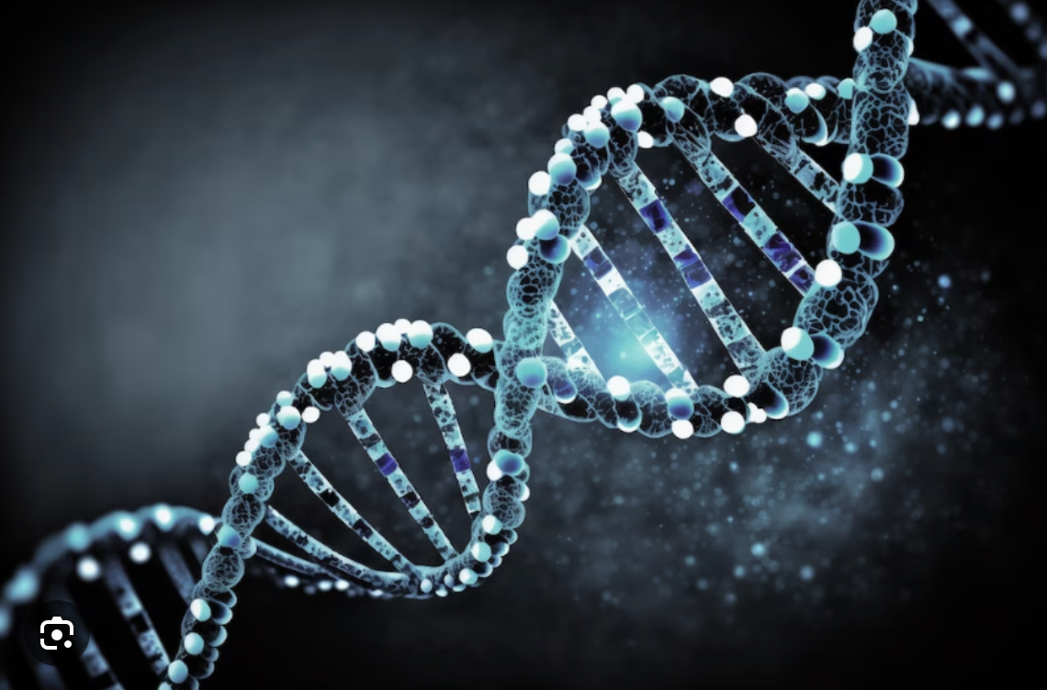
REVIEW ~The first phase of this plan to “catch away” is described in terms of a military initiative! It begins with a trumpet blast and a shout from the archangel to begin the action! It will be a surprise attack deep into enemy territory, and no one that belongs to God will be left behind! He is very possessive of His own! ~It will be a rescue operation – very sudden – utilizing the element of surprise - certainly a surprise to both those it rescues, and to those it rescues from! [1 Thess. 4:14-18; Matt. 24:44]
~After being collected by the angels of God – snatched by those great and powerful messengers/servants of God from out of the very midst of enemy territory, what will follow will be the great unification of the body! Understand that death has always separated people from each other – one generation from the other. But in the first resurrection that immediately precedes the rapture/ the catching away of the church, death’s power of separation will be broken, and all the people of God that have ever lived – will be outfitted into their new and immortal bodies, all connected to Christ’s resurrection by their own resurrection, and connected together into the greatest gathering of peoples of all time! This combined and “ageless church” will immediately be connected with those who are alive at the time of Christ’s first coming! And so, the various generations of God-lovers, a hundred and more generations strong, from the beginning until the present - from creation until that day (may it be soon) - are all given an immortal body, and all together are gathered by angels to go to meet Jesus! ~How does that happen, you might ask? I would say that it has to be an act of new and fresh creation as powerful as the first creation! New human DNA will be reconfigured and made quite differently from the old human DNA! Unlike the old, the new DNA will never deteriorate/decay! It will contain no predisposition in it toward the excesses of bodily misuse and sin, which was an internal corruption that began when humans rebelled against God early on in Eden! The new human DNA will be designed to powerfully regenerate and refresh itself perpetually, and in this way every body will be made for eternity! Most importantly, the body will be made to withstand the incredibly intense glory of God, who lives in unapproachable light! We will be constructed to stand in God’s Presence! ~But think of it! What a spectacular accomplishment by the Creator/God! Human souls that are in heaven must be brought back into this earthly realm and be joined with their new eternal bodies! Those who are alive at Christ’s return will also be instantaneously recreated physically and will join the vast resurrected “body of Christ”/the church, to meet their blessed Head in the clouds! We will all meet the formerly “dead in Christ” for the first time! I mean, think of it! The living saints will joyously meet the old Testament saints! That means that those who are alive at Christ coming will meet the people who were eye witnesses of the plagues of Egypt, and who walked through the Red Sea, and who drank water from the rock in the desert, people who looked to the brass serpent and were saved from the viper’s bite! We’ll see and meet the saints early church – those who had tongues of flames dance over their heads and who spoke in various languages in the streets of Jerusalem to the Jews from all over the known world gathered there for the Passover celebration! We’ll meet people from the early churches - in Jerusalem, Rome, Corinth, Ephesus, Philippi, Thessalonica. The apostles, Steven–the first martyr, Silas, Barnabas, Ananias and Saphira, Phillip, and the 4 daughters of Phillip – recognized prophetesses! The living church will meet the persecuted and martyred anabaptists from Europe in the 14th through the 16th centuries! We’ll hear the first-hand stories of God’s faithfulness from devout Christians who were part of the westward expansion - western pioneers from the 18th and 19th century. Some of those started the Evangelical Free Church denomination in America in the late 1800s, in Iowa! (By the way, some of you may not know that this very church was the second Free Church started in America, incorporated in 1893! In fact, services were conducted in the Swedish language up until the 1930s! In the rapture of the church, we will meet and mingle with those people!

Slide 3
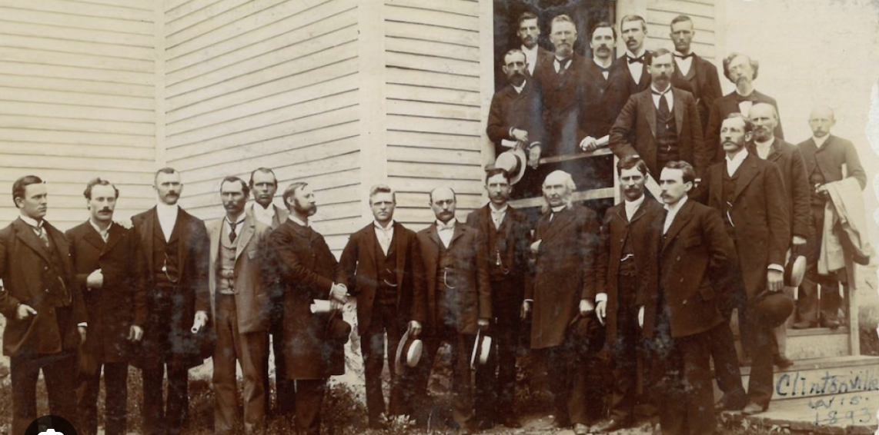
BTW - In 1993, we celebrated the 100th anniversary of the founding of this church! Karen and I had just accepted the pastoral position here! I remembering how the happiness of the celebration was spoiled for me because I was laid low with a kidney stone that week before! It was too big to pass, so I had it removed on Saturday before the big celebration. I got through the special service on Sunday - but just barely – as afterward, I was hit with swelling and spasms caused by the extraction that were as painful as the stone itself, and so, I could not stay for the big celebratory feast we had afterward – complete with a Sparn Farkle – that’s a pig roast, if you didn’t know - with a huge pot luck dinner! Missing that just added to the pain!
~Getting back on topic,.. so not only is the body joined with itself, the entire body is finally, joyfully, physically joined with its Head, which is Christ! Christ is completed in the same way that a man is completed when he is with his loving wife, and visa versa! In fact, the church is referred to as “the bride of Christ”, and there are references by Jesus and by the apostle John in his book of Revelations, regarding a great wedding feast in the heavenly realms! The book of Revelations seems to indicate that this celebration comes after the wrath of God wrecks the world – and we will talk about that soon! But the joy and euphoria of being together and being with Christ will be unimaginable! We will be giddy with laughter and expectancy, experiencing emotions off the charts! Now, I don’t know what exactly we will be expecting, but imagine the relief of being out of enemy territory on earth where Jesus is reviled, where politics is a cesspool of corruption and lies, and where justice is regularly perverted, and where the lie is venerated, as the truth is subverted! We will have gone from darkness into the light – from lies / ignorance, stupidity - into truth / mental health, clarity! We will feel the unimaginable joy of having been delivered from our cursed and corrupted human DNA, and into our new bodies with incorruptible DNA, and no longer having a sin nature! And there is the wonder of being all together with the saints of all time, and of course, being with our loved ones that have gone on before! And if that isn’t enough – the wonder of being within sight and sound of God, and being overwhelmed by the grandeur of heaven, and living in the endless possibilities of other dimensions in the heavenly realms! And all our questions are answered, and all our doubts have disappeared in a flash as we first grow accustomed to the sight of God – an experience to which no one can ever really become accustomed! And then there is the waiting with anticipation for our assignment as servants of God – we will be wondering what we are going to be put to work doing in heaven? It will certainly be something gratifying/fulfilling, and important! *My 14-year-old grandson, Castiel, just landed a job at Chick-fil-a this week. He is sooo excited! You’d think he won the lottery! Having a good job is will always be important to us! Eventually we know from scripture that we will be put to work ruling and reigning with Christ back here on Earth! And, finally, there is just the peace and celebratory joy of just really knowing that we have arrived! We are there, and we ARE SAVED, and we are finally safe in our eternal home!

Slide 4
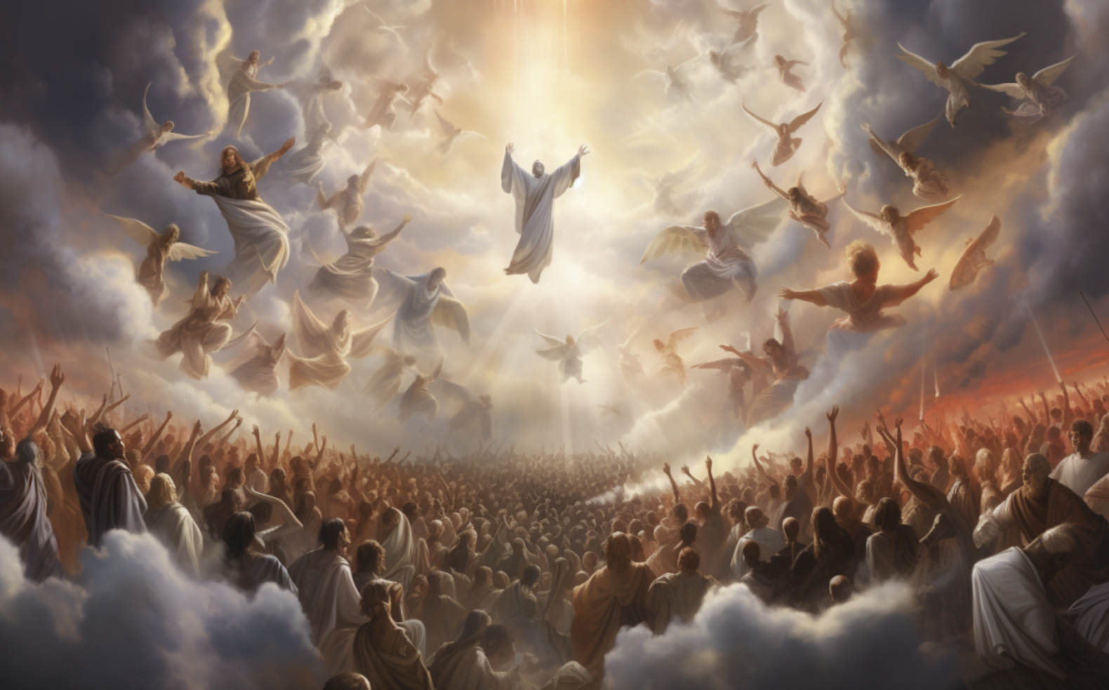
So, there we are – all together – getting acquainted - waiting to be taken to our new residences in the heavenly realms, a place that has been prepared in His house for his new bride! Take a fresh look at [*John 14:1-4] with that in mind!
Unfortunately for the rest of humanity, the rapture has been a culling out of God’s people from among the general population of the world [Matt. 24:30,31] – even the part of it that takes place during the resurrection of the dead is selective! Jesus said that one would be taken from the field, and two left behind. It will certainly be the same with the resurrection! In fact, most will not arise at that time. The great majority outside of Christ will have their own resurrection, but not at this time! They will not yet be called forth. They’re time is coming and it will not be good! However, this time, this action of God which is called “the first resurrection”, is the express love of God manifested toward those who have loved and obeyed Him over the millenniums! He is giving our bodies back to us! Only, as I said before, the bodies given out will be the vastly new and improved model! And then the embodied souls, and the formerly disembodied souls will together be transported between realms to our new home where we have really belonged since we gave our hearts to Jesus! Someone might ask – so why do we need bodies at all?! Why not just continue on into eternity existing in a new form? The answer is that it is our bodies that make us individual human! The body appears in scripture to be an indispensable part of the unique human makeup! Jesus Himself was a man, and is shown by the testimony of Luke, in the book of Acts, to have been bodily raised from the dead - although it was not exactly the same body – but a “glorified” body! Christ’s body was changed. How do we know? Well, He went through a locked door to get into the upper room to be with his disciples there! The lock didn’t fail. It was still locked! The door didn’t even open! The risen Jesus just appeared to them in that room! Yet, even in their wonder, and not a little fear, they (Thomas in particular) touched and examined Him carefully, and His body was, indeed discovered by Him(them) to be a physical body, not a “spiritual”/ethereal/ghostly one – and it was even found to have retained the scars of His terrible ordeal on the cross - for an irrefutable means of identification! Later, he shared a meal of fish with them – He ate [John 21:15]. His changed/glorified body had to digest that food! And then, not long after, Jesus was seen to ascend into heaven in bodily form [Acts 1:9-11]! His body ascended up as the forerunner of the church’s ascension into the clouds! Anyway, my point is that even Christ will always retain His human body in heaven! That was the point of His being seen to ascend by hundred of witnesses! And then, again, indications are that He will remain a man forever and ever, because once you are human, it is apparent that you cannot just renounce that, or you would become,.. well,.. something else other than a man! Jesus was a true man on this earth, and as such must now remain a human, like us, and like us – continue to be an embodied man, even in heaven – thus His resurrection! ~God obviously wants all thing to be as He envisioned them – completely whole again - as they should be! He doesn’t want to concede even one thing to Satan, the enemy! At the first resurrection and rapture of the church, the first phase of His victory is complete! The final victory is not entirely complete yet, as the enemy, Satan, and all his participating minions still have to be humbled and defeated/ wiped out/ destroyed, to make way for God to start over with His vision of a new and perfect earth! But we will get to that in a bit.

