Slide 1

Eschatology - The Doctrine of the End
The Judgment Seat of Christ
Panoramic
The Story of God
as seen through
The Great Christian Doctrines

Slide 2

Before the end of things as we know it, the earth, humanity, is slated for judgment and wrath by its Creator. Things have not been good on earth since Eden. In fact as dangerous as the world seems to be now where you cant even let your kids play outside on their own, because of all the perverts! Globally, Geo-political tensions run high everywhere, as Russia threatens Europe, and China threatens Asia, and Israel – the only “free and democratic” nation in the Middle East is under attack again by its neighbors, things are actually MUCH better, safer for the average person than they have been in the past, before there were police, and jails, and investigative journalism where the terrible acts of men are brought before the public eye . Back when every man, every tribe, every nation and King “did what was right in their own eyes”, everyone did wrong, and the earth was a den of perverts, thieves and murderers! Kings, Lords, chieftains, were overwhelmingly corrupt, perverted, marauders! Throughout history, the average person was not safe! Powerful human predators ruled the face of the earth, and their predations have decimated it! The Creator/God has watched all of this suffering and ruin, despair and untold loss over the millenniums, and He has certainly reacted with great disappointment and anger! In the Biblical account of the end of the “last days”, the earth, as it gets close to the end, has become intolerable to God! “As it was in the days of Noah”, said Jesus as He talked about the end of the world as we know it! This earth and its rebels are scheduled to experience the terrible wrath of God! But - before we get to all of that, there is an important event that happens in heaven after the rapture of the church and most likely before coming wrath - a happening that we must cover carefully, as it needs to be an important part of the Christian mentality! *Three weeks ago or so, I purchased a package of cheap plastic fly-swatters on eBay, because our old one had broken. They arrived and were absolutely worthless – way too flimsy! Then this past week, eBay sent me a picture of a row of five stars to rate my purchase, one star being the worst experience and five stars being the best. By this time, the swatters had gone into the garbage! So, of course, I gave them a “1 star” rating to warn others not make the same mistake that I made! The company that sold them had asked me to judge their product - and I did! This week they apologized, promptly refunded my money, promised not to sell that product any longer, and asked me to revise my rating. So, of course, I did! I was reminded of the fact that I myself will be rated one day – and so will you! ~After the angels gather the saints of all time from around the globe - and those saints that are living at that time will be gathered also and will see and meet Jesus for the first time! The deceased lovers of God must be brought back to earth at the rapture of the church to be joined with the new and immortal bodies that are created for them by their Creator/God at that time Then the living Christ-followers at the time of the rapture are also changed instantaneously, being outfitted with new and regenerative DNA, and they are gathered by the angels and transported upward to meet Jesus in the clouds where He has been directing this surprise attack deep into enemy territory! Paul goes into great detail about this great act of creation that surpasses the original creation of man! In the first creation, God created one man, and then a bit later, his companion and mate! But in this second act of creation, millions of bodies will be outfitted for their owners all at one time! Again, Paul goes into detail about this in: [1 Cor. 15:23; 35-58]

Slide 3
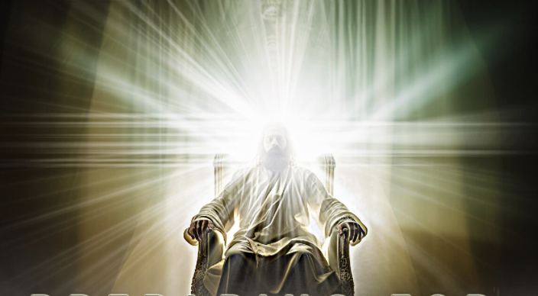
When does this happen? Paul adds this important detail about it in [*1 Thess. 4:14-18] It is clear, (at least to me, and many others), that the resurrection of the saints that Paul talks about in 1 Cor. 15, happens at the rapture of the church described in 1 Thess. 4. ~[*Heb. 9:27,28] – “…and after this the judgment” - This connects the first judgment with the rapture. So, the first scheduled event at the end of the end is the rapture, with its first resurrection – the saving of the human body through the resurrection of the saints – and bodily transformation. The second major event that seems to follow the rapture, is “THE JUDGMENT SEAT OF CHRIST” [*2 Cor. 5:10] It is the judgment of the saints where our works are evaluated / rated and commiserate rewards are given out! This judgment seat will not carry with it a possibility of eternal condemnation and Divine wrath, (Hell)[*Rom. 8:1; 39], but it is for an awarding of prizes (or crowns) for the quality of our works, OR, it may mean the taking away of the awards! This judgment is referenced in multiple New Testament passages – more than you might think! [*2 Tim. 4:7,8] – Here, Paul puts this judgment in a positive light. He is personally looking forward to it, and rightly so. Throughout his life, since coming to Christ, he had an impossibly productive output of rich, devoted service to Christ! His motives were never about self-promotion, but it was always about elevating Christ to His proper place - in his own life and in other people’s lives! So He was looking forward to the judgment of the saints and the awarding of honors/crowns (and the most basic, but most important of all that he mentions here – the “crown of life”). Here at this judgment, there is recognition and honor for all those who served Christ first – who put Him before themselves, who devoted themselves to the health and the benefit of the body of Christ – who applied themselves, time, talents, gifts, resources, – to encouraging and helping people follow Jesus more successfully, and to spreading His gospel to the world that needs Him! With that in mind, there will also be those who have done exactly the same things as those who are rewarded, but who lose the reward because their motives were compromised with ambition, or worldly recognition, or were just all wrapped up in garnering respect, reputation, position, or even financial reward [*1 Cor. 13:1-3]. These will suffer loss – the wiping out of any commendation by Christ for their labors! There will be those, for instance, that give their money and resources to the work of God in the church. One will be rewarded because they gave worshipfully, sacrificially, joyfully - and the other will receive no reward even though they may have giving millions, because they gave without worship, or without an overriding sense of gratitude, or they gave out of obligation, or, perhaps, they were trying to buy a place in heaven!
Notes:
b

Slide 4
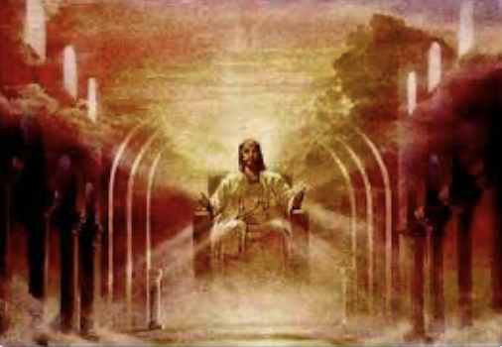
At this judgment, we will probably look at ourselves quite differently than we do now. Now, we exonerate our own behavior, we self-justify, and we rationalize, and we defend ourselves, and we deny, deny, deny, and we excuse ourselves, and we parse words to our advantage, and we downplay, and we gaslight! But then, before the Judge, we will finally see and know ourselves for who we have actually been in all our sinfulness and ugliness. 1 Cor. 13:12 says “Now we see but a poor reflection, as in a mirror (mirrors were of poor quality in those days), then we shall see face to face. Now I know in part; then I shall know fully, even as I am fully known”. There is no hiding from the truth before the judgment seat of Christ!
So the admonition of the apostles are to give ourselves ever more fully to the work of the Lord [*2 Cor. 15:58]. The admonition here is to not hold back, to go all in on Jesus, and not give up! A Christianity of convenience only, is for losers - in the sense that the double-minded, partially committed Christians will lose out on that Day! I don’t want that to happen to ANY of us here today! It will,.. but not before I do what I can to stop that from happening! The understanding we need to share, is that it will be worth it, and we will truly not know the true importance and full impact of that until we look into the face of Christ, the Judge, and are “fully known”!
[*2 Tim. 4:7,8] “I have fought,.. finished,.. kept… Now there is in store for me a crown of righteousness which the Lord, the Righteous Judge, shall award to me on that day (What day? That’s easy - the Judgments Seat of Christ day), and not only me, but all those who have longed for His appearing”.
[*2 Pet. 1:10] “Make your calling and election sure” – Serve Jesus whole-heartedly!

