Slide 1

Eschatology - The Doctrine of the End
Precursor of the Wrath to Come – Antichrist
Panoramic
The Story of God
as seen through
The Great Christian Doctrines

Slide 2
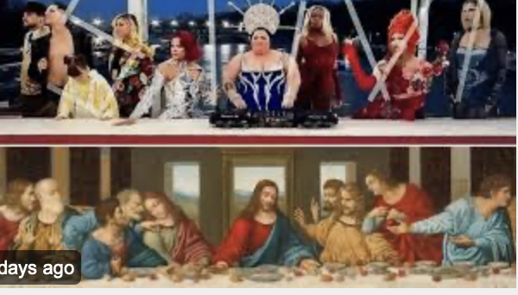
Salvation history, as recorded in the Bible, is a history that records the unfaithfulness of humanity to its Creator and to itself, and, conversely, the faithfulness of the Creator/God to humanity! Given humanity’s inexorable drift to evil behavior, the Creator/God who is holy and who hates evil, has been withholding His anger/wrath from this world. There was a time when human behavior had become so gross, and evil so steeped/saturated into the fabric of human society that there was no way to come back from it! The earth had become completely incorrigible – lost to any kind of fellowship with God! It was for fellowship that we were fashioned out of the dust of the earth, and humanity had completely and irrevocably lost the purpose for which we were made! This was unacceptable to the Creator! So God’s controlled and purposeful wrath touched this earth with catastrophic flooding - which then drowned and virtually wiped out all air-breathing life upon this planet! He preserve one family that did not deserve such a death. That was just a touch of God’s wrath! God’s breath gives life, good, wholesome, delicious life – but if we totally misuse it, His Holy judgement and wrath can take that breath away! What can be known through history is that we have consistently misused the wonderful breath of life that God gave us - to distort and pervert His image in us - just to drift deeper and deeper into self-interest – which tends to manifest itself in cruelty, and perversion, hatred, theft, and murder! This is the natural de-gression/retrogression of human society. *For example, now that the internet has connected the nations of the world together – let me ask you - has human civilization gotten better or worse?! The answer is exponentially worse, of course! Women and children are stalked by sexual predators – their perverted desires stoked by the darkest internet images! Men are competing in women’s sports, showering in women’s locker rooms, entering women’s bathrooms as if they belong there! In a bizarre and dangerous development, the ideology of Carl Marx (Marxism) is gaining real strength again in western universities, despite having directly or indirectly been the cause of 200 million deaths in the last century in the nations that were crushed by Marx’s empty promises and flawed social calculations! Identity politics have divided the races now more than ever! Hatred boils over in the streets, fed by activist teachers in the public schools, teachers who were taught to indoctrinate rather than educate, by activist university professors! And this is everywhere - and the hatred is picking up speed it seems! No one is more frequently targeted by the “progressive” far left, than Jesus Christ and any devoted follower of His! *Case in point was last weeks blasphemous mockery of the Leonardo da Vinci’s depiction of the Last Supper of Christ and his disciples during the opening ceremony of the Paris Olympics, where the last supper scene was staged by indecently garishly gay and transgender models! Don’t let them kid you. They said there was no intention to offend, but don’t believe it. This intentionally targeted all Christians, mocking and insulting them on a the biggest world stage there is! These people not only have no fear of God – they have no fear of expressing just how much they despise Christianity! So, one day soon, the wrath of God is coming for them! All the condemnation and wrath that has been held back for so long by the dam of God’s patience and love, will break out of it’s confines and plunge down on the earth - for a third time!

Slide 3

1- the curse / 2-the flood / 3-the end It begins with the emergence on the world scene of a man that the Bible describes and labels “The Antichrist”. He actually is given many names – “the Lawless One”, “the Man of Sin” [2 Thess. 2:3,4,8,9]. The Book of Revelation adds the title of ”The Beast” (Rev. 13), “The Serpent”. Way back in the Old Testament, Daniel call him the “The Abomination of Desolation (KJV)” [Dan. 8:13 / Matt. 24:15 – Jesus references Daniel] For urther description of what many believe to be the Antichrist: -Dan 8:12 – “Truth was thrown to the ground” -8:24 - “He will become very strong, but not by his own power” -8:24 - “He will cause astounding devastation” -8:23 - “a master of intrigue will arise” -8:25 - ”He will destroy many and will consider himself superior” He will have unparalleled success on the world stage, politically! No one will be able to stop his rise to power, and no one will even try! All will jump on His bandwagon! This will not happen because of his personal charisma, although he will mostly likely have that in spades! The one underwriting his rise to fame and success will be Satan! He will be the power behind the scenes – *just like the mysterious multi-billionaire, George Soros, is providing the money support behind all these radical campus protests and violent marches in the big cities! That takes money, and a lot of it! He provides the money for all these professional agitators to create chaos! It looks like an impromptu grass roots movement, but it is not as it appears. It is instead, well-planned out and well-financed behind the scenes! In similar fashion, Satan will provide a “strong delusion”, a smoke screen if you will – where nothing is as it seems on the outside. It will become a movement that will grow in strength and will blanket the world and cause the nations and the people of the earth to fall in love with this monster - and fall hard! He will bring the nations together under one authority – Satan’s. On the surface the earth will appear to have finally become that bright, shining “city on a hill”. Underneath, behind the scenes, it will be as corrupt, and dark, and as ugly as a cesspool! Deception and coercion, payoffs and murder at the highest level will be the modus operandi, because that is how Satan does business! This man will do what has never been done before – unify the world and bring all of humanity under one governmental, one jurisdictional authority. All world leaders will give in to this one authority, many will come voluntarily, and others will come first by expediency, and then by the necessity of force! It will be done without war. If a nation were to belligerently hold out, they could be embargoed and starved into submission and conformity! All of these unprecedented and epic political developments, globally, will intensify the world’s conflict with its Creator/God! Satan will have completely taken over the earth! It will force God’s hand to dramatically speed up His plan to bring this sorry epoch of world history to a savagely devastating end! I say “savagely” because God is going to release the hounds of judgment upon this earth! As Eric Sauer, German theologian, puts it - The earth will be “suddenly torn to pieces” by waves of Divine wrath!

Slide 4
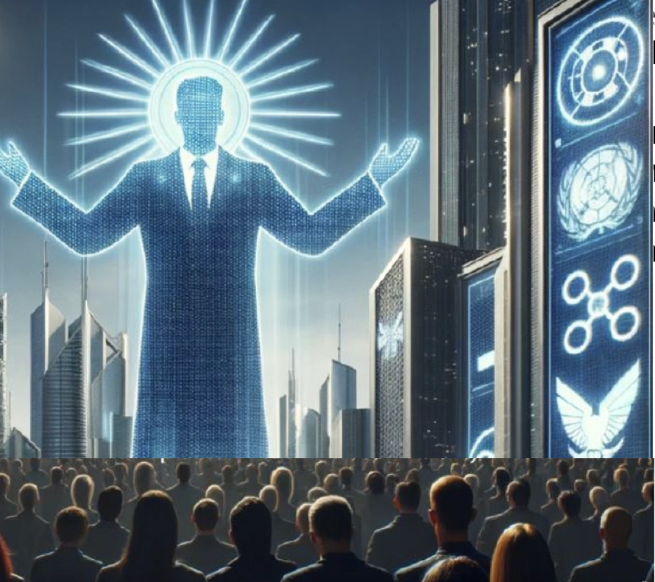
At first, the world will be taken in by a scene of apparent peace, security, and prosperity! Behind the pretty façade, the extreme measures of the Antichrist against certain resistance movements, and resistant nations - will be forgiven by the average person - and excused as a small price to pay for all that peace, security, and prosperity! *Of course, that is what the Germans did for their supreme leader, Adolf Hitler! As he rose to power, they went along with all the dark and rotten schemes of his regime building, because he promised to restore Germany to world prominence and to prosperity again! Just like with Hitler, the Antichrist will be leading the world into judgment and destruction, and ultimately to share the fate of Satan and his minions – which is eternal Hell! The Antichrist will be a puppet. *A puppet is a lifeless shell until you put your hand in it and give it life, or pull its strings and give it movement that is not its own. Satan will be pulling the strings of this man of destruction and making him appear as if he is a powerful entity on his own,.. but he is only a tool to oppose God and make war against Him! He is simply a means to an end! Satan doesn’t care about this man – his faithful servant! He doesn’t care about any of his victims – and be assured that all who align themselves with him become his puppets, and then his victims – make no mistake about it! Asking him for friendship or loyalty, or caring, is like asking for your dog to sing a perfect rendition of ”Somewhere Over the Rainbow” for you. Ultimately, all who align themselves with Satan’s kingdom of darkness, and his lying ideologies – and all who take his side – who defend him, and who fight for him – they will share his terrible defeat and share his ultimate reward – God’s judgment and wrath – and finally inescapable incarceration in an eternal prison called ”Hell”, “the lake of fire”, and ”the second death”. There is only one escape from the condemnation and wrath God! Just One! Jesus said, “I am the Way, the Truth, and the Life. No one comes unto the Father except through me.” You switch sides. You give yourself to Jesus Christ! Only He has the capacity to care about you, to remain loyal to you, to love you and reward you with exquisite life, and an infinitely better life-eternal!
As we go to the symbolism of communion, we celebrate our leader, the True Christ, who loves us – who loved us enough to suffer a most terrible death to reconcile us to God, save us from wrath, and draw us into a love relationship with Him instead. No other leader would pay such a price for our allegiance and love!

