Slide 1
Eschatology - The Doctrine of the End
The Wrath to Come – Waves of Retribution
Panoramic
The Story of God
as seen through
The Great Christian Doctrines

Slide 2
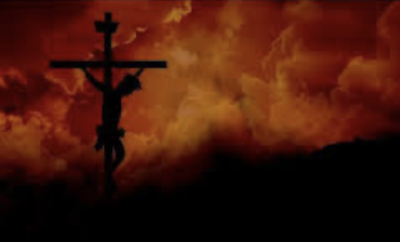
Don’t ever think of God, or treat God, without respect! Don’t misuse His Name as a curse word, or as an emphasis word, or think of Him as the “Old guy in the Sky”, or ”the Man Upstairs”! Don’t think of Him as your buddy, or your best friend, without including that He is a dangerous God! You think of Him with respect, and you SHOW Him respect! *I loved my father and was proud of him. I respected him as a man, as a follower of Jesus, as a man of strength and as a man of leadership, as a man of conviction, as a man of wisdom, and as a man of faithfulness! I never forgot that he was the only man who ever spanked me! When I was in my later twenties, He and I somehow became best friends. But I never lost track of the previous respect I had for him! With my other friends, it was total familiarity – back-slapping, joking, pranks, rough housing. But with my father,.. well, we joked around, but whatever expressions of friendship I shared with my dad were always tempered by my deep respect for him. He was my father! I always kept that in mind! It made a difference in how I interacted with him! It was deep love, warm affection, interlaced with an appropriate restraint because of who he was to me! ~For all that the love of God means to us - manifested in His goodness, kindness, patience, generosity, and faithfulness - He is also a God who is very capable of becoming wrathful, and His wrath can be violent in the extreme! His wrath is always preceded by His judgment because His judgment engages His wrath! He judges that something or someone is really, really bad, and it can make him angry, and cause Him to focus His attention on an individual or a group in a way that that individual or group is not going to like one bit! Even as we, God’s people through faith and trust in Christ, engage in relationship with God - it is vitally important not to lose track of the fact that the purpose that God the Father sent Jesus die on the cross, was to save us from His own judgment and wrath! God sent His Son to save us from Himself! Jesus came to earth on a mission to be our Savior, cushioning us from God’s judgment! Through putting our faith in Christ, His judgment is not engaged against us, because we are protected by Christ! It was poured out upon His own Son on the cross! Now, He is as likely to judge us as He is His perfect Son! But, even with Christ as our perfect protector, it is important to remember that this God that we love, and who loves us, is not a soft, warm, fluffy pushover! We need proper respect!
The Bible confirms this over and over and over again! The judgment of God is righteous, and the wrath that follows is worse than we would probably guess. But the way that the Creator/God is going to end the rebellion of humanity as He brings our sorry history to a close, is epic even by His standards! Last week I talked about the rise of the anti-Christ, a powerful man who rises to world prominence and then, dominance! The nations of the world are wooed to him by an ethereal delusion – being convinced of things that are not true about him. *It is like some of the political ads I have been seeing already. They are not and never will be true, and yet half the population is falling for them, in an insane hope that they may be telling the truth! Likewise, the nations flock to this man

Slide 3
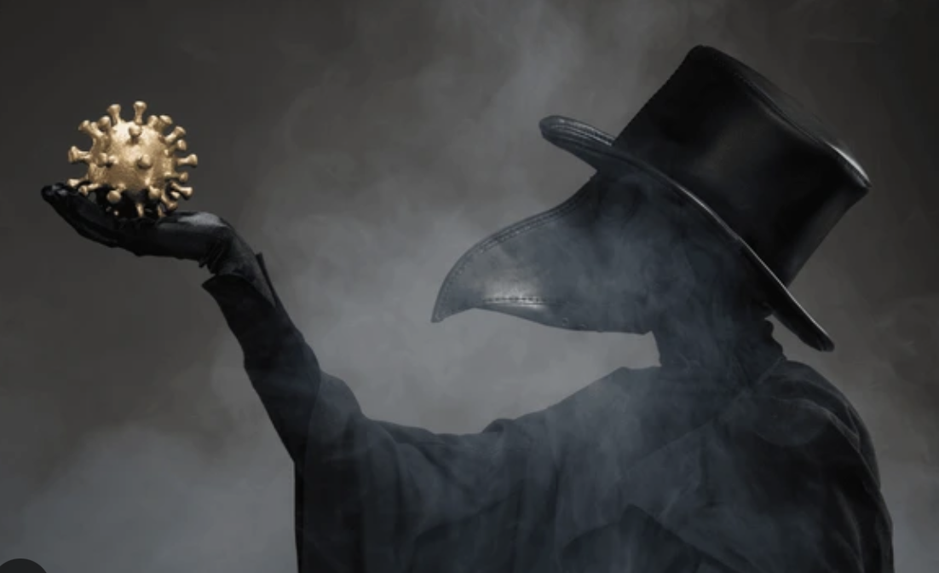
He is a man who hates God and is Satan’s puppet, doing his bidding in Satan’s war against God! Humanity has always been trying to wrest control of the earth from God, from the building of the tower of Babel, to the many leaders/conquerors that tried empire building - from Belshazzar, to Alexander the Great, to Julius Caesar, to the Papacy, to Napoleon, to Hitler! But no one engages God’s judgment and wrath like this man, and this particular age of man- kind! I think there is also the element of the fact that God’s wrath has built up over the millenniums of human history. We’ve seen glimpses of it, but it has never fully expressed itself and fully depressurized at any time except for the great flood! But, in the future - in bringing humanity to its knees, and the world as we know it to an end – God’s supercharged wrath will unload upon this planet! This time is referred to as “The Great Tribulation” in [Daniel 12:1ff; Matt. 24:21,22; Rev. 7:14]. The word “Tribulation” in the scriptures means distress, trouble, danger and/or hardship! The term includes the word “great”. The world is full of tribulations, but this world ”great” puts this tribulation in a category that exceeds the worst times of tribulation. *Its like the flood of Noah. We have floods the world over and they often ruin dams and bridges, homes, fields, roads, etc… But the “Great” flood, – that was quite different, as we know! It destroyed EVERYTHING on the earths land surface! In the same way, this tribulation is global and unlike any other distress, surpassing any the world has ever known before! The flood killed all air-breathing things outright, and probably most aquatic creatures. But summary death would be merciful in comparison with what God has planned for the end! In this tribulation there is to be much suffering as the earth is slowly squeezed by God, like a ripe melon! This time people will experience prolonged and intense suffering before finally dying. Waves of catastrophic events will encompass the world, one right after the other - most of them catastrophic natural disasters caused by God calling them forth to rip the surface of the earth apart [Rev. 6 – an example of how things are going to be going on the earth for a minimum of the next 3-plus years]! It is impossible to know how much of this is to be taken literally, but we so know that the earth is in for it!! Rev. 8 – The 7 Trumpets of Divine judgment and wrath – hail, fire, and a third of the earth is burned up – a third! Something the size of a mountain hits the earth, and a third of the ocean dies! Another ”star” hits the earth and a third of the fresh waters turn poisonous and people die like flies! The solar system is disrupted – and the sun and moon are darkened by a third (always a third for some reason), and daylight is decreased by a third and nighttime increased by the same! Then it looks like a great volcano explodes and the earth’s atmosphere is filled with smoke and ash, darkening the daylight further – which, of course, causes the crops to fail, which then causes starvation! *It has happened before - in the years 1315-1317, it is thought by some historians that an asteroid may have hit the earth in South America, kicking up vast clouds of dust into the upper atmosphere that shielded the earth from the sunlight that the crops need to grow and mature. Food in Europe became scarce and too expensive for most person to purchase. People resorted to eating their dogs and horses, anything that breathed - and even cannibalism was practiced by many! Then, shortly after, the Bubonic plague (the black death) began expanding – a terribly toxic bacteria spread by fleas and lice on rodents, like rats, and on people – because the people of Europe were unbelievable filthy and smelly at that time! Personal hygiene was virtually non-existant at the time – and so, the plague spread across the known world because of the weakened condition of everyone! It is estimated that 50 million people died in Europe and up to 200 million worldwide! And that is when there were far fewer people than there are now! Between 30-50 percent of the population of Europe was wiped out! It must have seemed like the end of the world to the people then!

Slide 4
In chap. 16, we see the end of the dissipation God’s judgment and pent-up wrath against the whole earth.
The War of Realms - [Rev. 16]
7 Bowls of Wrath Poured Out!
A booming voice from God’s own house – gave orders to the seven
“Be on your way, to earth convey – this message hurled from heaven”
So angel-one went forth to spill – the first of seven bowls
And the-earth is poxed with painful sores – from the head down to the soles
And then, the angel-two arose - to force his bitter bolus
From this time on, until the end – the earth will find no solace
The salty seas will turn crimson – resembling human blood
The creatures of the deep will die – the stench, a miasmic flood!
When angel-three spills out his bowl – fresh water changes too!
The reservoirs change into blood – and thirst starts to accrue
And humans and all living things – that live upon the land
Will suffer now a shocking plight – because of God’s command

Slide 5
And the watcher heard the angel of – the waters when he said
“To the One who was and the One who is – true justice is NOT dead!
These humans shed the blood of saints – and of God’s prophets too!
So, let them drink the blood they’ve drained – they’ve earned wrath’s revenue!”
The alters from on high agree – “The Lord is true and just!
His judgments are outstanding – and in the Lord we trust!”
The fourth angel flew high to pour – his bowl upon the sun
The sun flared hot, to the extreme – increasing its fission!
The people roast, and thirst, and scratch– they’re cursing God above
“Where is this God who controls all? – Where is this ‘God of love’?”
And-earth’s men stays unrepentant – and-it’s women, no remorse
So, on they bake, which only serves – to anger them, of course
A fifth angel then left the alter – to unleash increasing terror
And when his bowl is then discharged – great fear compounds the error
For-the earth is plunged into the dark – a sweltering midday night
Men gnaw their tongues, and curse the Lord – still itching for a fight!

Slide 6
Continuing on, this plague of bowls – ravages all the planet
But the people here are growing worse – and God’s heart turns to granite
So, angel number 6 goes forth - to-unleash the curse he had
And Eden’s river dries to dust – a sign that’s very bad!
And now is cleared a passage way - for invasion from the east!
And-the dragon’s mouth is opened then – and-the prophet’s, and the beast’s
And out comes forth three spirits that – look just a bit like frogs
They’re demons sent unto earth’s kings – as evil demagogues
The demons work some miracles – to get the damned on board
And call the kings of the whole earth – to-do battle with the Lord!
The Day-of-God has now arrived – and Armageddon’s here!
And like a thief it comes, so sleep – with clothing on - in fear!
The kings will muster, to their fate – in-that valley of renown
It’s just in time for angel-seven – to empty his bowl down
And from the temple of heaven the voice – roars out, “It is dispensed!”
With thunder, lightening, megaquake – the battle is commenced

Slide 7
No earthquake like this earthquake - has ever ripped the world!
From side to side and up and down – the dust kicks up and swirls
The mountains fall, and islands flee – the-great city breaks in three
And all the cities of the world – are wrecked, or underseas!
But the-worst of it is centered on – old Babylon the Great
For God has seen her adulteries – and truly is irate!
Her cup is filled with-the bitter wine – of God’s astounding rage,
And from the skies fall blocks of hail – to end these seven plagues!

Slide 8
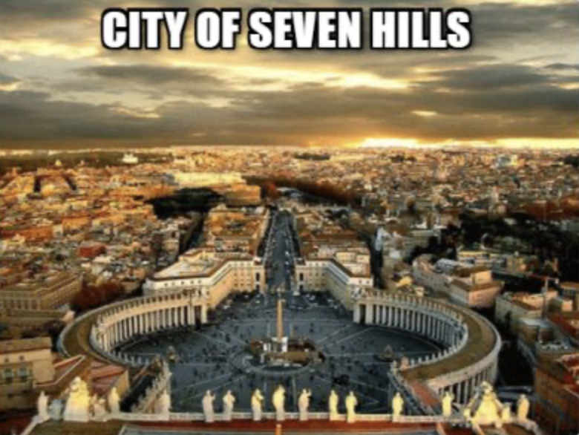
In chapters 17-19, His wrath will become more focused upon the beast (the anti-Christ) and upon “Babylon the Great” - the great city that is aligned with the anti-Christ – called ”The Great Prostitute”, which many think fits the description of the city of Rome.
Now,.. as I talked about earlier, the earth has experienced times of great tribulation before, where 10s of thousands up to even 100s of millions have died from terrible outbreaks of natural disaster, where one disaster leads to another even worse! But nothing in recorded history even closely resembles what is described in Revelations! There is a school of theological thought that thinks this has already occurred! But I cannot see it. I believe these things are yet to occur, and then comes the actual end of this part of human history, as the civilization that opposes God is destroyed, and the beginning of a new era begins! But we will speak of all that, next week, or maybe even the week after, because the saga of God’s judgment and wrath continues still.

