Slide 1
Eschatology - The Doctrine of the End
The End of the Wrath to Come and the Final Retribution
Panoramic
The Story of God
as seen through
The Great Christian Doctrines

Slide 2
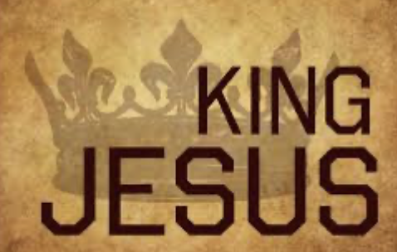
1
~The Creator’s express goal, ever since humanity declared self-rule way back in Eden, has been the re-establishment of His rule on earth. Why He didn’t just wave His hand and make it happen is a mystery to me. Why both humanity and God Himself had to go through the agony that the last few thousand years represent, I cannot answer! God tells us a lot of things in His word – answers to fundamental questions that we could otherwise not know. But this question is not really answered in the scriptures. I am certain that there is a reason. God always has a reason for the things He does, and a good reason! But in this case we are not told what it is. We will have to wait until we see Him, and then He can explain and then we will know! But we do know that the Creator/God has gone through a lot to re-establish His rule on earth, and we know that He will not stop until He is successful! But it seems that he has been fighting this war between the heavenly and earthly realms “with one arm tied behind his back” as they say – and maybe both tied – and we can only speculate as to why! But it has been a tedious process by any standard, to say the least! ~At one point, it was so bad on earth that the Creator/God had to start over! He had to destroy the terrible cancer that human life had become on earth,.. and He did so with a great flood, shortly after which, there was a dramatic shortening of the human life span from over 900 years, to 70 or 80 years! With vastly shorter life spans, men could do far less damage during their lifetimes, and the world was made better because of it! ~Then, about 2000 years later, there arrived the Word of God, 2nd member of God’s Tri-unity, who took on human flesh, lived a perfect life among us as one of us, and who was on a great mission to take upon Himself human sin! He did this in the very process of being terribly sinned against by humans, who inflicted upon Him one of the cruelest deaths ever devised by humans – the Roman cross of execution! And this was perpetrated upon the only completely innocent human ever – convicted falsely, tortured, mocked, humiliated, BEFORE taken out and having His wrists and feet impaled with stakes to attach Him to His cross! There, hanging on the cross, asphyxiating, the wrath of God against human sin was directed against the Word and Son of God, Jesus, so that it could be directed away from us! This was truly the beginning of re-establishing God’s rule on earth! The cross became the gateway into God’s new Kingdom! By inviting people to put their faith and trust into Jesus, who died a scapegoat’s death for them, earning their trust, God was inviting people to accept His rule in their lives. In this way, God established His rule in individual human lives around the world! He then created “pockets” of His rule, called churches, where individual Christ-followers formed collectives to mutually help each other to follow the rule of the living Jesus Christ in their lives! The rule of Christ means that Jesus gets to tell us what to do, or how to do it! To accept the rule of Christ means that we accept the fact about ourselves that we need God’s leadership – that in our moral and ethical life, we trust that He will always steer us right, and never wrong! In our thought life, we trust that He will always guide us to a mentally and emotionally healthier place in our heads and never a worse one! We trust also that He will enrich our personal aspirations and goals in life, altering them or accompanying them with His own purposes. For Him to do all of that, we must trust Him implicitly/completely with our viewpoints, politically, culturally!

Slide 3
Life becomes more complicated, because we need to run everything by our King first! We have to really think about making good judgments and avoiding bad ones, and making good choices not bad ones, and rearranging our priorities to fit with what we know the Spirit of God would want! These things become paramount in our lives! We always desire to get sharper, not sloppier! So our values must be examined to see if they mirror our Master’s values, and then each of our values assigned a new value based upon how God puts a value on what we have valued! ~Anyway - God began His offer to rule human hearts and to establish His Kingdom through His Son Jesus Christ, and the cross, then, became the gateway into His Kingdom [*John 10:9]! Jesus said “I am the way the truth and the life. No one comes unto the Father except through me [John 14:6].” But it must be voluntary! God patiently WINS hearts, and does not force them! He has been doing this since Eden – as the beginning of this sad historical journey when humans established their own rule – their own dominion (of sorts) over the earth!
~But there is coming a day, and most think it is soon, when God’s patience has run its course, and He must bring the nations of this earth and every one of its heads of state down! He intends to defeat them utterly by finally unleashing His justice and wrath! He has been holding back for thousands of years, but He never intended that it would be held back forever! Always, in the plan of God - eventually, a rebellious world would have to be brought to heel, as they say! If people would not be won by the LOVE of a gentle Savior who suffered and died for them, they would be humbled and made to kneel to the POWER of the same Jesus, yet wholly different as the reigning Lord and Judge of the Universe [John 5:21-23, 26,27 – the context is that He has been given the power of life and death in the end]! So last week we looked at that wrath – waves of judgment and wrath, upon judgment and wrath! Jesus is instrumental in this. He has judged the earth, and the old earth must die. Understand that this is warfare! Most kings through the ages have understood that in warfare, the enemy nation must be humbled completely, devastated so that they will not have the power to come back from the devastation anytime soon – because they will be coming back! It is just a matter of how long it will take!
~So today, I want to focus on the last of the wrath of God directed toward earth! After decimating the earth, utterly ruining the world economy, and a third of everything is destroyed, and then some, and then God turns His attention onto a city called “The Great Prostitute” - “the woman dressed in purple and scarlet” [Rev. 17:4] perhaps a confederation of nations that defy God and have hunted down and kill great numbers of loyal Christ-followers (or saints). She/they also seem to be the focal point of world rebellion against God! Satan’s followers always eat their own and this happens in the end. Probably allies at first, the great prostitute and the anti-Christ (the beast) have a falling out. The beast wants all the power, and gets it at the expense of the prostitute. Without lifting a finger, God destroys this alliance as it turns on itself as God knew it would - and so the beast lays waste to the great city at the center of the rebellion against God [Rev. 17:15-18]. So now the anti-Christ, known as “the beast” or the “dragon” in Revelations, has consolidated all power to himself!

Slide 4
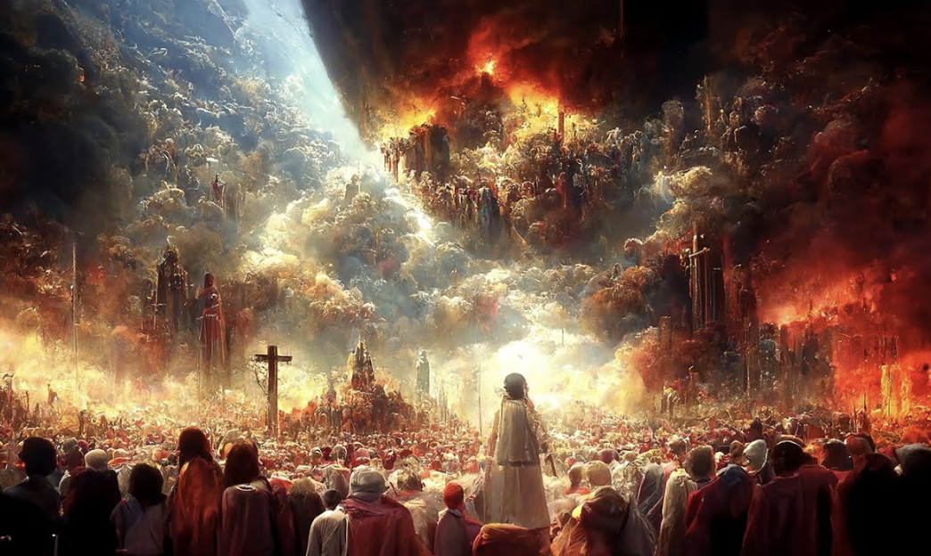
Now God has the beast, the anti-Christ, right where he wants him! Let me read once again from the poem I wrote depicting this scenario – this time in chapter 19 of the book of Revelations. Again, I’m trying to capture and explain just a bit what transpires at this point as the terrible rule of man is brought to a brutal end and the rule of God is re-established! Again, John, the writer of Revelations, is using “apocalyptic language” - a special literary device on the same level as the poetry of today, but which seems to be preferred by prophets of old. This type of writing is not exclusive to biblical prophets, but was a fairly common form of literary expression. Unfortunately, it is like one great unsolvable riddle! Thing are often not as they appear, but hidden. What appears to one thing is actually something else! And yet some of it is literal too, and some of it is both literal and symbolic of a deeper meaning. I let smarter people than me try to untwist it and figure it out, but I haven’t found one yet that I think has done it! ~So, in my poem, I don’t try to solve what is unsolvable, or explain the unexplainable. I try not to add more than what is there, and I also try to include everything that is relevant, verse by verse, even if no one can make sense of its full meaning! Yet, there are some things that can be concluded, at least to some degree, and I also try to bring those truths out of the text and make them more understandable.

Slide 5
The War of Realms - [Rev. 19] - One Last Battle
The watcher heard a mighty roar – from heaven’s multitude
They’re celebrating noisily – for joy is heaven’s food!
Shouting “Glory Hallelujah – Salvation is the LORD’s!
Salvation, Glory, Power be” – and thus the volume soars!
“His judgment is unerring – against the blighted whore
Who’s infected earth with evil things – and-is ready to spread more
Who is renown in history – for-the murder of the saints
Whose retribution day has come – from God, without restraints
And smoke rises above her ruins – now and forevermore
As like the smoke of sacrifice – her death has pleased the Lord!”
The four and twenty elders bow – as do the four creatures
And prostrate do they worship God – praising His countless features!
“Amen, and Hallelujah” they - will cry unto the throne
not out of fear but out of love – their voices will intone
and then resounding from the throne – a voice responds to them
“Oh praise the Lord, you great and small – and praise the Lord again!”
Again, the multitude sounds out – so great, so vast, their call
It sounds like pealing thunder or – a mighty waterfall
“Hallelujah”, they all begin – “The Lord Almighty reigns!
Rejoice, be glad, and celebrate – His glory will be gained!”
The wedding of the Lamb is now – and-His bride is nearly ready
She wears the finest linen bright – and she, herself, is steady
The clothes she wears, so fine and white – immaculate indeed
Stand for the righteous acts of saints – the ones that Jesus freed
And then an angel spoke and told – the writer to write down
These truths that come from God above – the truths that will abound
That those who are invited are - the ones extremely blessed
They line the tables of the hall – for they are heaven’s guests
The wedding supper of the Lamb – has blessed those who are there
And brings the watcher to his knees – in-the attitude of prayer
But the angel who accompanies him – rejects his rapt attentions
“Don’t worship me, but only God – I-won’t have this invention!

Slide 6
For just like you, I serve the Lord – and serve His gospel too!
We’re fellow servants, you and I – with all who love Him true!”
This precious testimony of – Jesus, the Living Christ
Is prophecy of finest worth – which can’t be overpriced!
And then the heavens parted wide – to-a white horse standing tall
And a rider seated on the horse – who is the Lord of all
He’s called the “Faithful and the True” – who judges and makes war
And all of heaven waits to see – that He will right the score
His eyes like orbs of blazing fire – with crowns upon His head
And-a tattooed name, a mystery – that cannot be known or read
He wears a robe that’s dipped in blood – He is the Word of God
He leads a stunning cavalry – a splendid sight that awes
This white army follows their King – their tunics bright and clean
But it seems they don’t have much to do – for HE’s the war machine
For from His mouth darts a sharp sword – to strike the nations down
He’ll ruin them with His spoken word – and cow them with His frown
He’ll tread the winepress of the wrath – of Him who is Almighty
And rule them with a rod of iron – for He will not tread lightly!
And on His thigh and on His robe – a noble Name is shared
“The King of Kings and Lord of Lords” – to-whom nothing can compare!
And silhouetted in the sun, an angel calls the birds
‘The “great supper of God” he calls – “is ready to be served!
Come eat the carrion of men – from every walk of life
from kings to paupers they will die – for-they choose to stand and fight!”
The Beast, and all the Kings of earth – gather for one great battle
They throw their armies on the sword – like so much worthless chattel
And so, they die in monstrous heaps – and when it’s all concluded
The Beast and his false prophet lie – in chains they’ve not eluded
Into the burning sulfur of – the lake of fire they go
Their screams of rage and agony – echo above the glow…
…And back on earth the silence grows – for there are few survived
And so God’s wrathful meal is served – it’s winged guests arrived!

Slide 7
This is the end of human government. It has always been corrupt and unjust. In the American experiment there was a time when people knew who the God of the Bible was and what His expectations were. And so we enjoyed more than 200 years of government that wasn’t as corrupt as governments across the millenniums have normally been, and we enjoyed a justice system that was as close to real justice as the world has ever known! But no more! People have lost respect for the knowledge of God and of the will of God, and we have gone and ruined what truly made us the wealthiest nation on earth – not in monetary wealth – but in honest government, and honest(blind) justice. Of course there was corruption behind the scenes because people are no better natured here than anywhere else in the world. We just have a better system and a better moral base (the Judeo- Christian ethic) than other places – or we use to. Not any more! We were a blip in time that will soon fall from a great height to drown in our own excesses! ~But, when God re-establishes His own government, and Christ sits on the throne of the world, and Satan the Tempter is shut away for a thousand years, the world will be stabilized and happy for a very long time – but that too is a bit down the road in our study of eschatology.

