Slide 1
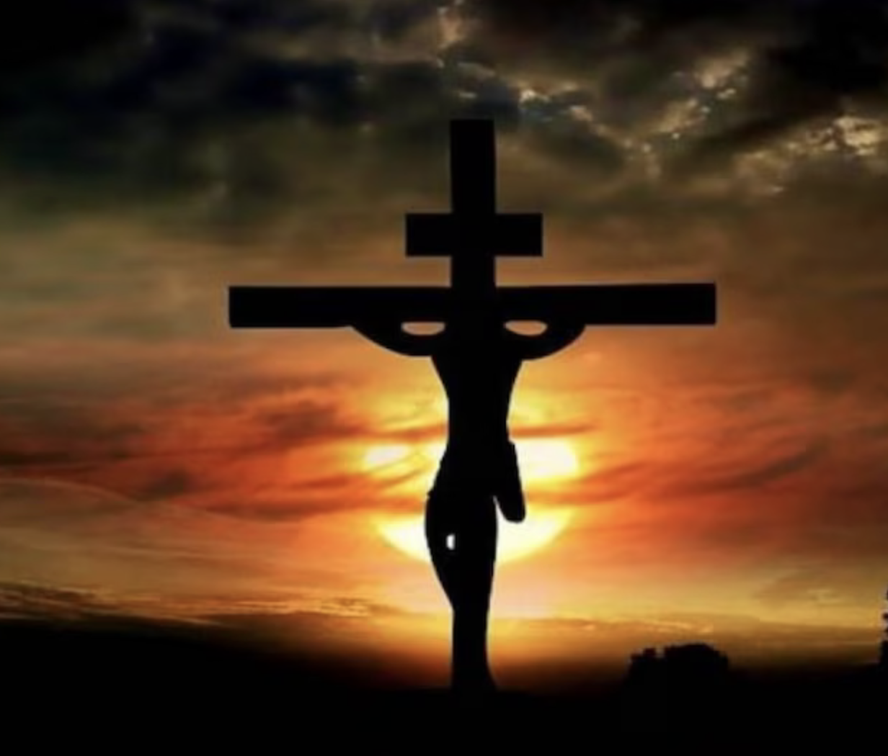
Clean!

Slide 2
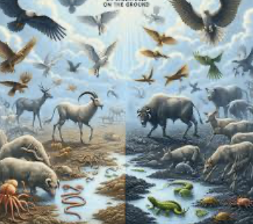
In the Old Testament of the Bible – Genesis through Malachi, the concept of the clean and the unclean was very clear to the nation of Israel, because God had made it clear to them through the Law of Moses [Lev. 11]. The Israelites were told that they could eat animals with cloven hoof, and that chew the cud - like cattle, sheep, goats, deer, etc.. But, they could not eat unclean animals such as camels, horses, dogs and cats, pigs. They could not eat anything that was of the family of reptiles – snakes, lizards, crocodiles, or, amphibians like turtles, frogs, salamanders. They could eat the regional fish with scales and fins, like musht (which look a lot like bluegills/or a pale crappie), or biney/ barbels (related to the carp family, and which the Jews eat at Passover and other feasts of Judaism), and sardines, tilapia, and other local fish. But they could not eat the unclean species – catfish, shellfish, lobster, shrimp, and other sea creatures without scales. They could eat certain birds, like ducks, geese, turkey, chicken, or doves, but they could not eat carrion eaters/predator birds - like eagles, hawks, owls, falcons, vultures. The people of Israel, the Jews, had to be very careful about this! But - most of the time they weren’t, because most of the time they were far from being on good terms with God, having largely given themselves over to worshipping the idols and gods of their neighboring countries! There were periods so lengthy, where they had forsaken God and His laws, that even the memory of him was largely gone! One time, around 627 BC, when Israel was in one of its most apostate conditions, the priest Hilkiah found a dusty old copy of the Torah/the Law of Moses in one of the rooms of the long neglected temple in Jerusalem. He read what he had never read before, and alarmed, he took it to the King (at the time), Josiah, and read it to him! Upon hearing it, Josiah tore his clothes in extreme alarm and concern – immediately calling for a time of national repentance and mourning, while the book was read publicly, throughout the land! As an entire nation – they had made themselves unclean before God – and had remained in that condition for decades - even centuries! They had literally forgotten the God of their forefathers with whom they had a covenant! So they had made themselves ”unclean”. They ate unclean animals, and did all manner of morally and ethically unclean things! ~Let me say here that it is an observable fact that “unclean” is not compatible with “clean”. It is like North or South, or like yes or no – light or darkness! It is one or the other, but not both, and no possibility of compromise! Even “less clean” and “more clean are only nuances of being and remaining unclean! *For instance, if a surgeon operated in a mostly clean operating room, he would be a incompetent hack! Surely none of us would want to be operated on by such a careless surgeon, right? You could end up getting a bacteria-resistant infection that could cripple or kill you! It may even ”look” clean, but you can’t see the really deadly germs! No, the hospital staff must have a specially trained cleaning crew wipe down and completely disinfect every surface! The floor, even the walls, and all the equipment would have to get sprayed and wiped down with disinfectant or bleach - every corner and every seam, and every crack! Then, hopefully, it is clean, not just “less dirty”!

Slide 3
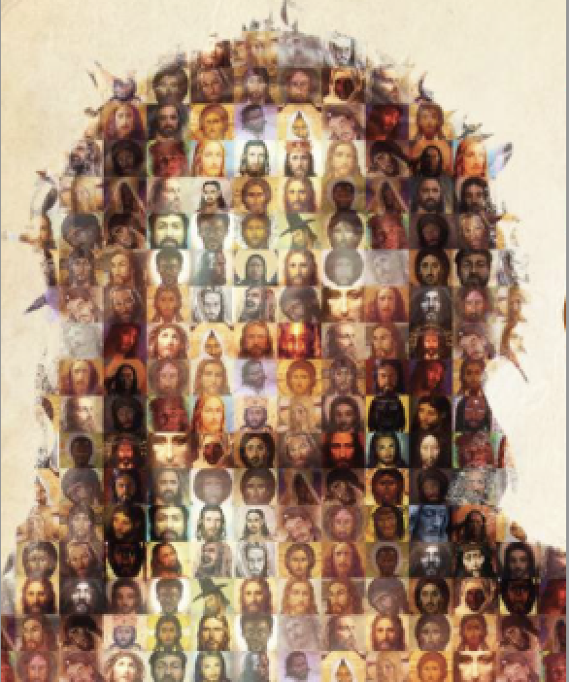
What Jesus did on the cross was a perfect cleaning and disinfecting operation! In His agony, He was offering Himself - to clean the unclean – you and me! *There is something about the smell of a pig barn that really offends my sense of smell! It’s not their fault, and not the farmer’s fault – it’s because they are pigs, and pigs generally live in their own filth. Now, on the other hand, I love the smell of bacon,.. but the pig barn not at all! We who had transgressed the law of God and who had made ourselves offensive Him - who have made ourselves offensively unclean in His eyes - are being offered the deal of a lifetime – actually, the deal of an eternal lifetime! On the cross, a sinless, perfect, and clean Jesus the Christ was offering to take upon Himself our offenses - the clean for the unclean - to suffer in His own body and mind, the terrible penalty we owed God! He was offering us His own perfection in exchange for our sins – “Here – I’ll trade you! [1 Pet. 3:18] The righteous for the unrighteous. ” Because He was God in the flesh, His self-sacrifice was potent enough to eradicate the sins of every unclean person in the whole world – in other words, everyone. But He didn’t actually do that. He offered it to the world, and John 1:12 states that to “all who ‘received’ Him”, (or welcomed Him and took advantage of His offer), “He gave the right to become the sons of God” – a position of “sonship” was a position of the father’s favor in the ancient Middle East culture! So this “sonship” here in the text is not a reference to the gender of a person, but to their position of favor in God’s eyes! ~So then,.. when we place our faith and trust in Jesus, we are given His “cleanness” from God. He who was sinless – who was the only human EVER without the stench of sin upon Him – has gathered all His followers “into” Himself, as into a great container of souls, and has washed our sins and their guilt from us, bathing us in His righteousness, and then coating us with the finest lotions of His merit and goodness! From that Divine “bath”, we end up smelling like a rose in the nostrils of God! This is something that is absolutely necessary if anyone is to be reconciled with God and made acceptable to Him! That is why Christianity is necessarily exclusive in its claims! People don’t like it, but the truth doesn’t care whether you like it or not! The truth is that only Jesus is the Creator’s provision – only He can carry this cleaning-up process through – all the way to a Holy God’s satisfaction! [Acts 4:2] “…no other name…”. Only He is equipped with what we need to be united with a pure and holy God – and for all of time and eternity! Only He was in a position to deal once and for all with our sin problem in a way that is acceptable to God – [2 Cor. 5:21] - “… that we might become the righteousness of God”!!! Perfectly clean! Just to clarify - I’m not talking about the righteousness of ourselves – our own achievements! Righteousness posturing, which we see so much of these days, is just another stench in God’s nostrils! Trying to reach a state of righteousness/goodness by impressively good acts, including being really nice/kind to everyone, would be like putting cologne on an unwashed pig! It wouldn’t work one bit, because the filth is not washed off! No,.. for us it is Jesus – dealing with our problem of uncleanness – washing us, making us clean of the guilt of our sin,.. and it is completely Him! God will have it no other way! So, He is our sure thing! Humble yourself before God and trust Him to accomplish what He said He will do for you! If you have not done so yet, I urge you to call upon Him and accept His offer in Christ, and He will surely give you everything that He has that you will need to be right with Him! This is how we start with God! Then, (and not before), He begins building His character of goodness into ours! Don’t try to be self-clean enough to ask Him to clean you! You will never be clean enough! Give Him it all, without delay, without embarrassment. He’s seen it all, and He already knows about your “stuff”. So, you can give it up without delay! ~Today would be great for that – especially before we go to the communion table and handle the elements of His suffering, the elements that remind us that, by rights, it should have been our suffering! Just thank Him, give Him your guilt, and trust Him with it!

