Slide 1
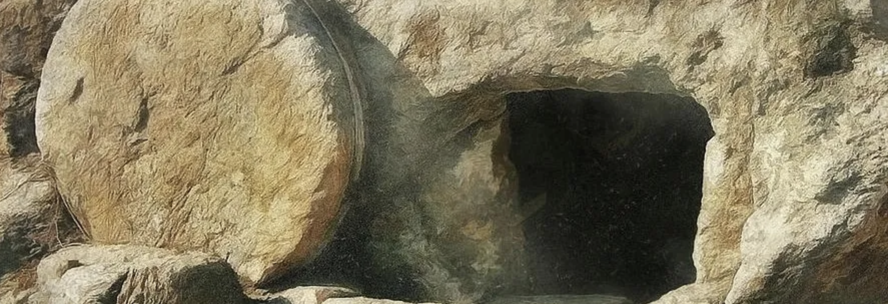
Validation!

Slide 2
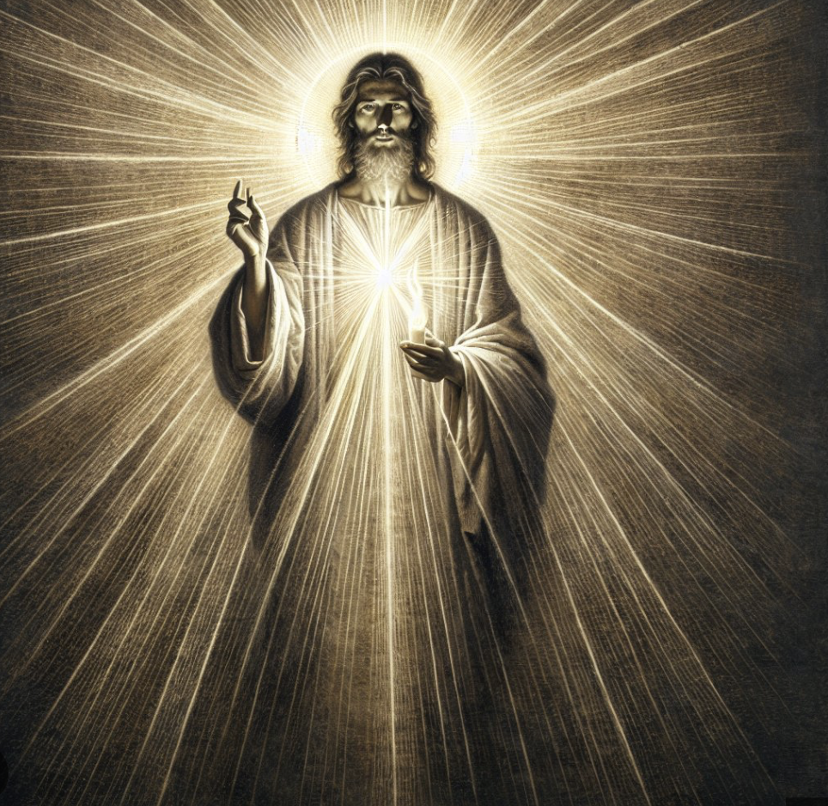
[Luke 24:1-12] ~The miracles of Jesus are difficult for most people to believe! The miracles recorded in the gospels have actually put off a vast number of people from believing in Jesus, especially since the advent of science and its many discoveries about the laws of physics, and biology, and the medical encyclopedias that are filled with volume after volume of discoveries and advancements to our understanding of matter - cells, DNA, and how the relate to the physiology of human beings. The miracles contradict everything we know about scientific empirical data/ evidence - so they cannot possibly have happened as recorded in the gospels. Philosophers, scholars like the teachings of Jesus - His philosophical approach to life – the golden rule, and all that. But it is those miracles that take up much of the re-telling of the 3 ½ ministry years that get in the way for a great many people. It ends up discrediting the message! Those left-leaning theologians have tried very hard to excuse Jesus from the guilt of making up a bunch of tall tales to hoodwink poor, ignorant blue-collar workers, uneducated women, and slaves of the ancient world! “No”, they say, it was His followers that, after Jesus was gone, cooked up this scheme to make more of the life and ministry of Jesus than was actually there! They created the miracle myths and included them in the gospel accounts! A modern day, educated, and intellectually- aware individual would certainly not fall for such tall tales! After all, miracles are completely “unscientific”, therefore impossible, right?! *It’s like saying that you believe that the Easter Bunny is real, and that it lays Easter eggs everywhere, overnight – except for the fact that rabbits don’t lay eggs! So that would have to be a miracle, right! But no one except children can believe that, and no one but children can believe that the miracles of Jesus actually happened either --- or so they contend! ~Listen - the gospel accounts claim that when Jesus ordered it, the blind gained their sight – 20/20 vision, even if they had been born blind! And the lame walked, ran, and jumped after Jesus told them to stand up and use their legs! And paralytics gained perfect function of their appendages that had been useless for years - atrophied from disuse! Nerves just simply cannot be restored - once severed! Modern day people KNOW this, rendering people today to be not as gullible as the people of the ancient world! But there’s more! The gospel accounts assert that a few dead people were raised!! Then there were the few bread loaves and fish that were multiplied into a huge amount of food as Jesus broke them up into baskets – into enough food to feed crowds of 10-12,000 minimal - counting the women and children that would have been present – so, these huge crowds ate their fill, with food left over! And the gospels maintain that the storm was calmed with a command, and the surface of another stormy sea became a walkway for Jesus! And there were many fevers and incurable skin and tissue infections such as leprosy that were cured immediately with a touch from Jesus – almost 2000 years before anti-biotics were discovered that cure these diseases today! ~But of all the fantastic stories “invented by the apostles and early Christians (again, “invented”, as many “intellectuals” would have you believe) the story of the resurrection of Jesus is certainly, far-and-away, the tallest tale of them all! Parts of three days, dead! His body’s cells far beyond being revivable! And yet, the gospel make the fantastic claim that Jesus came back to life and was seen by hundreds of His followers! But,.. but,… - “They invented these stories” say the skeptics!

Slide 3
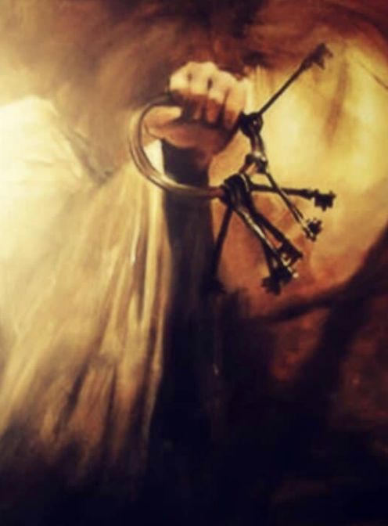
[1 Cor. 15:3,4] Paul gave up his life promoting these basic tenant of the gospel. He believed it – enough to expend His life for it! These apostolic claims are central to Christianity! Christians believe the unbelievable! But certainly not without reason, or good evidence! Some of the greatest minds in the last two thousand years have believed, and have spent a lifetime collecting evidences and rationales for why they believed the unbelievable! *I once had a long conversation with a pastor of another denomination – a liberal one. He was unusual in his denomination, and actually was in trouble with his lesbian bishop because he believed in at least some of the miracles of Jesus – not all - but some of them. He did not believe in the inerrancy of scripture, and was actually one of those that believed that the disciples and later Christians made up at least some of the miracle stories! I couldn’t get him to explain how he knew which ones were real and which ones were made up, but he did use some formula for determining a biblical story’s authenticity. BUT,.. I was relieved when he told me that one of the stories that he adamantly believed was the resurrection of Jesus! Even he knew that the resurrection was one of the central tenants of Christianity,.. AND,.. that, as preposterous as the idea of resurrection from the dead is, in this case, it was believable! In fact, the only way to not believe is if someone is determined not to believe! The truth is that if one will not believe the evidence, there can be no persuading them. *If a person just will not to believe, even gravity cannot be proven! ~The actual basis for the Christian rationale for believing in the miracles/resurrection of Jesus goes all the way back to,.. belief in creation! We believe that the complex, chaotic-yet-structured workings of physics on earth and in the vast universe did not just happen! Especially organic organization and it’s complexity even in a single cell, simply does not happen out of,.. nothing! Even scientists admit that there is not a chance of that ever happening,.. EVER! So with no evidence that it ever could happen,.. NONE,.. it takes far more faith to believe science’s theories, than to believe the biblical account of creation! Instead, we believe in an all-knowing, all-powerful, eternally pre-existent Creator, who created,.. and our evidence of His existence surrounds us – “The Heavens (and earth) declare the glory of God” – and if we believe, as the Bible portrays, that science verifies that He created the incredible array of life on this planet, and that death was the terrible penalty for the rebellion and separation of humankind from their Creator,.. then it is logical that He possesses the power of life,.. and death! Believing that, it is rational and logical to believe in ALL the miracles of Jesus! It would be a rather simple thing for the one who would have conceived of the building blocks of matter and of living things, and spoke them into existence, to have commanded small alterations, especially correcting imperfection of the fall in His own creations. To us it looks like a miracle. To Him it was just another act of creation! ~[John 1:1,2] - John says here that Jesus (The Word) was the Creator! We know from other biblical passages that the God the Father and the Holy Spirit were also fulfilling their roles in creation! So then - in the Bible’s New Testament, we learn that all three members of the Godhead were also involved in the resurrection! Jesus raised Himself (Jn. 10:17,18), the Father raised him (Gal. 1:1), and the Holy Spirit raised Him from the dead (1 Pet. 3:18). Acts 2:24 says that “GOD” raised Jesus from the dead! In [*Rev. 1:18] Jesus proclaims to John, the observer, that he hold the keys to death and hell – imagery for the fact that He can “unlock” death if He needs to – and He proved that He could!

Slide 4
So believing in creation and in a Creator is the prerequisite for believing in the resurrection of Jesus, the Creator, from the dead. Then, everything makes sense! Jesus earned the keys to unlock death by, Himself, returning to life! If we have a God who can do anything He wants – with the universe itself as proof of it – and who comes equipped with omnipotence - then He can surely bring off a powerful resurrection – unlocking death for Himself, and promising to do the same for His followers, gifting them with life after death – with the resurrection of their own bodies, and with “eternal life” for body and soul! All the Miracles, and especially the resurrection, were also necessary for verifying that everything that Jesus said and did during His ministry years – all the otherwise preposterous claims He made were not preposterous after all, but absolutely legitimate! They were true! That means that when He forgave the paralytic’s sins – the guy that was lowered through the roof by his friends - He actually could forgive His sins when He said the man’s sins were forgiven! It was stated by His enemies who heard Him say this, that only God can forgive and eradicate sins [Mark 2:5-7]! The undeniable inference is that Jesus is God! This also means that when He was worshipped - by Thomas (“My Lord and my God!”), by Peter – “You are the Christ, the Son of God” and many others, He accepted that worship without giving rebuttal! It means that He was either a cynical fraud, or He was completely,.. God! But it is the resurrection that is the ultimate proof that He couldn’t have been a trickster and a fraud! Many safeguards were taken by the enemies of Jesus, who strongly suspected His disciples would try to pull a fast one – like, fake a resurrection! His disciples were severely disillusioned by the death of Jesus on the cross – too much so to try an elaborate hoax! That doesn’t make sense! They were defeated, afraid, DONE! No,.. they had no hoax in them! ~So, for Jesus to die and actually come back to life, which He clearly did,.. meant that He had to have had the complete approval of Almighty God the Father for EVERYTHING He had done and said! So, the resurrection WAS God’s final stamp of approval! After the resurrection, it just makes sense to go where the evidence leads – that He was God and that as God, He could do what He said He came to do – deal with our sin! Sin is the BIG issue here! God was finding a way to forgive our sins – to deal with them appropriately and with finality, that we might be reconciled with Him! At the cross Jesus accomplished it – He dealt with our sin – and then, the empty tomb verifies and validates it! And if He had the authority and approval of God the Father to forgive people’s sin back then,.. Then He can certainly forgive my sin, and yours today! ~And finally, one last, but essential thing - the resurrection is our assurance that Jesus is personal! The faith we have in Jesus is not just a belief system stuck in the pages of a book! The empty tomb means that Jesus is alive eternally! Now – importantly – we LEARN about Jesus from the Apostles accounts in the pages of the scriptures, but we experience Him in real time and in real relationship! In this daily relationship, we are learning to love and appreciate Him more and more! We confess our sins to Him, we pray to Him and ask for His help and His guidance! We actually feel His presence, and find comfort and assurance in it! We daily - moment by moment - live to obey and please Him - live to make Him smile!

