Slide 1

Proverbs 13:20 – Impact: The Friends We Choose!
~ Uncommon ~ The Common Sense of God Wisdom for Beginners

Slide 2
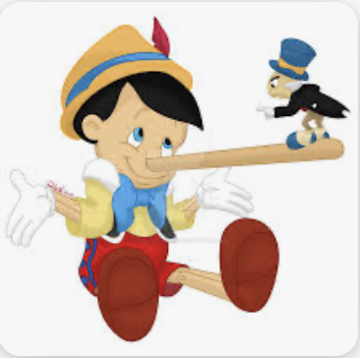
[Proverbs 13:20; Rom. 2:14,15] There is a moral capacity in humanity, but as children, very undeveloped. So we know a basic something about right and wrong without anyone have to explain it to us. At an early age, we already know what we like and don’t like in the way that other people’s treat us! For instance, we don’t like to be lied to, and we don’t like to be stolen from, and we certainly would not like to be murdered. We will always know this. But, although we know, purely instinctively, that these things are wrong if other people do them to us,.. we still have to learn that it is wrong to do these things to other people! We don’t know that instinctively. We have to learn that from outside sources not from inside ourselves. So the development of morality and the character that goes with it depends upon who is doing the influencing. *The Comanche Indians were taught from infancy that that stealing another tribe’s horses was one of the highest skills a man could develop. On the other hand, it was terribly immoral to steal anything from one’s own tribe! It was so immoral, so unthinkable to steal from a tribe member, that the crime of theft in the village was virtually non-existent! They certainly did not have to put locks on their teepees! At the same time, they were taught from childhood on up, that the highest form of entertainment there was in life was to exact the most creative and excruciatingly painful tortures of one’s captive enemies! I won't describe what they did to members of rival tribes when they were captured, or to the white settlers. You can Google it if you have a very strong stomach! Mercy toward one’s enemies was unknown! But, again, they treated their fellow tribesman with respect, were generally good toward each other. So they DID know right from wrong to a certain degree. Now, that tribe certainly did not have a lock on a mixed-up sense of morality among the thousands of societies with their own cultures and their own rules across the face of this planet! There are a great many very twisted value systems out there that would leave us shaking our heads in wonder, and disgust! But the question is: how does this happen?! Well, it is an easily observable fact that virtually all moral development from childhood on, is learned from sources outside of ourselves, good sources, or bad. *Many of us might remember the children’s morality tale of Pinocchio. A lonely woodcarver named Geppetto lovingly carved a wooden marionette puppet out of wood. As he admired his finished work, he really wanted the puppet to be able to be a real son so badly that one night he “wished upon a star”, and the blue fairy (I’m sure you know about her) heard his lonely wish - and granted it! The puppet was given life, with a catch. He was still a wooden puppet! Self-animated, but still made of wood. But eventually, this just wasn’t enough! Both Geppetto and Pinocchio wanted Pinocchio to be a real, flesh-and-blood human boy! So, after another wish upon a star, and the blue fairy returned. She told Pinocchio that he could become a real boy if he became a good boy. When she gave him life, the blue fairy also gave Pinocchio a companion named Jiminy Cricket who served as Pinocchio’s conscience – his moral guide. Jiminy Cricket was there to help Pinocchio to make good decisions and become a good boy! As a side note, I learned while researching this that the name, “Jiminy Cricket”, was not chosen randomly. It was actually a common euphemism for the name Jesus Christ! Already at the beginning of the 1800s people were using the name “Jiminy Cricket” instead of taking the name of Jesus Christ in vain! Interesting, right?! It was back when Disney company made at least a show of having a moral conscience, and they knew where to go to Jesus for a true picture of right and wrong! Anyway, as rambunctious boys normally do, Pinocchio often went against Jiminy’s moral urgings because he was kind of a naughty boy at heart. But each infraction earned him trouble that he didn’t like - like his wooden nose magically growing longer every time he lied! Anyway - through a series of adventures and mis-adventures, Pinocchio learned truthfulness, courage, and self-sacrifice, and finally earned his true boyhood… and,.. of course,.. they lived happily ever after! But the story is a good example of this principle in [Prov. 13:20]. Geppetto and the moral voice of Jiminy Cricket exerted great influence on Pinocchio become a good boy. Parents and loyal friends so often do.

Slide 3

Listen, everyone has to learn to distinguish good from evil in their life, and they have to decide who they want to become. Solomon’s proverb points out just how influential the people we have around us actually are on who we are becoming. *As a kid, I was the self-conscious type - so I remember trying to copy the way one kid in my class walked, because I thought his walk looked the best. And I tried to copy another kid’s laugh, because my own laugh did not sound good to me. And I tried to copy another kid’s smile because, well, quite frankly, I wasn’t sure what how exactly my smile should be, and anyway, I liked his smile better than my own! Of course, I ended up not looking like these other kids at all, but my own version of their mannerisms. But when I think back, I really can’t believe how friends and classmates influenced who I was becoming. *I have told you before that my brother was a huge influence in my life. He pitched in Little League and he pitched on the all-star team. So ten years later, I came along, and I became a Little League pitcher, and was successful enough to also earn a spot on that same all-star team that my brother had been on. However, my brother did not continue on in organized baseball while I did – all the way up through high school and a year in college, before getting married. I also played football on the same high school team my brother had, ten years before. Then I went to the same Bible school my brother had gone to, and eventually became a pastor as he had. I wasn’t just following him. Actually, I think we just happened to have a lot of the same interests. I think that I would have done sports even if he had never picked up a ball, because I just loved the competition of sports and testing myself! I played high school basketball which he never did. And I went to the Bible school where he had gone mainly because we would visit him a few times, so, I was familiar with that school, making it the least scary option for me as I went out on my own. (Glad I did, because that is where I met my wife-to-be, Karen). So, it turns out that I wasn’t just following him in everything. But it did help that he showed me much love and approval as my big brother, always asking about my exploits on the playing field, or talking theology with me for hours on end. I responded well to his love and interest in me, by loving and admiring him! God surely used him in my life as I was in the process of becoming who I was to become! Maybe it was because I saw him as a worthy person to try to be like, that I never wanted to hang out with the kids that were trouble in our neighborhood or at school. I always avoided those kids. They may have ruled the roost in high school, but they had absolutely no appeal to me, and I was big and strong enough that I didn’t have to worry about trying to defend myself against them. So I just instinctively kept my distance – and it was probably just self-protection. But how different my life would have been if those kids had appealed to me! I probably would have turned out to be someone quite different from who I did become! Different influencers, and I might never have become a pastor, or even a Christian for that matter! Because Solomon is right, and the wrong people will never have no effect! They will always have some effect, and even a little bad influence can really throw off the trajectory of a person’s life!

Slide 4
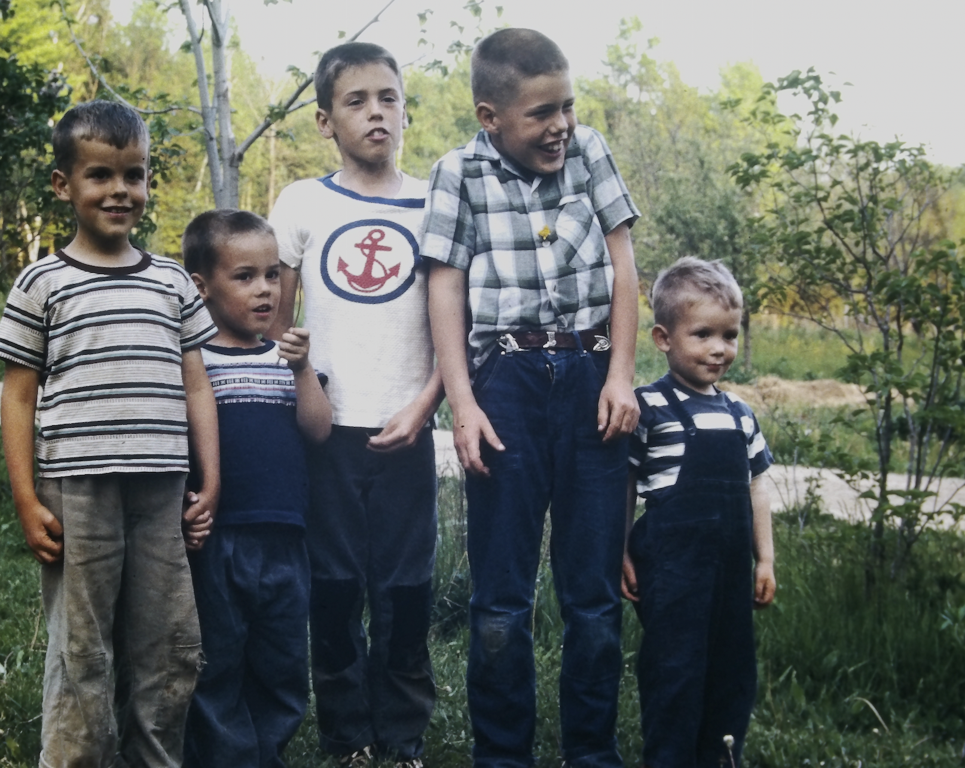
~Family is always a part of this social equation, of course. You don’t get to pick your family and, as I have experienced, they generally have a profound influence on what type of person we become. Many come up through harsh family circumstances, unfortunately, with little love and much fear and even violence! Some people go bad under the influence of bad parenting, and the cruelty of mean and jealous siblings, but a few actually learn the opposite, rejecting the modeling they see from their parents, or cruel siblings, and repulsed and ashamed of such behavior, they seek to be unlike them! Its actually kind of unusual though. Most people just go with family traits making a choice, without consciously making a choice. In Chap. 13 here, Solomon mentions human traits of pride, and dishonesty, rebellion, mocking, unfaithfulness, pretending, all common human characteristics of a large human subset that Solomon calls “the foolish”, or “fools”. But vs 20, I think, is central to it all! Family and friends can have a profound influence on us. What we come to admire in them will rub off on us and we come to share traits with them! You have heard the expression “birds of a feather flock together”. If you are not a troubled person but those you tend to you hang out with, are – you will soon become a troubled person yourself! It is almost inevitable! If you hang out with good people – kind-hearted, generous, peace-loving, faithful, genuine people – they will affect you to be as they are! But,.. it is a choice, and it has to be one or the other. It can’t be both! Wisdom and folly repel each other, as good and evil does! On a personal level, the evil man despises the goodness of the good man, and the good man is repelled by the folly of the evil man. You simply can’t have it both ways! It’s impossible! So one has to choose! ~I wonder if that is why Jesus refers to His disciples as His “friends”. He was spending His time with them for 3 ½ years, influencing them with His teaching and by His example and by being their friend. They were certainly different men at the end of those years together than they were at the beginning! Listen, Jesus is the one we need to hang out with! I speak to Him all the time! He is not my imaginary friend, but my risen Savior who I want to be like. When I gave my heart to Him, I welcomed His influence upon my life with open arms! I know that I need Him, and I will never stop needing Him! Without Him, I will be influenced by someone else, and I don’t want that! I want the best, and He is the best! So when we acknowledge Him in all we do and say, we are including Him in our developing personality! I also hang out with friends, who are friends of Jesus! He has made His followers “birds of a feather”. I admire and respect Christ’s handiwork in their lives! It’s why I like hanging with Christ-followers! They inspire me [1 Cor. 11:1]! I can hang out with people who are not Christ-followers, and I can be genuine and loyal friends with them, but where I know I belong is with people who are deeply involved in the process of becoming more like Jesus! [Prov. 18:24] The ultimate friendship – the unfailing love and loyalty of God

