Slide 1

Proverbs 16:2,4,9,25 – The Weight of Motivation!
~ Uncommon ~ The Common Sense of God Wisdom for Beginners

Slide 2

An earthly courtroom judge will not typically pass sentence on a person’s motives. Bad motives are not against the law of the land. An earthly judge cannot really discern a person’s motives because he cannot see into a person’s heart. He/she can speculate based upon concrete evidence, but he or she cannot know for sure! So a judge does not pass sentence based on motives. Intentions, on the other hand - if they can be somehow proven, are a different matter. Intentions will determine, for instance, whether a killing is first degree murder, second degree, or manslaughter – with mitigating factors such as prior convictions also factored in - which will make a big difference in sentencing! If it can be shown that a killing was premeditated/ planned – well, that’s 1st degree murder. You will go to prison for a minimum of 20 years to life in prison! You may never get out! If a killing was unplanned but happened in a fit of passion, well, that’s 2nd degree murder! The law will possibly give a half the sentence of first degree. If someone died as a result of careless or reckless behavior, that is manslaughter – which will usually get you 1-4 years behind bars! Now, when solving a murder case, investigators must try find a motive behind the crime. Finding a MOTIVE for murder is a part of the investigatory process. But after the trial is concluded, motive is usually not part of the sentencing process! But, to the contrary, to God – the Supreme Judge over all humankind – motives ARE paramount – especially when judging the actions of His own people! Now, it seems that God is not at all sympathetic to our motives when we do wrong. He doesn’t cares about the motives of sin – but just whether they are committed. Motives to sin would fall under the category of temptations. Temptations are not sin. Giving into temptation is! ~But, interestingly enough, motives certainly are assessed by God when we do what is right! God is very much interested in WHY we have done a good or right thing! Now,.. we are not used to being judged when we do what is right! After all, what does it matter – just as long as we did right! But God knows so much more about us than an earthly judge does. God reads the depths of the human heart! The heart tells Him who we really are! Actions do not tell Him as much about us as motives do. So our good works may accomplish good things, but, our motive might be all wrong! For instance, a Christian might desire to capitalize on a good or generous act for our own self-aggrandizement – in other words, we did something good to show everyone what a good person we are so that we gain the admiration and respect of others! *Celebrities are an easy and obvious example of this. They are so self-absorbed, and their personal space is so often taken up by fawning, groveling companions (who are using them for their own purposes), that they don’t even have a clue regarding how transparent their selfish motives are when they are “righteousness posturing”. They don’t really want to do good. They want what doing good will do – for themselves! They want to see their selfies on Facebook, or X, or TikTok, with their attractive face in the foreground and their latest righteousness project in the background!! Then everyone responds with what a wonderful person they are. It’s yukky to tell you the truth! As Christ-followers, we are asked to assess our own heart and judge both our bad behavior (sins), AND our motives for good behavior, because a bad motive for good behavior can be as repulsive in the eyes of God as sinful behavior – [1 Cor 4:3-5]!

Slide 3
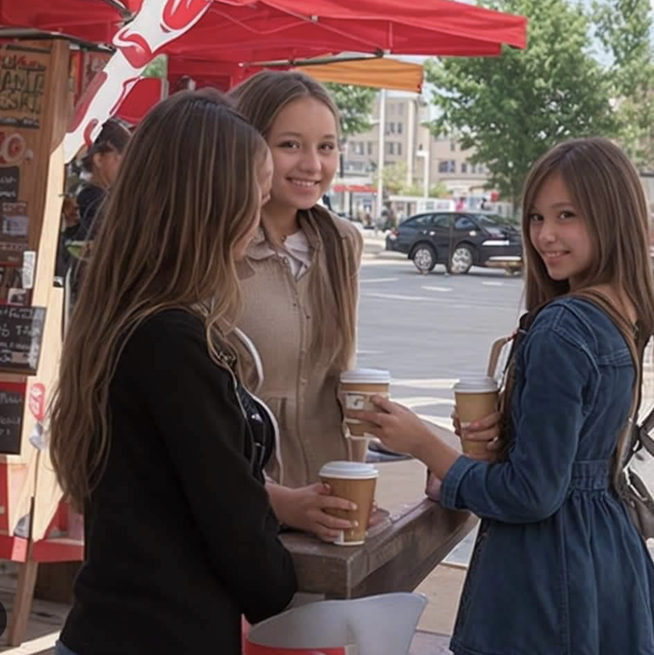
Paul speaks of judgment for the works of the saints. The way that I see scripture, I cannot find a bit of evidence that the sins of true Christ-followers will be judged by God! When we place our trust in the person of Jesus and His work on the cross, both the guilt and penalty of our sins are taken from us, and we are placed in the center of Christ for safe- keeping. When the Spirit of God does that, we are clean in the view of God – as clean as His own Son – and prepared to enter His heaven at any given moment. We are saved unto God - saved from His unerring justice, and saved into His eternal love! But 1 Cor. 5:10 says that we will be “judged for everything we have done whether good or bad” (some translations say “good or evil”). But if everything bad/evil that we have done has been paid for by the shed blood of Jesus, then we will NEVER have to answer for it under God’s justice! It has already been answered for! Jesus died so that we could be saved from death and from Divine justice! He died so that we could live and be taken with Him into immortality and transported to His heavenly home where we are to remain forever! Our sins will be remembered no more. They have been removed from us and placed upon the crucified Christ! So, no, Paul cannot be meaning that Christ-followers will be judged for their sins. Let me put it this way. We will be judged – yes – but all judgment will be referred to the surrogate punishment that was inflicted upon Jesus! He was judged and punished for my sins! And He is enough! His punishment is all that is required by God! It does not seem fair. But it is in God’s eyes! Sin is paid for, and I didn’t pay it! He did! All we can do is be utterly grateful! Oh,.. and trust Him enough to proclaim Him our Leader, Teacher, Guide, Master, and our overriding Reason for living! I give myself to Him as He gave Himself for me! From now on, His purposes superimpose themselves over my purposes. The word “superimpose” means to place or lay one thing over another so that both are can still be seen. They are merged! Taking on the will of God and His purposes and laying over my will and my purposes does not entirely eradicate my own self. I/you will remain intact – and probably too intact! But His character and His will is on top – pre-eminent, while my will fades into the background. As John the Baptist the great prophet, taught - “He must increase, but I must decrease”! ~So under those conditions, my sins cannot be judged because they already have been at the cross. BUT,.. BUT,.. my motives for the good things that I do in the name of Jesus can be judged by God, and will be! When I become “saved”, I have made an agreement with God. My life is His! I’ve turned it over to Him. It now belongs to Him! I don’t get to be whoever I want to be. I don’t get to do whatever I want to do. I don’t even get to feel any way that I want! It is all subject to what I know HE wants! His image is superimposed over mine – emphasis OVER mine! His image is predominant, and mine, while still there, is more and more in the background – and this is how I want it to be with all my heart – and this is how it should be! So what does that mean in practical terms? It means that if I revert back to the me-centered life, and I make a practice of using Jesus for my own ends, to gain recognition I’ve always dreamed of, to hear the applause, to get the respect my ego craves, to climb the social ladder of the church, to be prominent in the wider Christian community, to gain control over others, to use people to my own advantage,.. Why - all of that will be judged! If that is all it was really about, He will say on judgment day - “Depart from me – I NEVER knew you”. If it was about a true Christ-follower losing their way, then that person will not lose eternal life with God in His heaven. But they will lose their reward!

Slide 4
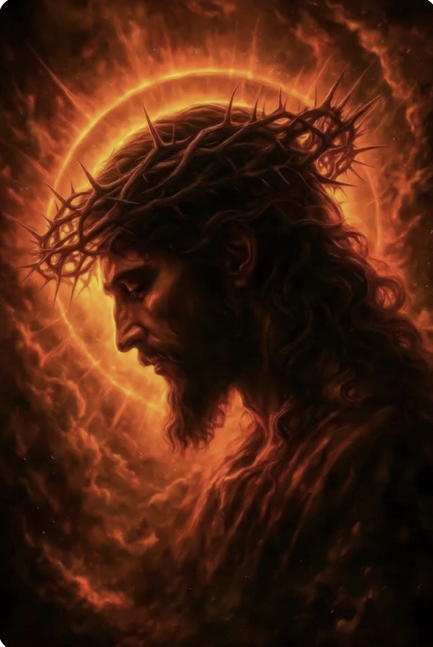
So, when Solomon says that “all a person’s ways seem right to them, but that their motives are weighed by the Lord”, it is talking directly to us! This is personal! We shouldn’t be thinking of anyone else’s motives right now, but only about ourselves and our motives in doing anything in the church, or community, in the Name of Jesus! Any personal sacrifice, any good work that would pass as service to Christ – from pastoring, to teaching Sunday School, to serving on the worship team, to mowing lawn or cleaning a widow’s yard, to fasting and praying, to even studying the Bible, and everything in-between – if our motives are weighed by the Lord and they are more about gaining an advantage or an edge for ourselves than they are about actually serving Jesus out of love, gratitude, we will have a problem! And one day, the scriptures say, we will stand before Jesus, and He will say to some - “Well done, good and faithful servant”. Others will plead with Him, and bring up their feats of service, and their sacrifices, and their biggest achievements, and He will turn to them and say those dreadful words – “Depart from me, YOU WORKERS OF INIQUITY – I NEVER knew you”!! Why?! Well, because their works are the same as the good and faithful servants,.. but the heart is not the same! The motives were not what they should have been. *The book of Acts records the story of Simon the Sorcerer. [Acts 8:9-24] So Simon had come to belief in Jesus. He was amazed by the miracles that he had witnessed the apostles do in the name of Jesus! They were undeniable miracles, healings of people long known in the community. These were not tricks, and as a magician, Simon was very intrigued, and his mind was turning it over and scheming – looking for a way to capitalize on this new phenomenon! So he went to Peter and John and offered to pay them to lay their hands upon him so that he might be filled with the Holy Spirit. He wanted the power! And it was for doing good things like healing the sick or injured! Can that be so bad?! Well,.. yes! Peter rebukes him in the harshest terms and tell him his heart is not right before the God whose Divine eyes that see right through a person to the most private thoughts and inner conversations of the heart! It was revealed to Peter that Simon was more interested in using Jesus to catapult himself into greater prominence, greater influence, and more affluence, riding this wave of religious fervor in this Jesus movement! And the Holy Spirit revealed to Peter that this “believer” was totally compromised! *I remember once, a person coming to me and telling me that they felt they were born to be on stage! Then proceeded to tell me that they saw themselves up on stage with our worship team! Needless to say, that wasn’t going to happen! You see, when we serve Jesus, it must be from the purest motives, unselfish motives! It should be out of love for people and out of love for Christ! And that’s it! We are not looking for higher social status, or for greater respect, or even for a pat on the back! We are ONLY looking forward to the day when Jesus Himself looks us in the eye and says, “Well done, good and faithful servant!” What everyone else says down here in the earthly realms does not matter! Oh, certainly we should be gracious and thankful when someone says something nice about us and shows their appreciation, and is trying to encourage us. This is of God too, and we should express gratitude and encouragement to each other because it is the right thing to do! This is appropriate and good for the soul! If we don’t do that, it bad for the soul! But if we are on the receiving end of complimentary language, we need to talk ourselves out of beginning to believe that we are anyone special! Now, being special, and having a great desire to be recognized as being special are two different things! I appreciate every time someone tells me a sermon or a song spoke to them/helped them - and good for them for expressing it. But NO Christian leader can serve Christ for the sake of acclaim and respect! If we seek it, we are compromised! Again, if it is given as encouragement, it is only right. If it is given as flattery, that’s just wrong! But I can’t demand it or ever expect it! Anyone serving Christ must guard their heart against all forms of pride or self aggrandizement. It is a detestable, shameful thing and can not be allowed to gain a hold on us! We can be encouraged each other so we do a better job! That is a good thing to do! But I only seek it/only NEED it from the mouth of Jesus! This motivates and drives me to do my very best in the service of my Savior and Leader, Jesus Christ! [1 Cor. 3:10-15]

Slide 5
Everything I Do – Brian Adams
Look into my eyes
You will see, what you mean to me
Search your heart, search your soul
When you find me there, you'll search no more
Don't tell me it's not worth trying for
You can't tell me it's not worth dying for
You know it's true (you know it's true)
Everything I do, I do it for you
Look into your heart, you will find
There is nothing there to hide
Take me as I am (take me as I am)
Take my life
I would give it all, I would sacrifice
Don't tell me it's not worth fighting for
I can't help it, there's nothing I want more
You know it's true
Everything I do, I do it for you
There is no love, like your love
And no other, could give me more love
There's nowhere, unless you're there
All the time, all the way
Everything I do
You can't tell me it's not worth trying for
Just can't help it, there's nothing in the world I want more
Oh, I would fight for you, yeah I’d die for you
Walk the wire for you, yeah I'd die for you
You know it's true
Everything I do - I do it for you

