Slide 1
Proverbs 16:6,7 – Through Love and Faithfulness!
~ Uncommon ~ The Common Sense of God Wisdom for Beginners
Happy Father’s Day!!

Slide 2
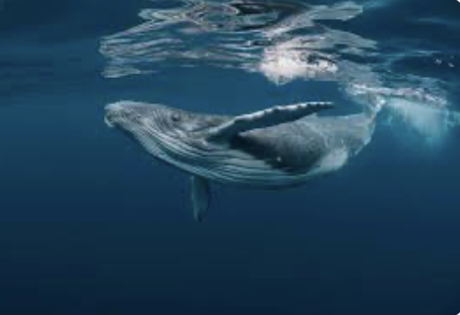
The sins and flaws of the fathers
Passing on our traits
Jesus frees us from our deficiencies / replaces them with His traits!
[Heb. 12:14] - The mandate!
The process of sanctification
The need to surface (at church)

Slide 3
Christ-followers – “in the world but are not of it”
Church - where we inhale blessing & are restored!
Skip one week, and you must wait two weeks to inhale - or three (try that in real life)!
Church - where we practice, perfecting love, openness, authenticity!
The world – blessed where/when we exhale [Zechariah 8:23]
FAMILY
Prov. 16:6 - the “love and faithfulness” - the strength of a wise man
Parental testimony – 1st visual of our children

Slide 4
*Living with a flawed but changed man!
Jesus within Him was strong and wise
The peace of God – Prov. 16:6,7 – “…and by the fear of the Lord men depart from evil. When a man’s ways please the LORD, He makes (even) their enemies to make peace with them”.
Creating the peace of God at home first
Building a convincing case to believe!

