Slide 1
‘
Proverbs 17:5 – Respect/Contempt!
~ Uncommon ~ The Common Sense of God Wisdom for Beginners

Slide 2
When I was growing up, I would see people with various disabilities, wheelchair bound, deformities, obvious mental deficiencies, pronounced nerve disease with spastic motions, skin diseases, and for the strangest, most disturbingly incomprehensible reason, it triggered a sense of irritation in me. I would often back up and whip myself mentally for even an involuntary reaction like that. I certainly knew better, and it put me in touch with the fact that I could be a very bad person if it was not for what Jesus had done for me. Yet, I did have those feelings - as unjust and unfair as they were. But it was Jesus that had put me in touch with the fact that those feelings were wrong and, in fact, evil! I would feel ashamed, and sorry, and I would talk to God about how confusing it was that those feeling were still in me! I also knew that this was not uncommon. Now - I wanted to be different than other kids, but in my heart I knew I wasn’t. At the public school, anyone that was disabled, mentally or physically, was teased and made the butt of jokes by many if not most of the kids! I did not join in on such mob behavior, and in fact, defended many a loner who was being picked on. But I could have done more! It grieves me now that I did not do more for those kids! I should have befriended them, but I really didn’t do that! I was friendly with them, but did not try to be the one thing they needed – a friend! I can’t imagine the pain of their seclusion and loneliness, and I should have done more for those hurting people! I also noticed that many, if not most of them, began school as really nice, open-hearted kids, and that many of them ended high school as bitter, cynical, angry people who basically didn’t like people anymore! ~This whole thing of bullying and picking on people that cannot defend themselves is so animalistic. *One time when I was visiting my grandparents farm, I was watching the chickens in their big coop, and I saw a chicken that was looking pretty beat up. It had bare, angry red patches on it’s body where there were no feathers growing. Then I saw a group of healthy strong-bodied chickens sneaking up on it. They ended up chasing it all around the fenced in yard, pecking, and pecking, and pecking at it’s bare spots until, finally, after a long time they got tired of it. It was hard to watch, and I asked my grandpa about it. He said that chickens tend to sense weakness in some of their population, even when it is not apparent to the human eye. And although it seemed cruel, they were weeding out the weaker members of the flock. But, I remember thinking that humans were not really very different from this at all! Certainly not from the cruelties I had witnessed in the public schools! It was a “pecking order” right from the barn yard! I hated it, yet,.. I also knew that I had that very capacity for cruelty in me – as part of my nature! I did not like that thought, believe me. So, for decades now, I have hurt when I have passed someone in a wheelchair, or with obvious disabilities! Now I will often whisper a prayer for them and ask God for a cure for these afflictions, as He has given us so many amazing medical miracles in the last 100 years or so. I do the same thing when I see an ambulance speeding past to some emergency somewhere down the road – I pray for whoever might be in a medical emergency! Jesus changes human hearts and minds and heals that cruel and animalistic “fallenness” in us! ~I think that verse 5 of this chapter addresses this great evil in the world! People without Jesus working on their core character can be incredibly cruel! There is nothing/no one holding their cruel tendencies back. But it is clear that the Great Creator will not abide by this in His people! He views a sneer, or an insult to the downtrodden as an insult to Himself! This verse refers specifically to poverty, and the tendency of people to look down on the poor, and not give them the respect that they would tend to give others. It is a pathetic thing!

Slide 3
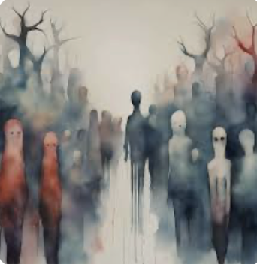
~But then we see Jesus, our example, and how he dealt with the poor, the sick, the hurting, and He was a wonder in contrast to the human norm! His enthusiasm for using His Divine creation power to heal the diseased, the deformed, the wounded, the disabled, the sick, or even the dead, was infectious to his disciples! [Acts 5:12-16]. This was a big part of how God gave the church it’s amazing and miraculous jumpstart in the first century A.D., when thousands came to faith in Jesus the Christ because the mantle of His power had been transferred over to His disciples! Not one of them went off the rails with this newfound superpower and used it to accumulate money, or concubines, or political power, or acclaim. In fact, they were often persecuted and forced to go into hiding because of fierce opposition from governmental authorities, everywhere they went. Their power continued to be primarily used upon the voiceless masses of the poor and needy who flocked to them! The rich and privileged rarely lowered themselves to mingle with such crowds. They had to maintain their false appearances of aristocracy, of being above all the pathetic, desperate, grasping need of the teeming masses of the very poor! So they mainly stayed away. These were the very people that could and would have paved the way to power and influence in society for the apostles, if only those apostles had cared the least bit about wealth, power, or influence! No, they turned their attentions to the masses who had no voice. Remember that there were no American-style republics or democracies at that time and would not be for most of 1800 years after that! People had no vote and no voice! They just wanted some food for their next meal, and some rags for their backs, and shelter from the hot sun over their heads! Medicine in that day was more likely to harm than offer any help for their ailments – and they certainly had more medical problems back then than we do today! Their life expectancy due to diet and disease, was generally half of what it is today! It was to these people - impoverished in every way - that the apostles gave their attentions to – and so these people flocked to wherever these church leaders were holding these huge open air meetings! And they didn’t start out these gatherings with amazing worship band performances with light shows and smoke! As far as we know, there was no music at all! Imagine that! They simply healed and helped. They helped the poor people, the beggars, the slaves, the women,.. and then preached the gospel of Jesus Christ to these huge audiences that needed Him for their empty souls, even more than they needed food or physical healing! But it was the gospel of Jesus the Christ that the aristocracy and the religious and political powers-that-be opposed so vehemently, and violently! Just as Jesus had said to his disciples while he yet walked with them, ”Light has come into the world, but men prefer darkness over light because their deeds (and thoughts) are evil”. They couldn’t stand to watch the apostles. It threatened their control of the masses! [Mark 13:9-13]! The people that belong to this world - that prefer darkness to light - they notice that Christ-followers are different than they are. We have a belief system in place already. They cannot coerce, or intimidate, or deceive, because we know too much – we know better! That puts us on the same footing with all the other social rejects - by their way of thinking – worse even, because we oppose their foolishness and destructiveness! I mean, these people in this country can get all emotional about abused or hurt animals, but have you noticed how disinterested the media are about the victims of human sex trafficking in America – a terrible percentage of them being children?! Or organ harvesting in China! Yet, mostly “crickets” from the mainstream media! This is the skewed perspective of people that have made themselves into fools! As Romans 1:21 says – “Thinking themselves wise, they became fools!”

Slide 4
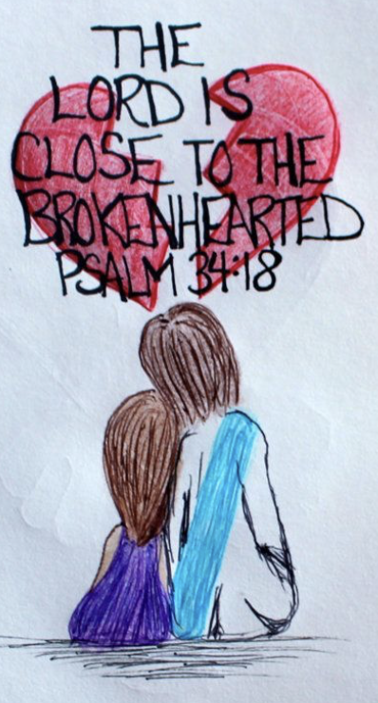
Christians learn to oppose their fallen human nature and to confess it – to renounce it and replace it with the attitude of Christ! This pleases God, because when you look down on anyone, it is like looking down on the Creator Himself who made them! It is not that He made things imperfect, but it is we who can take the credit for that! We ruined His creation by trying to usurp His supremacy over creation, and bringing down a curse of partial ruination upon the world! The fool blames God for his or her trials and limitations in this life, while the wise recognize that humans are victims of own human rebellious spirit! We should feel terrible about the role of humanity in this sad spoilage of creation, with its many natural ways to kill or injure – and that’s just natural spoilage. Then there are all the victims of self- inflicted suffering - human aggression, abuse, or neglect – war, oppression, starvation, human trafficking, abuse within families, and hundreds of other diabolical ways that humans can, and have, come up with, to cooperate with Satan and to seriously hurt and even destroy each other! ~But Jesus ~Christ-followers, on the other hand, are ”salt” and ”light” in this world [Matt. 5:13-16]. “Salt” – making an unsavory world more palatable to its Creator, who is very disappointed with His sixth-day creation. So, on His behalf, we are bringing relief where we can. “Light” means that we are harbingers of the guiding truth of the Creator/God to the world. ~We are always “gospelors”, however, bringing the “gospel” along with our practical relief work. It is never just relief work for us. We WANT to help people where we can, but we are who we are, and we must connect it to the gospel – the best thing that has EVER happened to this fallen and warped place! In the gospel, people find value, because they discover that they are actually loved, valued, and WANTED by their Creator! They also find a solid and unchangeable identity in Jesus! People need an identity other than that of an abusive family, or their preferred sexual identity, or the identity they get from the social pressure of their peers to look or dress a certain way, or to hold certain political views, or by their social media presence, or from their faithless friends at school! That is no way to form and identity! No, the gospel frees us from all the insanity and instability of the culture/world, and brings into the sanity and stability of God! In a world that has no satisfactory answers about virtually anything, we have answers. I mean THE answer! We really do! The world is cynical toward us and our answers, but we can be proud of the fact that some of the best minds that have ever existed on this planet have analyzed the Bible and its truths and have reasoned out that they are, indeed, the only truth that makes cohesive and conclusive sense. The world says that this is taken by unreasoning faith! But the Bible is the most analyzed, scrutinized, clarified, contextualized, dissected, explained books in all of human history! And this is all for “whosoever will”. It is offered first to the broken, and the broken-hearted, because these have discovered in their brokenness that they are not enough, and not in control, and in need of the love and acceptance of the God who made them! Remember that next time you look upon someone less fortunate that you are. Remember that God loves soft hearts who greatest ambition is to honor Him with a changed heart – one becoming like His own!

