Slide 1

‘
Proverbs 20:6,7,9 – Hard to Find
~ Uncommon ~ The Common Sense of God Wisdom for Beginners

Slide 2

When I was a kid, I made friends pretty easily. In the neighborhood, at church, at school. We played and laughed a lot. We got into mischief and giggled until our sides hurt! So, I found that I generally liked people. I especially liked people that were fun, and funny. I learned that I could have fun with some adults, but not others. I could joke around with some teachers and I always tried to “entertain” them. I felt like they were my friends too. Aside from some really grouchy teachers, I had a good feeling about the world of humans. People were smart, honorable, talented, interesting. I trusted the police, and my doctor, and scientists, and the media. It was probably the best of times this nation had ever experienced – at least in our part of the country. People were employed, prices were low, divorce was rare. I knew a few bad apples, bullies, liars, creeps, but they were a small minority of people, and they didn’t really count. The people in my life that really counted were good to me. But It never dawned on me that people could be dishonorable, especially my friends. But my mother was reading Bible stories to me every day at that time, and to tell you the truth, a goodly portion of those stories showed another side of humanity. I learned from the Bible, even before I learned by experience, that people were complicated. People could lie a lot. People could be so cruel. People killed each other. People even lied about and killed the only perfect man to ever exist – Jesus – in the cruelest possible way! People persecuted and even killed the amazing apostles and many of the early Christians! My naïve view of humanity was still positive, but becoming less so because I knew people hadn’t changed! But I wasn’t seeing the same things in America! Then I learned history - about WW1, and WW2, and the Korean War! And then there was the Cold War with the Soviet Union and the terrifying nuclear arms race that the USA had with the Soviets that literally threatened the whole earth! ~Closer to home - - then, one of my friends lied to me and betrayed me. I wasn’t use to that! One time when I was with a group of friends, I felt the sting of a friend abandoning me and taking sides with another one in the group. It was hard to believe/handle! Then I watched another one of my close friends from church betray Jesus at school. It crushed me, and I was so disappointed in him. It had never dawned on me that someone could actually do that and live with themselves! And then I found that I too could betray Jesus! I didn’t outwardly betray Him like my friend had, but inwardly I could think terrible thoughts that I knew I should be ashamed of – that Jesus would be disappointed in! And sometimes I didn’t even care. I think I figured that I was young and had time to make up for it. I learned that I could do wrong things secretly, and if undiscovered, still feel like a pretty good Christian boy. I could lie to get my way, or to stay out of trouble, especially if I knew I could get away with it! I could cheat on a test from time to time when I hadn’t studied hard enough, and be relieved when I got a passing grade that I had not earned. I wa slowly, bit by bit, discovering fallen human nature and its sins. It is sins that are the defining trait of the human race! It was hard having my young illusions stripped away. But, life still had its promise. I still lived in a free country where people had basic human rights, and we had the best medical care in the world, our judicial system seemed as just as any judicial system could be, and our educational system was still top notch at the time, and with determination, perseverance, and hard work, a person could become almost anything they set their sights on! So I remained optimistic!

Slide 3

But then I went to Christian college to get some higher education, and learned a lot! I also met up with many bad ideas there, and with those that embraced them as good ideas! It was my most dangerous time! It would have been an easy time to have gone off the rails! But I didn’t, purely because I had a firm foundation in the scriptures and they kept me grounded. They could not teach me perspectives that I already knew not to be true! Then I became a pastor. I was betrayed badly in my first church. It shattered my illusions about the church and working with Christians. I expected more character, less pettiness and gamesmanship, judgmentalism, and I found all of those disappointing human weakness there – but just disguised better. It stayed hidden until stress or conflict, of just plain selfishness made it raise its ugly head! Then, I felt like I was seeing pure evil – because these were people that had been under the teaching of the Gospel, Christ and the apostles, for decades in some cases. So that made their ungodly behavior even more evil than bad behavior coming from people outside of Christ who didn’t really know better. These people knew better, but chose to justify themselves and also chose to try to recruit others to their issues, and support each other in bad attitudes and bad behavior! I did not stay there at that first church for long. Then, my next church was great, until it wasn’t. I loved it there for a few years, and then a handful of people developed an attitude and created a nightmare! I was not expecting that, but it reminded me that ministry is not heaven-on-earth. It is a truly battle against hell and the dark forces of evil that threaten us at every step of the way! The more progress we make at making inroads into accomplishing God’s purposes on earth, the stronger the push against against it from some of the people and,.. from demons! It is not people on the outside of the church that threaten us. The biggest threats come from within – it’s true! It is we ourselves that are the biggest threat! We each carry within us the dark ability to turn on Christ and to align ourselves with those who are working against Him - and feel like we are doing the right thing even as we do the Devil’s work for him! Jesus said – ”By their fruit you will know them”. ~We need to fully comprehend that it is the entirety of one’s life that defines it. *I read a book written by a biblical scholar, Greg Boyd. It was called ”God at War” – a very voluminous/big book. It was arguably the best, most thoroughly researched book on the topic of the spirit realms and their effect on earth that has ever been written! It was just eye opening to all that the Bible has to say on the matter! It was thorough and solid, in my opinion. Then, a few years later, this “scholar” left academia to become the pastor of a large Twin Cities church. And there he changed, and his church became one of the first of the large city churches in America to become “woke” – where there was a new ”gospel” preached – a gospel of social justice – of tolerance, of white guilt, of inclusion, of activism, and so on – right down the line. It made me so sad so see Boyd’s dramatic fall into the abyss of bad ideas! It didn’t make that book any less relevant! I still have it in my library. At the time of its writing, Mr. Boyd was in pretty good shape, it seems to me, so the book remains relevant. But a life is not defined by any particular period of one’s life. It is defined by its entire body of work – by all of its fruit! I could have sworn that Greg Boyd loved Jesus deeply, but later it became obvious that he loved the world more! One day he’ll have a lot to answer for because he did not stay on the path, but became anti-Christ, and in the guise of compassion and justice, he is now separating people from the path to Christ, getting them damned! I still can’t believed it! It is just so all-around SAD! [Matt. 15:8,9] [Prov. 20:6,7]

Slide 4
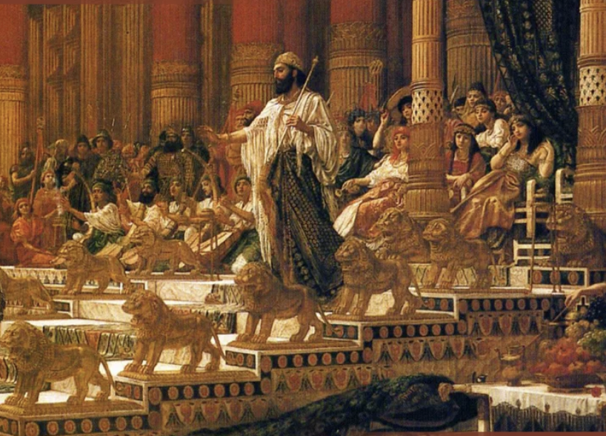
*My father lamented to me toward the end of his life about how most of the men he had looked up to during those first years after he gave his life to Jesus, had ended their last years poorly! The pastor that led my father to Christ was caught having an affair! One former church leader was asked to leave the church because he kept harassing the church secretary and kept asking her for a date. He was in his 80’s and she in her 50’s at the time! Another got, what my father described as, “a bug in his craw” over some minor issue. He made it into a major issue – the church disagreed with him – and he left the church in a huff. Actually, two or three men had done that over the years! The former pastor, who was undoubtedly the best Bible teacher the church ever had, had to be asked to leave because he could not control his own family. At the time, a couple of his boys were unrestrained terrors in the neighborhood – thieves, bullies, trouble-makers - thugs –and it was not just bad, but really bad! It was a very sad time for the church, but the church’s reputation and ability to affect the neighborhood and Wausau community for Jesus was being ruined! Fortunately, his five kids all turned out well in the end, I believe. Anyway,.. one by one, my Dad could recount the downfall of men he had once looked up to in the Lord. Only one man that he had known was faithful to Christ to the end. But even though that man had been his closest friend, my father would put an asterisk* on that case, because that friend had died young – in his early to middle sixties. He didn’t have the extended time he needed to mess up his life and besmirch Christ’s reputation! My father had become a bit cynical from his experience. Not of Christ, mind you, but of people. Yet he continued to obey Christ and love people and continued to do all he could to give them a chance to succeed in the Christian life and to persevere in it, and HE remained faithful to the end! ~So when Solomon writes this generality about a man who claims to love, He was most likely writing from the disappointment of experience with people who claimed love and allegiance, loyalty to the King, but were actually in it for themselves! When the pressure was on in the king’s court (and there was always political pressure and intrigue in the King’s court) they exposed who they really were. There was competition between Solomon’s sons – spoiled-rotten princes - probably a couple of hundred of them at least (having 700 wives), all princes who wanted, somehow, to be the next king! So his sons were most likely loyal to themselves, not their father! This saying might have come out of his experience with his sons, or advisors, or allies, or with childhood friends who had proven to be unfaithful. ~Following Jesus is similar. How many people have taken Jesus on for a time, and then become complacent, or have allowed failure to generally creep into their lives – where they left a favorite sin in their life, and indulged a little, but only on occasion. And then, in the end, it crept up on them and they let it command more of them until their love of Jesus cooled. That “cooling” is inevitable in the presence of unconfessed, un-dealt-with sin! Where sin makes gains, Jesus inevitably loses ground in us! Now we must fill that with something else that makes us feel better – legalism with its extra-biblical rules and regulations, or aberrant/cultic teachings, or woke social gospel and its overbearing sense of a superior righteousness – and any and all of that can suddenly give us the feeling of superior edge on other Christians - so that even if we are failing Christ badly, we still can feel good/superior about ourselves and OUR special brand of Christianity! But, in truth, these are soul-jeopardizing missteps. ~What God wants is for people to stick to the teachings of Christ and His apostles! It… is… enough! We don’t need interesting but gospel re-defining interpretations and practices! *I had a young man recently that wanted to interview me for his podcast. He was traveling all over the United States, ”interviewing” pastors, he said. I was skeptical, but agreed to meet him during the next week. All he really wanted was to argue with me about the idea that New Testament Christians should be upholding the food laws of the Old Testament! I’m like – “Are you kidding me?!” Out of all the things you want to talk with pastors nationwide about, and you choose this? Com’mon man!! That was a two-hour waste of my time! In the end, he has no one to blame but himself! It made me sad, because I liked him, but couldn’t reach him! [Mark 7:14-23] ~The key to longevity in the art of Christ-following is to stay the course and resist the voices that call us this way or that! With the internet, there are far more voices calling to us than ever before in history! But if we know the scriptures, and have a few solid people to trust and bounce questionable things off of, we’ll be protected! Our love will prove faithful! [Rev. 2,3] – “To those who persevere”. - Be faithful!

