Slide 1

‘
Proverbs 21:16,20 – In the Company of the Dead
~ Uncommon ~ The Common Sense of God Wisdom for Beginners

Slide 2

[Text] - There is a small class of people on earth that feel that they must tempt death – who take deliberate risks with their life – thinking that they will not die. These are people that do “extreme sports” - climb cliffs, or that rare breed of climbers that do free-climbing, or, climbing without safety harnesses or ropes, will almost certainly die young- probably about half the thrill-seekers that practice wingsuit skydiving are also going to die young at a vastly higher percentage than people who do not do wingsuit diving or freeclimbing! The wingsuit jumping statistic that has been publicized for the last few years, is one death for every 500 jumps. The ratio of wingsuit base jumping deaths – which is jumping off the top of a tall cliff high on a mountain, or even jumping illegally off the top of a skyscraper – is, as you might expect, much higher that simply wing suiting from a plane. But, these are people that feel that they have to feel the thrill of living on the edge of death before they can feel truly alive! It becomes like an addiction to them! They say they have to do this to feel alive, but ironically/ tragically, a high percentage of even the best of them are headed for a senseless early death! ~On the other hand, someone has said that cowards and worriers have died a thousand deaths before they actually die! Of course everyone dies once, but cowards and hypochondriacs are always thinking they are going to die! So they go through the fear of dying, constantly. I mean, to be truthful, there are 10 thousand ways to die, and most of them are dumb ways to die and entirely avoidable - and it does behoove a person to not take unnecessary risks in life, but it does not help a person to be afraid of everything – including their own shadow! *It can get so that fear will paralyze some people from climbing stairs for fear of falling down them, or will keep them at the sink washing their hands again and again and again – until their skin cracks and bleeds – for fear that they have left even one invisible virus or bacteria on their hands! Some people are afflicted with agoraphobia – where they are deathly afraid to leave their home or apartment. The outside world terrifies them! These poor souls are already in a kind of living death! ~But the best way to live is not just to get close to death, or to avoid accidental or incidental death – but, simply, to live joyfully – to live life with a sense of wonder at even the simple and most common things! *Insects are a wonder – marvelous little creatures – such variety! Ticks, mosquitoes, invasive Asian beetles, not so much. But even spiders are incredible organisms! Birds, animals, fish, trees and vegetation! Fascinating! The laws of physics! The solar system! The ever-expanding macro-universe! And then, there is another whole universe under the microscope – the micro-verse, which keeps growing in it’s minuteness! How could a person not enjoy a life teeming with,.. interest/fascination, sensory and intellectual pleasures almost without end! What kind of a person does not have the presence of mind to appreciate the totality of life on this planet? Who needs to flirt with death to feel alive! Or, on the other hand is too afraid to enjoy it! Both extremes are forms of mental illness! But joy… joy is a different dimension to life on this planet! Joy is emotional/spiritual euphoria, when one is caught up in the goodness of the Creator/God, and in the understanding that God loves me – He really does – and He wants me, despite who I know I am, and despite who HE knows I am! Joy is what children experience, and then it gets driven out of us by life’s hardships, and by too many hormones. But there is a return to joy to those who have “understanding”! ~Now – most people, even Christians, are counting on their circumstances to cooperate so they can experience joy – in other words, when they are rested, full of food, not too warm and not too cold, not poor and not rich, physically healthy, in a loving/fulfilling relationship, and they can do something they like to do – even better if it is something worthwhile doing –Then I can really have joy!

Slide 3
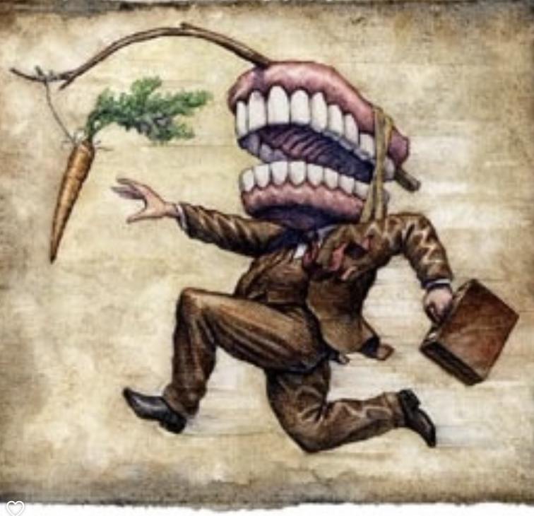
But, really – how often do these few basic factors all line up favorably at one time? Not very often, if ever. But I would argue that the joy of life does NOT depend on our circumstances. The joy of life comes from putting God in control, taking a deep breath, relaxing, and truly leaving it in His hands, even when, to us, things seem out-of-control. Wisdom is the ability to see more than what is in front of one’s face. It is the ability to look past the immediate, to the long view, to what I should do next, or do in response, that will benefit one’s future, or even when I can do nothing but leave it in God’s hands! When we depart from the paths of the knowledge of life, we are on the path to death where we join the majority of humanity who possess little wisdom, especially without the knowledge/fear of God, which we have already seen “is the beginning of wisdom”[Prov. 9:10]. ~Jesus said not to worry about tomorrow because today has enough to worry about! But Jesus would never have espoused not planning for one’s future. *My grandparents (on my mother’s side) had 13 children – five kids – and the two boys were criminal by todays standards. From a previous marriage, to a man who had died in the terrible swine flu epidemic of 1918. So my grandfather married my grandmother as a young widow with five children! And then they proceeded to have eight more together! My grandfather did not really bring enough of a paycheck home to provide for the needs of that many people. For a few years, in the 1920s he worked like a dog, as a lumberjack up by Rhinelander, for a dollar a day – 30 dollars a month, which he promptly sent home to support his family. Later, in the 40s and 50s, he got a better-paying job in one of the paper mills in the Wausau area, and by that time some of the older kids had grown up and moved away. But. my Grandmother (bless her) had always grown about an 1 ½ - 2 acre-sized garden that she and the children tended all summer, and then harvested a great deal of produce from in the late summer and early fall! And then was the work of processing all those vegetables – canning – (which is a ton of work) – and most of the basement of their house was filled with row upon row of shelves to store all those canned goods, both vegetables from the garden, and meat from the beef, hogs, chickens, ducks, geese, and turkeys they also raised. But growing your own food is a true exercise in patience. You have to wait 2-5 months for your labors to be rewarded – and five months to a year for animals! But, in the end, doing this every year, my grandma and grandpa provided for their family’s needs, even during the Great Depression of the 1930s. They were dirt poor, so they didn’t dress fashionably, but they were clothed. They also never once went hungry, because my grandparents had planned ahead for the coming winter months! Plus, the children earned their keep. They learn how to work – from field work, keeping up that huge garden, milking cows, to butchering, canning, to learning mechanical repair! Now, if you ask me, THAT is wisdom in action. Those with wisdom know that the best things in life come from delayed gratification, not instant gratification. That is a magnificent way to live! My mother was one of the hardest workers I have ever known. Work was her fun! At 94, she worked in my neglected garden, weeding for four hours in the hot afternoon sun – refusing to come out or even rest until she was done! [Matt. 6:33] – “and all these things will be added to you as well”. Our lives are not to primarily consist of seeking after physical things. We were made in the image of God, so we were made for bigger things than that! Of course we have to provide for our physical needs! We have to plan ahead – we have to take steps – we have to put in the work to meet our physical needs. But that is not why we live! *Wolf Larsen, the narcissist anti-hero from Jack London’s classic novel, “Sea Wolf” said that men move to eat, and eat to move – that we are nothing but a bag of intestines that must keep consuming and converting food to energy – energy that we use to get more food to eat and convert to more energy, to get more food, of course – and that is the point, Wolf declared, of mankind’s pointless existence! Wolf was a defiant atheist, obviously, a man of great strength and intellect, with a deep cruel streak in him, and a contempt for all men but himself. He had it wrong!

Slide 4

Yes – this is true of most humans, but not all. The wise ones have chosen relationship with their Creator/God through faith in the One He sent to take the guilt of our sins away – His Son, Jesus Christ! In doing so, they have also chosen the path of righteousness! They have signed themselves up to become a “new creature” in God’s “new creation” – different! [2 Cor. 5:17-21]! Once in, I’m ALL in! My primary aim in life is not to eat better and get more and better stuff. Sure, I must work and provide for my needs and for that of my family, But that is not all my life is about! It is not even the important part! The important part of my life is to obey, to please, and to serve God! And,.. What has become the primary focus of my life is the fact that I have had a profound change of heart – and that I will gladly follow and serve this astounding Creator/God with everything I have – from now and throughout ALL OF ETERNITY!! In so doing, I have gone from death to life [Jn. 5:24]! Now if you ask me, that is a LIFE that is profound – that is worthwhile living! That is life that is the opposite of a life of meaningless consumerism - moving to eat and eating to move - which is not really living at all, but only of dying! So I will make my mind and I will be unshakeable in the conviction that this life in Christ is the life that the Creator of life has provided for me with unbelievable generosity! I didn’t make it happen! He did! I didn’t deserve it! But when I asked for it, He gave it anyway! And, I didn’t earn it! He earned it for us! And, I don’t have what I need to make it into God’s heaven. But He has what I need, and so He gives to me everything He has earned – every honor, title, award, position! He transfers what is in His account, over into my account, and I am completely stocked with everything I need to be reconciled with God! Now, by faith in Christ, and trust in His saving work on the cross, I am aligned with Him and His purposes on earth, and one day soon, in heaven! My whole identity is wrapped up in Him! Furthermore, I don’t have to be afraid to die any longer, because death is just the very beginning for me – the gateway to my real life – as I enter into an incomprehensibly long stretch of eternal life! That’s how to really live, my friends – with THAT as your focus! Anything else – life, where the point of life is the frivolous pursuit of pleasure – is just wasting time while one waits for the horrors of eternal death!
The intelligent/wise choice here is to abandon the road that most people seems to be on. It is a “dead” end – so to speak! Solomon refers to this crowd as “the company of the dead”! Who wants to be in that company? It is certainly not wise to be numbered among them! Yet most will not trust Christ, and in not trusting Him with their life, they choose to be in the company of the dead! And by the way, it is an unavoidable choice. A person must choose! Even not choosing is actually choosing, in the eyes of God! If a person has not said “yes” to God, he or she has, in effect, said ”no thank you” to the life that author of life has offered at such great cost to Himself! Such a person is continuing along the path to a devastating conclusion where there is no hope of coming back and making it right! The key is to let go – out with old and in with the new! [Joshua 24:15,16] – “Choose this day who you will serve. But as for me and my house, we will serve the Lord!” - Choose to live as the Giver of life intended – joyful, and content to not be in control!

