Slide 1

‘
Proverbs 21:23 – The Things We Say
~ Uncommon ~ The Common Sense of God Wisdom for Beginners

Slide 2

Some of the most embarrassing moments in my life have come from having said something stupid. I think it was probably my first year in the pastorate, and I was preaching my heart out, and pleading with people to follow Jesus with their whole heart. And then I spoke of those in the church that were avowed Christians, but who were not actually following Jesus – who would at some point “expose themselves”! All of a sudden I realized what I had said, and my head kind of exploded inside, in panic, and I was mentally paralyzed for a moment – and just as I hurried on, hoping no one noticed - someone in the back row to burst out laughing – and then the others picked up on it and soon the whole room was laughing. I ended up laughing with them, because what else could I do? Those people never forgot that, much to my embarrassment. The vital point I had been so passionately making, on behalf of God no less, was totally lost on them, and that bothered me more than anything! I was young, and insecure about everything I did in pastoral ministry, but most of all about my preaching. I had the joy of having a woman in the congregation that took it upon herself to critique me, which ended up bothering me, a lot. Now, to be fair, her critiques were most likely true, and I actually heeded them, and the quality of my sermons actually benefitted from it, I think - but I did not appreciate the spirit in which it was given. It was often done in front of others, to undermine me, which was humiliating! But my problem this time was foolishly misspeaking. Her problem was being mean-spirited and without gentleness. She had taken on a dislike of me anyway, so it seemed like she enjoyed the humiliation she was causing me. Again, I could be speaking even now through the lens of my insecurities back then, but regardless, she was offensive, and her words often cut me to the quick! Fortunately, it took me a few years, but I developed a better sense of self-identity, and a thicker skin, and that kind of thing has not affected me for four decades or so – and less so the older I get. Communication – words/language are crucial in ministry and indeed, in life! We must learn to use them carefully. It is an important part of the plan that Christ has given for our everyday lives, with more detailed instruction passed on to us by the writings of Christ’s apostles.
~Language is a gift from our Creator. Our brains think in patterns and pictures. Language is able to describe those patterns and images, to verbally portray the images in my brain, so that your brain can “see”, in a sense, what I‘m thinking! The more words we know, the more detailed of a picture we can draw with language. Plus, we can put our own thoughts in better order when we speak to ourselves and make sense of our thoughts! Thinking is actually a self-conversation using words to order and express the back and forth of thoughts that occur in our own mind. Language is what makes us smart/intelligent, we have ideas to express, and when ideas are being expressed between two or more people, we are able to cooperate and get even smarter! *The book of Genesis tells us a historical story of humanity working together. People were living for hundreds of years at the time (400-plus), so they had the ability to gain many skillsets/knowledge, and together, humanity was building a great tower (the tower of Babylonian) that was going to reach to the heavens! In my opinion, people were doubling down on the desire to be God, the first sin in Eden! But they were building an incredible edifice, and God decided to stop them! Humanity was getting too advanced too fast! So what did God do to stop them? He took away their ability to communicate with each other! Each different language group divided itself away from the whole. The result was the all work stopped, and the various language groups moved away from each other, each settling in different regions of the land mass.

Slide 3
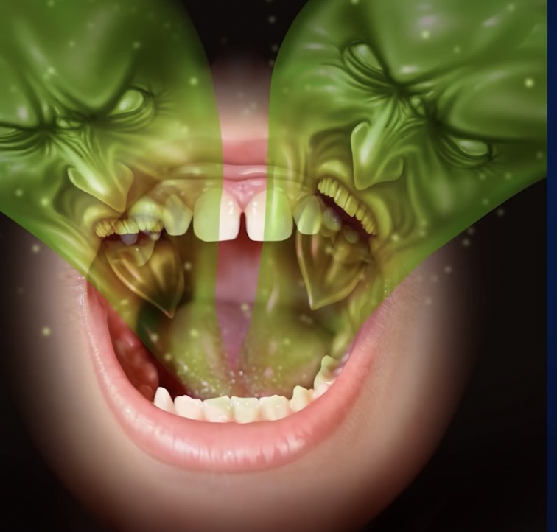
~The absence of a shared language had a most divisive effect on the families, tribes, and eventually, nations! They didn’t trust people that they could not communicate with! Eventually the language barrier became a key source of costly misunderstandings and mistrust. The result was hostilities, and then wars upon wars – tribe against tribe, nation against nation. But, of course there has been plenty of conflict in the community. ~In fact, people are in conflict in families, and at school, and on councils, and in boardrooms, on the jobsite, on the playing field, in the neighborhood, and in churches. Language is commonly used to express disagreement, to complain, to insult, to try to intimidate and control someone else, to impugn, or slander, to humiliate, to mislead and deceive, to express contempt, revulsion, hatred toward another person,... and, of course many of these uses (or misuses) of words and language, lead to open conflict between people! In fact we have an expression/ a phrase that is commonly used when two or more people are verbally fighting – and it is called “a war of words”. A “war of words” is when two or more people or two opposing groups of people unleash a barrage of disagreeable and hostile words at each other, word that further anger the people on the other side and that exacerbate the problem! There is a certain type of people that thrive on verbal/ relational chaos. Let’s call them WOLVES. I mean that they really enjoy it! It makes them angry and agitated, but they thrive on being angry and agitated, and they certainly don’t care if they are making someone else angry! They are the in-your-face people – confrontational – competitive – fighters! They will not turn the other cheek and walk away! There is second type of person – Let’s call these people, HORSES, that doesn’t actually enjoy fighting, but if they are pushed, if they are goaded, if they are hurt, they will get angry and go at it with whoever is doing this to them! *It is visceral/ primal/ animal-like reaction! Most animals, even big ones, even predators, all the way down to little ones – racoons, squirrels, even mice - seek to run away when they encounter a human (not always – because you never know with wild animals) but most of the time. But if they think you have cornered them, they will always turn and fight, tooth and nail! The majority of people are like that, I think. Often it takes a lot to get them riled, but when they are, watch out! The third kind of person won’t fight at all. We’ll call them SHEEP. A crisis comes and immediately their heart fails them, their mind freezes, their legs turn to soft rubber, and they run or just give up. In any kind of conflict, they are sitting ducks! No one of these three types of personalities are more valuable than the other in the eyes of God. But people, on the other hand, like to see a bit of backbone/courage in someone and will place value on a man, woman, or child, based upon their display of courage/standing up for themselves, for others, or for what is right! ~True courage is not the absence of fear, but the overcoming of fear, willing oneself to act despite being afraid. But Solomon is not even referring to courage in the face of conflict here in vs. 23. He is referring to relational intelligence! If a person does just a bit a consequence-calculating, they will be extra careful with their words. The words we choose in any situation, ignite responses from others – one way or the other. Repercussions for the wrong verbal responses, or reward for measured, controlled responses. Good responses will calm down most people – not all mind you – but most. But if you unload, without disciplining yourself and your verbal response, people are going to respond in kind – and this will adversely affect your life and your ability to communicate the Gospel of Jesus Christ. [Prov. 15:1,18,23,28,]

Slide 4

~So some words get us in trouble, while other words keep the peace. The gift of speech was endowed by our Creator, and His desire is for us to use it wisely to heal and mend, to respect and affirm others, to express approval, or if we don’t approve, it pleases God if we can discipline our tongue to refrain from saying anything – especially when we really want to speak our mind, but know we better not. We know He wouldn’t approve! [James 3] This is the definitive instruction in the Bible regarding the tongue! Notice that it’s highly dangerous! This is how God views the words we choose to use! We have the ability to curse someone, or to cause division, to cause hurt and pain, to deceive, and literally do the Devil’s/ Disrupter's/ Destroyer’s work for him – which is the anti-fruit of the Spirit - hatred, discouragement, word-wars, displaying impatience, insults, expressing filth, aggression and disrespect, lies and clever deception - that’s the dangerous part! Or we have the ability to BLESS – to show kindness, to lift up others, and to ask forgiveness as well as forgive, to express gratitude, to be funny and upbeat, to show others gentleness, grace, and mercy - even if they don’t deserve it, to show understanding, to tell the truth – and to protect and defend the truth, and best of all, to tell God’s truth – the gospel – and defend it! This is what God wants for us! [1 Thess. 5:14-18] “This is the will of God for you”
So my message this morning is quite simple. The words we say are important! Please don’t ever think that they aren’t! To have an undisciplined tongue is a destructive and reprehensible sin against God who gave us our brains, with lungs, a voice-box, and a tongue, teeth and lips to form the words that will share our thoughts with others! To abuse that gift is a serious breach of protocol – and He expects His people to take it seriously! He doesn’t expect a lot from those who are not His people, but He does expect much better from His own people! ~“GATEKEEPERS” - Is it true? Is it kind? Is it true but NOT kind (brutal)? Is it kind but not true (flattery)? Is it even necessary? (Advanced gatekeeper: Is it too much? Is it too little?) [Ps. 19:14]

