Slide 1

‘
Proverbs 27:1,18,23 Big Plans!
~ Uncommon ~ The Common Sense of God Wisdom for Beginners

Slide 2
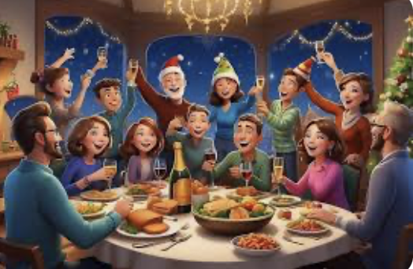
Vs. 1 addresses human desire. We all have desires – things we want to have, and things we want to do – places we want to go, and things we want to accomplish in our lives. And we tend to make big plans – if we actually intend to follow through on it, we go about breaking the big plan down into smaller bite-sized plans. *So, let’s say that family is scheduled to celebrate Christmas at your home. So that has been the big vision/goal for December, right? So you go to work, a month before Christmas, working to purchase and set up a Christmas tree, and decorate it, and then chunks of 2 days or 3 the whole house gets decorated, inside and out! There are Christmas gifts to purchase, and baking to plan, complete with a trip or two, or three, to the baking isle of the grocery store, with a list of ingredients you will need, from flour and sugar to chocolate chips. About 2-3 weeks before Christmas, you are starting to plan the daily menu, for their days at your house. And then, simultaneously, you have to figure out which days will be best for cleaning, and,.. how much time it will take – 1 day of hard work, or 2 days of less hard work, or maybe it will take three days of just a couple of hours a day to make it even easier. There is a whole plan to the process! Completing a part of plan leads to the next one, and then the next - until the plan is complete. That’s how things get done! Solomon knew that when he penned these words in verse one. He was a planner himself – BIG TIME! He was a builder/organizer of palaces, government buildings, huge monuments, cities and streets that he hoped would last forever! None of them did – not even the beautiful temple to God that he built, but he appears to have built and organized more than any other Jewish King, EVER - maybe combined! It all required dreaming big and making good plans, breaking it down to little plans strung together! So Solomon, the big planner, couldn’t possibly have been saying here, “don’t make plans”! As we move into the new year in just a couple of days, this verse is a cautionary reminder to us. No one knows what a day will bring! Most people who die on a given day do not wake up thinking that they will die that day. We all know that we will die, but not today, right?! But then, a certain number of people do die that day – or a loved one is injured or dies – or a house fire takes our home – or we crash our car – or we suddenly end up in a conflict with someone, unexpectedly – or we develop a terrible pain during the day and at the emergency room find out we have a terrible cancer… or, on the other hand, maybe we find out that our tax return is unexpectedly huge, or our kid just was accepted at the college of their choice; or that a distant relative twice removed, and who we barely know, has left us a million dollars in her will,.. or that our disease is cured! And on and on it goes – endless possibilities for setbacks or successes! And usually we do not know any of that will happen when we wake up to face the day! Solomon is saying here that we can make our plans, and even should make our plans, but no one knows how successful those plans will be! *Less than a month ago, I think I told you already, we were broadsided by a whitetail buck chasing a doe. Neither of us saw him streaking across the road at us. He hit our back passenger door window as if he was trying to jump straight through the car. It was like a bomb went off in the vehicle! The noise and force of the concussion was shocking as glass pebbles sprayed everywhere, but mostly across the back seat. The deer sort of bounced/tore away from the window opening and what was left of his forward momentum swung him over behind the care and into the ditch. We came to a stop on the side of the road while in my rear view mirror, I saw the deer laying there. Then I saw him wake up and crawl and limp away across the field! It was a traumatic moment for him especially, but also for us. He hadn’t woken up that morning expecting this to happen to him, and neither had we though about this happening to us! It was our first true deer/car accident! But, after thinking about it for a minute, the whole disaster was made easier by the fact that it could have been so much worse! The deer could have hit the front door window and landed in our laps. It’s happened, you know – sharp hoofs flailing, the weight of the deer at 60 miles an hour could easily have broken my neck! We ended up thanking our God profusely for His protective hand on our lives!

Slide 3

~Solomon is simply pointing out that all our plans are just plans. Life might have other plans for us than our plans for ourselves! The day might have other plans than ours! God may have other plans than we have! It is important to make our plans and to go forward with them each day, but to also acknowledge and keep in mind that we are ultimately not in control! We control what we can (and we should), but we should also never lose track of the fact that we are not in control, but that God is ultimately in charge of our days! He usually allows things to happen, good and/or bad, but sometimes intervenes and causes things to happen. That is not common at all, but we learn in the Bible that –– it happens - especially if it affects His overall plan. He will intervenes directly! But that hardly ever happens, that we know of anyway. Mostly, He lets things play out on this fallen planet, yet, things are never out of control! Terrible things can and do happen here, and none of us are immune! But true Christ-followers have learned to accept that we are not in control. *I’ve seen people that I thought were strong Christians go off the trollies and be angry with God because something bad happened to them! Listen, it is precisely when something bad happens that we find out what our faith is actually made of. It is easy to follow Jesus when all goes well. It is also easy to blame Him when we are hurt by the bad things that happen in life! It is infuriating to most people, even many Christians, that we cannot control our days! *We are used to controlling our environment for the first time in human history! With reliable, energy efficient furnaces in the cold of winter, to those wonderful air conditioners in the heat and humidity of the summers, we have the ability to evenly control the temperature in our homes, cars, the stores we shop at, and businesses where we work, no matter the season! *Our trip to the grocery store is a study in a controlled environment. Packaged meat in the meat department, with every type of food safety sealed, and given expiration dates, so that we don’t have to be afraid of botulism and salmonella poisoning developing in the food we buy,! Or the safety features prevent some deranged and malevolent maniac from sabotaging our food! Everything in our lives are sanitized and safe! But I think the COVID pandemic of 5 yrs ago startled and traumatized people who thought that the safe and safety conscious way that we live is normal! It is completely not normal/completely artificial, and COVID just exposed exposed the fact that we are not safe! I think this is why some people are still wearing hospital masks over their faces, even when they are alone in their cars, or out walking the dog! I’m talking about the young and healthy ones. The mask represents control - feeling safer! But it should be pointed out that if someone’s perfume molecules are getting through the mask and you can smell them, viruses are much, much, much smaller and can pass through a mask like a BB going through a chain link fence! What I am saying is that control is only an illusion/wishful thinking! So, according to Solomon, we do what we can and then we leave the rest to our God and trust Him with it! If something bad happens, we don’t get mad at God! We blame those who are to blame –Adam and Eve – and ourselves! Their desire to usurp the position of God in their lives and in our world is what has served us disaster on a plate!

Slide 4
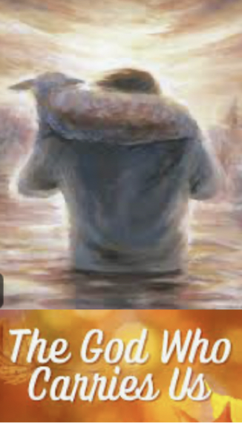
[James 3:13-17] As you can see – I’m not making anything up. What I have been saying this morning comes not only from Proverbs, but primarily from this passage here in James. We are dependent beings, and Christ-followers must carry with them a strong sense of this. We acknowledge our inherent weakness. Electricity, machinery, the internal combustion engine, the electrical motor, technology have all combined to support the fatal illusions not, and cannot ever be! *As many of you know, I’ve had cancer twice in in this past decade. In God’s providence, they caught both types early and removed it, so it should not return as cancer often tends to do. But I am not in charge of that. I am at peace with the possibility! I will thank God for the wonderful life He had given me and prepare myself for the next thing! This too is out of my control, and I am at peace with that, because I TRUST Him in life or in death, and in everything in-between. I will be okay no matter what. I’m covered either way! If you know Jesus personally, you are too. But this passage admonishes us to let go of our illusions. Self-reliance is evil! God wants us dependent upon Him. That is where we belong! That is the proper order of Creation, where He is God over our lives, and we have renounced being god over our own lives! This is where we are at our best - lifted up by our Savior and carried! [Col 3:23,24] In this passage, Paul is speaking to the slaves in the church. Their life was certainly not their own. They were someone’s property! Make no mistake, Paul isn’t saying to them that their lot in life was a good one! It wasn’t! But Paul reminds them that as Christ-followers, their life did not belong to them anyway. They were the bond-servants of Christ. They belonged to him before they belonged to their earthly masters. So, he tells them to escape their chains and run – right?! Wrong! He tells them to work for Jesus! Why? Because their calling in life was now to win their earthly master to Jesus if at all possible. It was not going to happen by being sullen, resentful, belligerent, or hostile! No – it could only happen if they did their work as if they were having the privilege of serving Christ Himself! This is the passion we must live with!! This is the key to whatever may come in our lives. We live for Jesus, and He helps us, carries us along as we live for Him! Look what the apostle Paul said of himself: [Philippians 1:21-23 – “For me to live is Christ…” ] [1 Tim. 6:11 – “But you, man of God, flee all this and pursue…] Run from… run to! This is life for the Christ-follower! This is the will of God for us in the coming year! This should consume our thoughts, our plans, our desires, our priorities! May the angry Christ-follower renounce their anger every morning and find joy in everything they do! May the lustful Christ-follower guard his or her mind and keep it pure and wholly under the watchful eye of Christ! May the impatient Christ-follower commit to relaxing, walking in the shoes of the people they are impatient with that they might have a new approach to life – perhaps not as punctual, but richer, kinder, certainly less frustrating and less prone to shameful outbursts! Listen - this who we are in Christ, and who we are being made into more and more! It is the only thing that is worth pursuing in this life, and the only thing that makes a difference! Make your earthly plans, but hold them loosely. But your plans to follow Jesus,.. those we never let go of! Those are the shiny treasures we are pursuing! These plans are the only part of us that will never change under any or all circumstances, good or bad! These plans are what we will take with us into eternity!

