Slide 1

‘
Proverbs 28:13,14 The Wisdom of a Pure Heart!
~ Uncommon ~ The Common Sense of God Wisdom for Beginners

Slide 2
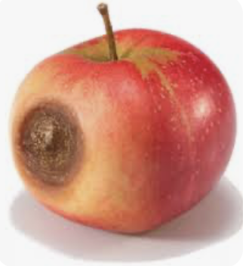
Nothing says “peace”, or relief, like disclosure! It is something I have observed in others and have experienced in my own life. We humans tend to think that being able to keep secrets is the best thing. Our shame and guilt for secret sins is kept hidden away deep inside, and our exterior is as innocent as can be! By what we portray on outside, people would never know what we’ve been up to, past or present. And we think we’ve won! Unfortunately, what wins are the secrets! It is the sin that remains in charge. While the sin remains in the dark, the guilt and shame of it eat at us from the inside, like a spiritual/ emotional cancer! While the secrets lie submerged, we are also helplessly chained to them! The problem with that is that in time we sense the water rising, the stress building, and the façade begins to crumble. It is the reason why we have seen so many big name pastors, Christian musicians, and well-know Christian writers finally either admit that they are frauds, or be exposed by the people they have worked with that they are frauds – even monstrous and cruel frauds! Our secret sins never just lie buried - NEVER! Secret sin turns into a noose around our neck, tightening with time, until we are exposed and destroyed! Solomon is saying that before we get caught, it is far better to confess - to bring it all out into the open! Why? Why would Solomon say that? He had secrets! He was King! He was forever plotting, and manipulating people just to keep the peace of Israel! We know he did not practice what he preached here – especially not latter in life. But in his earlier years, before he so foolishly and completely gave in to paganism, he had asked God for wisdom, and God had given it to him! So this was insight from Almighty God! Solomon had, at one time, been able to recognize simple but great wisdom when he saw or heard it, and then pass it on to us! [Prov. 4:23] This was a profound nugget of 24K wisdom-gold! This is the foundation of our desire to follow Christ. We are, above all else, expected by our Lord to protect our heart from all the garbage that is out there! The garbage wants to find a place inside our heart and mind to lodge there and start to rot. *Back in the day when tall sailing ships ruled the trading routes of the oceans – oh, probably up until 125-150 years ago, the ships would stow big wooden barrels of apples for the voyage. The crew and passengers needed fruit and/or vegetables on a long, agonizingly slow voyage, and they would become very sickly from malnutrition, and possibly die before they got to their destination! It didn’t pay to bring along more barrels of apples because apples have a fairly limited span of time where they remain viable for eating – perhaps a month, maybe a little longer. But the span of time the apples were edible could be shortened considerably if there happened to be an apple with a bad bruise or a rotten spot, or worms in its core in the barrel. The rot on an apple emits ethylene gas which promotes rot in the apples near to the rotten one, and then those apples promoted rot in the apples they were nearer to, in an ever-widening spread of decay! It is where the old saying comes from – “one bad apple spoils the whole bunch” or “I think that there’s a rotten apple in the barrel”. Today, people use that expression when they come upon something that is not looking right – something unlawful, or something underhanded, or a betrayal of some kind. Or, the expression is used when there is a person whose presence, attitude, influence is ruinous to the morale of the group! So they are called a “bad apple”! ~This is an appropriate metaphor for a heart that is unguarded, in which the rot of sin has found a place to call home! There are soooo many influences these days with the advent of the internet! Honestly, I don’t know how young Christians will/can possibly remain faithful to Jesus! Unless you are “surfing” with your guard up – and I mean waay up – there are a million videos available that will plant the seeds of sin into one’s heart and mind – a million! In fact, there is no end to them as millions of people from around the world are fiendishly making new ones every day! And our world is slowly slipping into insanity!

Slide 3
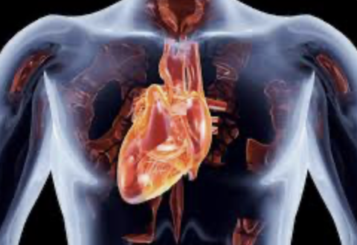
I once heard the quote “If you would have a pure heart, then you must keep it pure”. I don’t remember who said it first, but it wasn’t me. Is it that simple? Yes! Begin by BEING HONEST WITH GOD! It doesn’t hurt - He already knows! But He wants to hear you say it! He knows how important it is that you ID it - and say it! Without an admission of guilt, there is no repentance! Without true sorrow or shame for wrong-doing, repentance is non-existent! Without almost daily repentance, the bad apples remain where they are, rotting out the soul. There can be no following of Christ without careful, objective examination of the heart! When self-examination is objective, it means that you are not coming at it from a selfish perspective, but looking at yourself as if from the outside – through someone else’s eyes! Better yet, from God’s eyes! I understand that this is very hard for a certain type of personality! It is very sad, but some people’s fragile egos just cannot allow them to see, comprehend, much less admit that they did wrong or are coming from a wrong place, and sincerely ask for forgiveness – not even to God! Yet, this is what our relationship with Him is based upon – on our part - it is this very thing! Our heart must be right, or none of it is going to work for us! One of the greatest things that God does is to shift our heart from one side to the other. From darkness to light! *You know that our hearts are positioned left of center under our ribs. Let’s say that we were originally created to have our heart on the right of center. That was before mankind sinned greatly by envying God and breaking from Him. But before that happened, we call that the “age of innocence”. At that point, the human heart was pure and sinless – keeping no shameful secrets! But after the rebellion in Eden, our hearts were cursed with an irresistible inclination toward evil, and the position of the heart was shifted from the right side of the chest to the left! That, of course, didn’t actually happen, but just for our purposes - for the sake of illustration here, imagine that it did happen! When we reconnect with God through faith and trust in Jesus Christ, God miraculously, in a powerful act of recreation, shifts our heart back over to the right side, to its original position where it has always belonged! That is the imagery I want to portray to try to capture the great re-creative act of God! He profoundly changes the position of our heart! Of course it doesn’t actually go from left side to right side – it does stay in place - but there is a pronounced shift in our central core being! We go from disregarding God – and what He wants for us - to prioritizing Him and wanting for ourselves what He wants for us! There is nothing more difficult to change than the human personality with its lifelong inclinations, and habits, and ruts and patterns! Yet that is what God does! And then He gives us His Spirit who makes His temple-home in us, to solidify and put His seal/His mark, upon us - we are His possession, and under His protection - because He protects His human possessions! What did Jesus pray to His Father? (Jn. 17:11) – “Holy Father – protect them by the power of your Name – the Name that you gave me – so that they may be one as we are One. While I was with them, I protected them and kept them safe by that Name you gave me (Yeshua). None has been lost except the one doomed to destruction so that Scripture would be fulfilled.” God protects His own, BUT HE FIRST DEMANDS HONESTY! Honesty requires confession and repentance! [Ps. 51:1017] Honesty with God allows/enables Him to protect us and continue working on our heart’s character – beginning with its sincerity, integrity, and purity! Dishonesty with God about our sin, or our apathy toward it, will get us NOTHING BUT MORE SIN, spiritual atrophy, and grief! The ”double-minded” Christian “cannot expect anything from God”, say James. Such a person, no matter what they claim, does not trust Him! Their faith in Him is jaded - cynical! They want both their sin, and to be saved from it too! But God will not be played! He will have honesty in His followers, or on that day He will say to those who claimed to have followed Him but never really did, those devastating words - “Depart from me, you worker of iniquity (you lawless ones; you wicked, you evil people) I NEVER knew you”

Slide 4
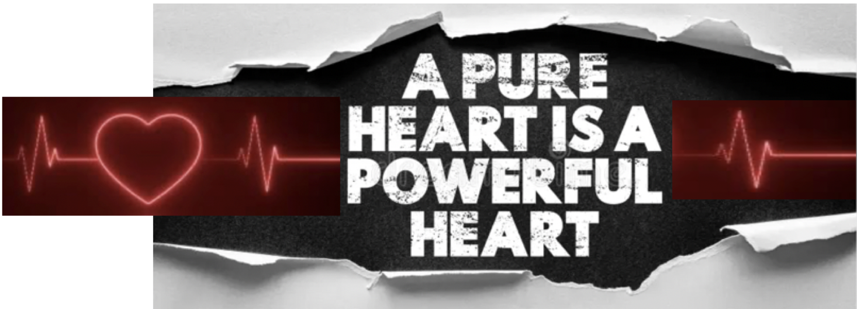
~Honesty is also what our RELATIONSHIP TO PEOPLE is based upon! I know that full disclosure is not necessary in human relationships. Declaring every thought that flickers through our brain would be injurious to the development of our friendships. We cannot help what enters our brain, but we do have control over whether we entertain those thoughts or not – or whether we judge and condemn the inappropriateness of sinful, dishonest, mean-spirited thoughts, and determine immediately that it will never see the light of day – not from our tongue anyway! But we also should not present ourselves to everyone in the church to be something we are not in reality. We should be that same person at work, or in our car, or in our home! That person we present to other Christians at church should be the person we are seeking to be at all times - God helping us, especially when under pressure. A pure heart is a consistent heart – not showing one sort of person to someone, and another version of oneself to someone else - not changing with the situation or circumstances! And yet we do just that! ~Confession is the process that keeps us going along the path of Divine change – of God’s re-creative process applied to our heart! Having come, by faith in Christ, into a genuine love and trust relationship with the living Jesus, our heart is in the process of going back to its original position - to innocence; to where it belongs in alignment with its Creator! Can a person become innocent again, having already known the evil of rebellion against God, and having been a willing part of the self-wreckage that comes with independence from Him? I believe a person can! I have to believe that, or why would I use my life up helping and admonishing people to follow Jesus? Why would I do it myself, if I didn’t feel certain that this is at the very foundation of salvation and of life in Christ?! [Eph. 4:22-24; Col 3:9,10; 2:1-3] ~Confession/repentance is why we continue to observe the worship of communion every month! The early church did what they called “the Lord’s supper” every time they gathered – which for some time, was daily! We don’t do it every time we meet because we suspect that it would become so routine that it would lose its intended impact! Even observing communion monthly, the act tends to become merely a tradition, a going-through-the-motions rather than a genuine encounter with the 3 essential elements of communion-table worship. We want the communion table to be an encounter with God! So those three are: #1- the encounter with JUDGEMENT - the bloody judgment of God against sin – our sin, by means of the bloody cross! #2 – the encounter with GRACE - the blood-soaked grace and mercy of God toward sinners (again, paid for at the cross). #3 – the experience of RE-CREATION – the triumphant re-creative power of God drawing us to Himself and changing/purifying our hearts, and aligning the desires of our heart with His own! ~How else can we enjoy Christ? If our heart is not right, and not in development, then Christ becomes just a nagging conscience that we try to ignore, and that is just miserable! No! Christ died to free us! This freedom in Christ is freedom from being tethered to our sin! This freedom is intended to bring great joy to our lives! To follow Jesus is pure joy – not drudgery; hope, not helplessness!

