Slide 1

Proverbs 29:1
The problem of a stiff neck!
~ Uncommon ~ The Common Sense of God Wisdom for Beginners

Slide 2

I remember when I was a young man, at a time when I was in my 2nd church, I woke up one morning with a sore neck. I could not look to my left! I had to turn at the waist, if I wanted to look left. I also could only lay on one side at night as it was too painful to lay on the other! I figured that it was just one of those things and it would go away on its own – only… yeah,.. You guessed it - it didn’t! Day after day, week after week, and then month after month! Nine months I suffered with a crick in my neck! It had gotten to the point of feeling kind of normal by that time. I thought that it was just my new reality that I would have to live with. And then, one morning, out of the blue, I woke up and knew - you know, like you do sometimes, and I knew that I had to go to a chiropractor – actually, a specific chiropractor that I knew in Wausau who had helped me after a football injury in high school! I called him that morning and set up an appointment – I think it was that same day! I didn’t have high hopes for the appointment, but I thought I would give it a shot. When I saw him, he sat me in a chair, went behind me, took my head in some very strong hands, and cranked it to the right - and my neck clickety-clacked loudly, and somehow, I knew immediately that the kink in my neck was GONE… like it had never been there! Then he took my head, again, and cranked it to the left, and it turned like there had never been a problem turning to left! My eyes got big as saucers, and I said to him, ”It’s gone”, and he smiled knowingly! To me, it was like a miracle! After paying the bill, as I walked out to my car in the parking lot, I was kicking myself for being so so stubborn and stupid! Why hadn’t I come in right at the start? I could’ve saved myself 9 mos. of aggravation! ~Do you know what would have been a lot more stupid than that? It would have been a lot more stupid if the next time that I picked up a similar kink in my neck, I would not have gone in to the same guy and got it fixed right away! Not doing what you know you should do, is the definition of being “stiff-necked – digging in your heels - stubbornness! “Stubborn as a mule” my dad used to say! If I were to keep suffering with the stiff neck… and still did nothing,.. now, THAT would have been REALLY stupid! ~ Results themselves are a form of rebuke! But results are not being read rightly by people these days. Few people seem to be learning from their mistakes, and you cannot tell anyone that they are wrong – not if it is THEIR truth! People cling to their truth like it is their religion – which, actually - it is! But their religion/life is not working for them! It keeps slapping them up alongside the head! Yet, instead of changing course, it is just filling them with more rage and impotent frustration! *It is akin to a scientist in a laboratory, testing a certain chemical or biological theory. But when the testing results clearly point in another direction,… imagine for a minute that that the scientist ignores the data and continues pushing their original hypothesis regardless of the results… and, well, that’s stubborn stupidity, and unfortunately, it is a very human thing to do! Such an approach to life defies all logic and rationality! Yet this is what we have going on right now. I think we all recognize that we have seen an exponential rise in what I would classify as insanity - minds descending into mental and emotional derangement from being consumed with outrage and hatred, finger-pointing, blame-seeking, alienation – as in cutting off friends or family completely, unfriending, ghosting, mocking, name-calling, labeling, stereotyping, villainizing, demonizing, and more! So much so that it seems that we now stand on the brink of a terrifying precipice - a devastating civil war in this country!! We actually do! *We see on the news and the internet - from 5 different angles - a woman hits a government agent with her car – a sideways blow - and getting shot and killed for it! Everyone sees the same videos, but one side sees a woman trying to run over a law enforcement official and being shot in a justified shooting, and the other side sees a woman victimized by out of control, trigger-happy Nazis (even though no one seems to know any more what “Nazi” actually means)! Listen – the USA cannot be destroyed from the outside because of our military might, so we are being conquered and destroyed from the inside as we are torn apart!

Slide 3

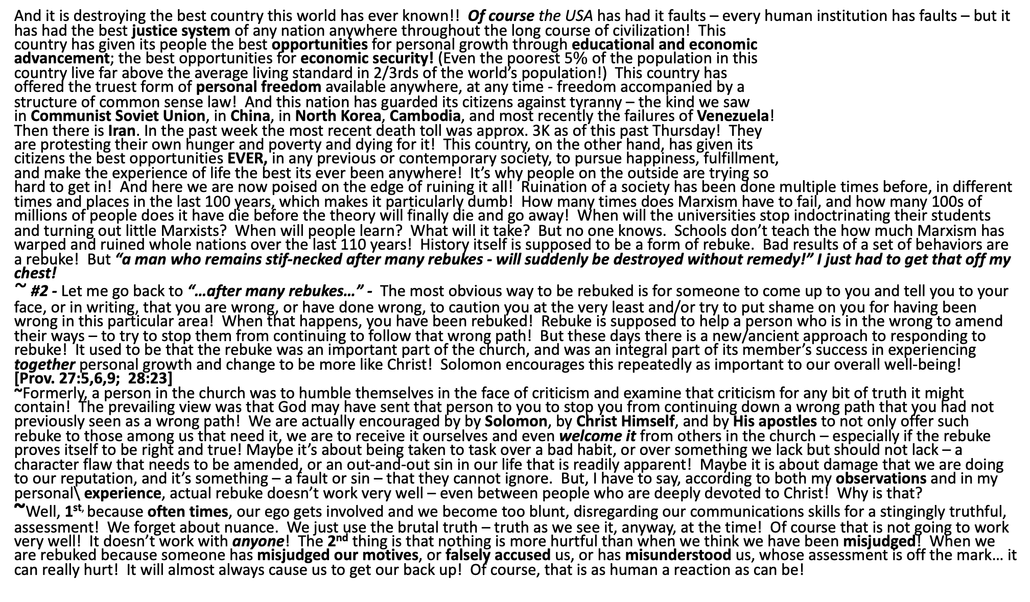
And it is destroying the best country this world has ever known!! Of course the USA has had it faults – every human institution has faults – but it has had the best justice system of any nation anywhere throughout the long course of civilization! This country has given its people the best opportunities for personal growth through educational and economic advancement; the best opportunities for economic security! (Even the poorest 5$\%$ of the population in this country live far above the average living standard in 2/3rds of the world’s population!) This country has offered the truest form of personal freedom available anywhere, at any time - freedom accompanied by a structure of common sense law! And this nation has guarded its citizens against tyranny – the kind we saw in Communist Soviet Union, in China, in North Korea, Cambodia, and most recently the failures of Venezuela! Then there is Iran. In the past week the most recent death toll was approx. 3K as of this past Thursday! They are protesting their own hunger and poverty and dying for it! This country, on the other hand, has given its citizens the best opportunities EVER, in any previous or contemporary society, to pursue happiness, fulfillment, and make the experience of life the best its ever been anywhere! It’s why people on the outside are trying so hard to get in! And here we are now poised on the edge of ruining it all! Ruination of a society has been done multiple times before, in different times and places in the last 100 years, which makes it particularly dumb! How many times does Marxism have to fail, and how many 100s of millions of people does it have die before the theory will finally die and go away! When will the universities stop indoctrinating their students and turning out little Marxists? When will people learn? What will it take? But no one knows. Schools don’t teach the how much Marxism has warped and ruined whole nations over the last 110 years! History itself is supposed to be a form of rebuke. Bad results of a set of behaviors are a rebuke! But “a man who remains stif-necked after many rebukes - will suddenly be destroyed without remedy!” I just had to get that off my chest! ~ #2 - Let me go back to “…after many rebukes…” - The most obvious way to be rebuked is for someone to come up to you and tell you to your face, or in writing, that you are wrong, or have done wrong, to caution you at the very least and/or try to put shame on you for having been wrong in this particular area! When that happens, you have been rebuked! Rebuke is supposed to help a person who is in the wrong to amend their ways – to try to stop them from continuing to follow that wrong path! But these days there is a new/ancient approach to responding to rebuke! It used to be that the rebuke was an important part of the church, and was an integral part of its member’s success in experiencing together personal growth and change to be more like Christ! Solomon encourages this repeatedly as important to our overall well-being! [Prov. 27:5,6,9; 28:23] ~Formerly, a person in the church was to humble themselves in the face of criticism and examine that criticism for any bit of truth it might contain! The prevailing view was that God may have sent that person to you to stop you from continuing down a wrong path that you had not previously seen as a wrong path! We are actually encouraged by by Solomon, by Christ Himself, and by His apostles to not only offer such rebuke to those among us that need it, we are to receive it ourselves and even welcome it from others in the church – especially if the rebuke proves itself to be right and true! Maybe it’s about being taken to task over a bad habit, or over something we lack but should not lack – a character flaw that needs to be amended, or an out-and-out sin in our life that is readily apparent! Maybe it is about damage that we are doing to our reputation, and it’s something – a fault or sin – that they cannot ignore. But, I have to say, according to both my observations and in my personal\ experience, actual rebuke doesn’t work very well – even between people who are deeply devoted to Christ! Why is that? ~Well, 1^{st,} because often times, our ego gets involved and we become too blunt, disregarding our communications skills for a stingingly truthful, assessment! We forget about nuance. We just use the brutal truth – truth as we see it, anyway, at the time! Of course that is not going to work very well! It doesn’t work with anyone! The 2nd thing is that nothing is more hurtful than when we think we have been misjudged! When we are rebuked because someone has misjudged our motives, or falsely accused us, or has misunderstood us, whose assessment is off the mark… it can really hurt! It will almost always cause us to get our back up! Of course, that is as human a reaction as can be!

Slide 4

So the problem with rebuke is in the potentially brutal, or humiliating, or disrespectful way that it is delivered! The problem in this case is the one who is doing the rebuking! The rebuke might be needed, or not, but the rebuke is doomed to be ineffective because the one doing the rebuking either does not have skills, or they chose not to use them! Let me just pause here say that an ineffective rebuke is worse than no rebuke at all! An ineffective rebuke does nothing more than strain or even end relationships! I mean, sometimes it just has to happen because we have to do the right thing NOW and take a stand - and there is no way around it! But that is unusual! Usually things can/should wait while the problem ripens and defines itself better and, in time, and our way through becomes clearer! Also, often things clear themselves up, which is the best-case scenario! We have to give room for the Holy Spirit to impact the situation! Then we can avoid the problem of exacerbating the situation by misjudging, or misunderstanding, or being misunderstood ourselves! ~But what we have now, in this present day, is that the standard response to confrontation is a reflexive response - not thoughtful and humble introspection – but a doubling down on our stupidity – reacting with haughtiness, with resentment, with vengefulness! This is the type of person that Solomon is referring to in our original text! The person that is un-correctable/ incorrigibly stiff-necked – they will persist in their wrong-doing and there is nothing that can be done to help them “without remedy”! Even God cannot to anything with such a person! He does not force us to Himself, or to do the right thing, nor to humble ourselves. He just tells us the benefits of doing so and lets us decide. If He made the decision for us, what kind of satisfaction would that have for God? ~When we are confronted/rebuked, we need to first humble ourselves before God! We need to hear them out, without defending ourselves, as God is our defender if they are wrong! If they are just persecutors – it’s fairly easy to determine if they have not been sent to us by God because they always end up being pretty far off! God honors that humble approach! He loves when a person can humble themselves when it seems unfair! If we are confronted on sin or shortcoming by someone, and we listen and determine they are right - then God has won, and we will bring glory to Him! If we are innocent - misunderstood, or misjudged - then we do our best to answer and to probably repair a relationship that has most likely been previously ailing for some time – and we may not have even know it! [Heb. 12:10b-13] ~Listen - I have been confronted on multiple occasions throughout the years. I know what it feels like, probably more than anyone here. It’s not so bad! It might sting for awhile, but it is best to ponder what might be from God, and then separate that from what obviously is not – and you still come out a winner! But remember – we might be surprised! Sometimes we need the eyes/ears of someone else to tell us what we are missing – what is getting by us! *In this church – in the past, it has often taken someone from the outside coming in – a visitor, or a newer person – to tell us what they saw, because we are use to it and don’t even see the problem anymore! It has been things like needed repairs that our eyes had glossed over for years, or organizational problems that we had grown accustomed to, or poor first impressions that we were not aware of – and their criticism really helped us a lot! It helped because we would not have recognized those problems without seeing it through new eyes! In the same way, we need to help each other follow Jesus! We get used to a faulty status quo, and sometimes someone can gently, skillfully, prayerfully come alongside and help us to become better Christ-followers, and we should buck the current trends, and invite that! Right or wrong – know that people’s intentions are usually good! That means a lot! You can tell when someone just want to hurt you, and if so, you try to get to the bottom of it. It’s often an unrelated issue completely. Or if two or three people tell you the same thing, then it’s time to really look again and take it seriously! Do not do what Israel did and potentially despise the prophets who came with a message from God! [2 Tim. 4:2] This is the work of a pastor (in whose work we all are to share)!

