Slide 1
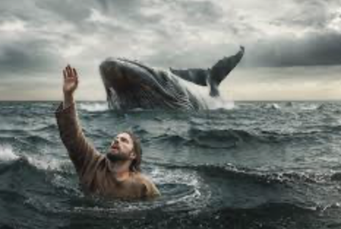
Jonah 1 – A Merciful God Employs An Unmerciful Man
Jonah – The Reluctant Prophet

Slide 2
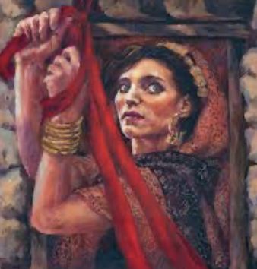
One of the astounding themes we see in the text of the story of Jonah is the mercy of the Creator/God toward His enemies. This is a watershed book in the Bible because of that great theme. There is no greater example of it in the Old Testament. We have previously seen that God can be very summary and brutal toward His enemies! *Because Moses was taking a long time up on the mount of Sinai, receiving the law from God, there were those at the Israelite camp, trouble-makers, who made Aaron, the brother of Moses and high priest of God, fashion a golden calf from some of the gold that the people had brought out of Egypt during the exodus. They descended into the gross sexual debauchery of paganism,.. and for their disobedience, 3000 of them were killed by an angry God! He had specifically told them not to create gods made of gold or silver in the likeness of animals or anything else for that matter. God was hard on His own people. Only two of that generation made it into the land that God had promised Israel. But He could be much harder on His enemies. The most well-known case of that is the task of conquest that he handed over to Joshua, and the 2nd generation of Israelites that he led. That conquest was one of genocide! There is nothing more brutal than genocide! It still happens today, and it is decried by the world’s nations. But that is because of the vile and ugly tribal or national hatreds that usually underlie such terrible behavior! When God told them He wanted them to kill everyone, it was not out of hatred. Those cultures were a source of sickness on the surface of the planet. I think we could compare it to a viral pandemic. We’ve recently experienced one! Every new viral outbreak has a starting point. It didn’t take long for the COVID virus to overrun the entire world by transmitting itself from person to person! I believe that is what God was dealing with with the Canaanites. He had been through this before when the antediluvian world, the world before the great flood, went crazy and humanity’s every thought became evil all the time, and the Creator had to unleash a worldwide flood on the earth and start over with a righteous holdout named Noah! So, approximately 1000 years later, God saw it happening again in the land we know again today as Israel, but at that time it was “Canaan”. But that is why these people and their hyper-crazy brand of evil had to be eradicated! But before the first arrow was loosed, or the first spear thrown, God gave them every opportunity to repent! If you check out Joshua 2, you can plainly see that in the story of the Hebrew spies that were sent out into Canaan to scout the tribes and peoples there, and to observe their mindset regarding what they knew was coming. Two of them were discovered in a city name Jericho, and were hidden by a prostitute named Rahab, and they discovered that she knew everything – everything that God had done to Egypt 50 years before, to reduce it from a world power to a wreaked and weak land! These people also KNEW that God and His people Israel were coming for them, and they also knew they could surrender, because that is exactly what Rahab did! Because she surrendered, she and her family was spared from the annihilation of the city, shortly after! Not long after, the Gibeonites chose a different method to surrender – that of a grand deception, where they put on old dusty clothes and worn out shoes, and showed up at the Israelite camp to parley for a peace pact, saying they had come from a long distance. God knew they were just days away and said nothing to reveal their deception. So the deal was struck and the Gibeonites were saved. But they were the only ones who surrendered! The rest chose to defy God and fight even though they were in mortal terror of Israel and its great God! In the end, God fought for Israel until they tired of the killing about 7 years later. By then, the few pockets of giants - the evil human hybrids, called the Nephilim, were mostly eradicated from that area, and that was important to God, I think. And then also, most (but not all) of the manifestly evil people/cultures of that region!

Slide 3
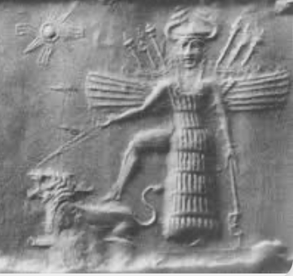
But the fact remains. They were warned, and they had their chance! God is a God who greatly prefers to show mercy to humans where He can – where there is a shred of hope that remains. He does NOT prefer judgment except where no hope remains! Otherwise He will display His love, mercy, and grace – and not His wrath and righteous retribution! Even in the days of Noah, this was so! God had Noah build an ark – an boat as big as a large ocean liner, built out of wood! Noah and his three sons worked on that boat for approximately 130 years! Peter’s epistle tells us that Noah was “a preacher of righteousness”. In a world of untold decadence, perversion, and criminal enterprises, Noah was out there preaching to crowds that climbed the mountain to see this comical spectacle - a monstrous boat being built high on a mountain! And there, Noah was pleading with them to repent, to change their ugly and evil ways, to seek the true God. And, as far as we know, he never had a single convert! Certainly no one joined his family in the ark at the end. But God gave them their chance, and it was a looong one! There is no question in my mind that Noah was crying out to the world that God had decreed that the great flood was coming to destroy the world and take their lives! The world had one language at the time, so the word was spread easily across the continents of Noah’s claims. I believe that the antediluvian world was a sophisticated world. We have no idea how sophisticated in technology they were! But if this contemporary world of ours – this technologically sophisticated world – was invented and built by people whose adult years number approximately 50 years, or less, then imagine what a smart person could do with 900 years of adult life! No question – they invented things we haven’t dreamed of! God took no joy in destroying it all. But He was grieved by the evil that had hijacked and consumed the human heart, and He was grieved to destroy them as well. He said He would never send another flood! But the truth is, I can’t imagine why God has stuck with us! We have been so problematic for Him over the millenniums! [2 Pet. 3:9] ~So now we return to Jonah. Liberal theologians do not even think this is a real story, but just a morality tale – a myth to teach the Israelites an important truth. I disagree, of course, because like other Old Testament accounts of miraculous happenings, this IS credible to me and fits a major theme/motif in the entire Old Testament – that God was not a territorial God like all the rest of the pantheon of Gods of the ancient world. God is God of the whole world! His concern is not limited to His chosen people, Israel, but to the entire planet! Israel was “chosen”, not to be saved from out of the world, but were chosen for a task that was paramount to God! He was going to “bless” the world through them, and that “blessing” was to be the ethnic vehicle through whom God would bring His Son into the world to take on human flesh – to offer salvation to the world! ~So, what is God doing when He makes contact with Noah? This story of Jonah is believed to have occurred during the reign of Jeroboam 2 of northern kingdom, about 130-150 years after the Northern Kingdom’s first King Jeroboam. Jeroboam 2 was 13th in the timeline of the kings of the northern Kingdom after the two kingdoms split. This particular man, Jonah, was a known prophet in the Northern Kingdom – his home being in the Galilean area, (the same as Jesus, much later on) in the north-eastern part of Israel, near the Sea of Galilee. In the story, Jonah has been chosen by God and assigned to a particular task that is well-suited to his particular skillset. The task was to go to this large city called “Nineveh” and warn them that God was going to destroy them for their great volume of gross sins and decadence! The Creator could not tolerate it any longer and either the Assyrians of Nineveh would put an end to their hellish vileness, or He was going to put an end to them! Like the decadence of the Canaanites, it threatened to catch on and ruin the whole earth again! God would not have it! So He approached Jonah, because Jonah was the obvious man for the job! We will see later on that Jonah was an effective communicator! So he was tasked to deliver a message from heaven, and deliver it to the best of his ability! God was giving this awful city His best shot at mercy! They didn’t deserve it, but He were getting it anyway! We should also know a little of the background information on this city. They were the Assyrians - a cruel human plague upon upon the Far East and Middle East. They were probably the first empire builders. The Assyrians had gobbled up nations like hors d'oeuvres (ordurves), and were known for their bestial cruelties to the nations! Now they threatened the very existence of Israel! No nation liked them, and no one wanted them! At the top of their multiplicity of god’s was Ishtar, a female deity. Much like Baal, top god of the Canaanites, this religion focused on fertility. Fertility meant wealth and success– the fertility of their flocks and herds, and of their families ensured their wealth and legacy.

Slide 4

They were a grossly decadent culture, sexually, from the king on down to the commoners in the streets of Nineveh, and as such, highly offensive and repugnant to the prophet of God, Jonah. They were morally disgusting, and they were also a real military threat to both the northern and southern kingdoms of the Hebrew nation! Is it any wonder that Jonah fled the mission he’d been given - in the opposite direction! [Vs. 3] ~I have to say that this is so very human. People have been saying “no” to God, and running from Him since the beginning. It seems to be a part of our nature to not want to do what God tells us. *[Gen. 4:1-7] - God told Cain, the first son of Adam and Eve, to stop being angry with/ jealous of his younger brother Abel. God told Cain directly to let go of his anger and to do right rather than wrong, or wrong-doing/sin would make him its prisoner. But Cain did the opposite, laid in wait, and committed the first murder on his own brother! As punishment, he was made an outcast from human society, embittered, playing the victim for he rest of his long, long life! *[Num. 20:7-12] God told Moses to speak to the rock and it would bring forth the desperately needed water. But Moses was angry with the people he was leading, and he since he felt like striking the rock, that is what he did instead. Water did come forth, but his punishment was that he was not allowed into the Promised Land. So he died just as Israel was poised to enter the land to conquer it! It was a sad ending for someone who had served God so faithfully up until that point! * *[1 Sam. 15:7-11, 22,23] Much later, Samuel, priest and prophet of God, told Israel’s first king, Saul, to kill every human being of the Amalekites that they were fighting – even the animals. There was a reason for this that I won’t go into today. God gave Saul and his armies a great victory, but Saul, instead of obeying God, saved the best of the animals, as booty from his great victory. Wars were always about booty and profit, so I guess Saul did not want to waste such an obvious source of wealth. He kept those animals alive, lied about them, and tried to hide them from Samuel/God - and Saul never had a moment’s peace after that! ~Jonah, here in our text, did not like the compassion of God. It almost felt like betrayal to him! I mean, whose side was God on, anyway?! First He is going to destroy Nineveh, and then He wants to save them! And so and unmerciful Jonah ran from a merciful God, setting off a string of incredibly stressful, life-threatening events that would make him exceptionally famous for all the wrong reasons! ~So, now I’m wondering about us – you and me? Jesus says to us to ”stop sinning” [Jn. 5:14, 8:11]. He literally frees us from our imprisonment by sin. ”Go”, he says. “You’re free”, and yet His followers stay in their cages! *Have you seen animals being released back into the wild, and the door to the cage is thrown wide open, and the animal cowers in the back of the cage and won’t leave! Likewise Christians stay in their sin-caged because sin is a more familiar place than not sinning! How sad! How self-destructive! ~And Jesus tells us to ”go into all world and preach the gospel”. But do you think we would obey him? Even in our little part of the world, most of us run from His command to give people the gospel. We don’t want the inconvenience! We don’t want the stress of it! We don’t want to feel rejection! We also hate many of them because of their gross sin, and perhaps because of their socially/culturally destructive ideologies! So why would we have any motivation to share with them a message that could save them! They will reject it anyway, right?! But that part of it is not up to us. Jesus said that to love him was to obey Him, and he commanded us to share the gospel. So what’s it going to be?!

