Slide 1
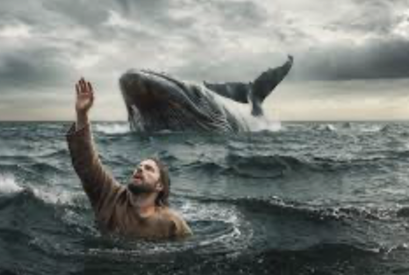
Jonah 3 – Strange Journey
Jonah – The Reluctant Prophet

Slide 2

~Jonah has revealed himself to be a self-willed and disobedient prophet/messenger, of God! God told Jonah what He wanted, and Jonah would not have any of it! He hated Nineveh – hated the Assyrians! Everyone did! They were an oppressive regime! Every one of the nations in the region knew that their nation could be next to be conquered, cruelly crushed and abused, and then absorbed into the great empire! Jonah hoped that God would go ahead and destroy the city, and save Israel the worry/ terror, of being overrun by the Assyrian empire! They would conquer and absorb the northern kingdom of Israel, and fairly soon, in only about 50 years from then, and Jonah’s homeland in Galilee would be decimated! So Jonah’s fears were well-founded! ~So he jumped on the boat going west, in the opposite direction! We don’t really know how far they got before the storm came up, or how far the the powerful winds of the storm drove them. They were trying to travel west but were probably being blown backward - to the east, which is the normal direction of the wind – so it would have been blowing in their faces, against their forward process. It says in chapter one that Jonah went below decks – it might have even have been storming at that point – and promptly fell into a deep sleep. It is hard on a person to be running from God! Somehow he continued to sleep while the storm continued to intensify around the ship! Before long the crew cast lots to see if they could discover whether someone on board is to blame for this great storm. Normally I wouldn’t recommend this method to find out any kind of truth or revelation, but this time God manipulated the dice and made them point to the real culprit. The captain and crew of the ship certainly knew that this was the truth, and indeed, Jonah admitted to it readily when they woke him up and confronted him. In fact, it says that he had told (probably the captain) when he had boarded the ship, that he was running from His God!
~An interesting thing to note about this account is that much of it occurs at sea – the Mediterranean. But the actual route to Nineveh is overland – an arduous 650-700 mile journey to the northeast into what is now Iraq! So when Jonah goes in the opposite direction by sea, he is adding many miles onto his overall journey! When he is swallowed by the great fish and carried back to shore, very possibly traveling about 100 – 150 miles in three days, he still had to take the overland route after that! Most people have the impression that after the fish, or whale, delivered him onto land again, that Nineveh was right nearby and Jonah just walked over and entered into the city. That is very far from the truth! Jonah could not have shown up at the gates of Nineveh all bleached out from stomach juices, as many a pastor have portrayed over the years. He had many hundreds of miles to go, after being spit up on shore. It was an arduous journey of many weeks on foot! He undoubtedly would have had to have to proceed to a known caravan route and then he would have had to have waited until one went by that he would attach himself to for protection and for provisions for the long, dangerous journey under the hot mid-eastern sun! So, no,.. he did not look ghostly or even scary to the Ninevite Assyrians by the time he delivered God’s message to them. He would have been sun-darkened, and would have had to have been in great shape! It was not Jonah himself that was scary. It was his message - and he would have been an angry man when he delivered it! Remember, he did not actually want to deliver it! It was a dire warning from Yahweh-God – a God the Assyrians barely knew – that doomsday/judgment and the annihilation of the great city was coming to overwhelm them in 40 days! Being angry, He railed against the sin he saw as he walked through the city – the decadence and perversions, the violence, murder, theft, and corruption! Now, there had to have been some order, as Nineveh was a great city, and their leaders would have organized some kind of laws and law enforcement to restrain the populace! This would have been especially so in the upper class part of the city – snob hill, where the money and power was! It has always been that way, and it still is, if you’ve noticed! But the level of depraved human behavior in city had to have rivaled the the violence and perversion of the antediluvian (pre-flood) world, of Sodom and Gomorrah of Abraham’s day, and of the Canaanite culture over 400 years later. These were the times and places, that we know of, that the Creator said “Enough! I must destroy you completely before your brand of evil spreads and overruns the earth, and before this extreme level of darkness impedes or encroaches upon my overall plan for the earth!” This same evil that had overcome the city was another of those benchmark times!

Slide 3
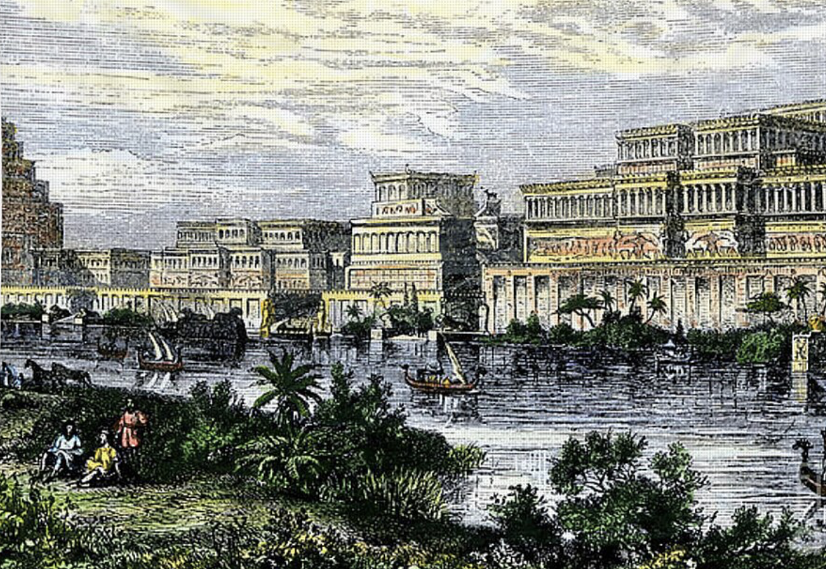
Although Jonah had repented and made a vow, while in the fish, to obey God and deliver the message, God called him again at the beginning of chap. 3 and repeated His instructions. I do not think that God likes to repeat His instructions. *Have you ever had a boss or supervisor like that?! I have! I think most people have. After they tell you something, or give you instructions, they get really irritated if you have to go to them with questions! “Did you mean this, or did you mean that?” They just want you to go and get it done! God came back – probably thru an angel messenger – and repeated His previous instructions. After his nice, relaxing, 3-day ride in the huge sea creature, probably a whale, I think Jonah knew he was on thin ice with God now! ~The text says nothing about the long journey afterwards - a minimum of 600 miles on foot! There are no details of that part of the journey that we long for in a story of extraordinary adventure such as this one. The story just cuts to the part where Jonah has gone into the great city and starts warning the city of what is coming! ~Let me backtrack and explain something. Nineveh had been founded by the city and empire builder Nimrod [Gen. 10:8-12]. That is only four generations after Noah! At first, lifetimes had been cut down by a third. Intriguingly, Noah had lived 950 years, and Noah’s sons, about 600, and then lifespans continued to plunge in the next few generation, but lifetimes were still much longer, 4 generations from Noah, after the flood, than todays comparatively few 70-80 years! Nimrod was able to live, perhaps, 3-5 of our lifetimes, or even more! Imagine what a powerful, ambitious, driven man could do with that much lifetime on his hands?! Well, as we saw, he used his time to build big cities, among other things. It is believed that he ruled the earliest empire after the flood, and, of course, with a population that was much less than during Jonah’s era, obviously. It was the early Assyrian empire – or at least, centered in Assyrian territory – the Iraq of today. It was small in comparison with the empire it would become 1500 – 2000 years later in Jonah’s day – in what historians refer to as the Neo-Assyrian empire! In Jonah’s day, the empire had expanded, and “the great city” of Nineveh, it’s center, would have massive walls, lavish castles, public buildings, and beautiful hanging gardens. It was a spectacular city – a vast monument to itself/to its own glory! But that was how it was begun - with Nimrod – a rebel toward God, and that is how it remained! In all that time, the city had NEVER before had a direct encounter with God - that we know of at least. ~So, when Jonah finally arrived, it would have taken him a few days to get all the way through Nineveh while declaring his Divine message of doom all along the way! First, he had to explain who this God was! The Assyrians were polytheistic, but their main god was a goddess named Ishtar, and completely different from Yahweh God - the God of Israel! She was decadence personified and Yahweh was holy, and perfect in righteousness! He would not have been on their radar at all! However, the Assyrians had a vast library of cuneiform tablets that preserved ancient knowledge! We know from archeologists uncovering some of these records that the Assyrians had knowledge of the story of the great flood and God’s judgment upon the earth! Perhaps Jonah was reminding them of that story! In fact, I’m sure of it! People began flocking to hear him, and soon he became the talk of the city. But his message was not all doom, but included the option of repentance! Somehow, they knew what he meant! Repentance means to be sorry for your behavior – to turn and go back – to renounce it, be sorry for your offense to God

Slide 4
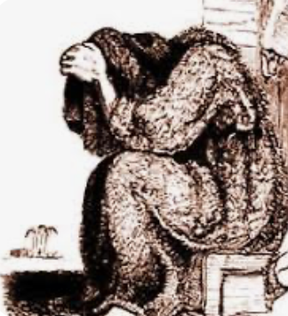
All of this happens to a society that has given themselves over to every base impulse to do what should not ever be done, not even once, much less being commonplace… and God had had enough! Yahweh had often reached His limit with Israel, and had always sent a prophet to warn them to turn from their sin and to turn back to the one true faith of their fathers. They had rarely if ever listened, and had always been devastated by God bringing in/allowing oppressors to overrun them and take them captive, to be their harsh taskmasters, and/or to levy harsh taxes that kept the people poor, oppressed, stressed and in fear of their lives – angry, frustrated, poor, and struggling! ~So, although Jonah began preaching of the coming wrath of God, and of an escape hatch offered through repentance – his expectations were surely low! ”Alright, I’ll do it, but it’s a lost cause right from the start!”, he thought But low-and-behold, the people listened, became alarmed, and were convicted of their sin! Even more amazing is that this unnamed but powerful Assyrian King heard of Jonah, and got the message – loud and clear – and got really scared! I mean, that has almost NEVER happened over the millenniums! No one listens to God! People are always too intent on being their own god! People want to do what they want to do! They don’t want to be restricted by the real God! It is almost invariable with people that it is not until they are devastated by life’s tragedies, by failure, by fear, disappointments, betrayals and hurts, by a pervading sense of futility, often through failing relationships, that people finally are open to listening to the Creator/God! But these Ninevites of the Neo-Assyrian empire, they gathered around and, somehow, listened to God’s message of warning – none of the usual mocking, discrediting, or marginalizing of the messenger! No – they took it seriously! Maybe Jonah, being a prophet of God, was given power to do a few miracles that spoke to the power of God and validated Jonah’s urgent message! It doesn’t say that here, but many/most of the prophets of the Creator/God had used miracles to prove to people that they should take God seriously! *Think of Moses and the 10 plagues of Egypt - every one of them a great miracle, and still Pharaoh rejected the message of God! But here, an entire city prostrated themselves before the living God - from the top officials to the beggars in the streets – and even the animals had to be clothed in sackcloth – a loosely-woven, rough, picky, skin-irritating sort of fabric, kind of like burlap, and to wear it as a garment was to make one’s self uncomfortable as an expression of great sorrow! The King heard and saw what was going on in the city, and he immediately was struck with a sense of urgency! He put out an edict for everyone to fast (to not eat). We are not told for how long they were to refrain – a day, 2 days, three – but also every living thing in the city was to wear sackcloth – even the animals! I cant’ imagine where they got all the sackcloth, as there were approximately 100K people in the city at the time! The other thing they were urged to do by the King’s edict, was to pray with urgency! I love their response to God! It is the right one! It works! It is the start of reconciliation with the Creator/God! It is an acknowledgement of being in the wrong, and being very sorry for it! ~Today is Palm Sunday, of course – w/Good Fri. and Easter coming up on Friday and Sunday. I know that this wasn’t much of a traditional Palm Sunday sermon. But,.. you’ve heard many Palm Sunday sermons before, and not many sermons on Jonah, I’m sure. The one thing I want to say about Palm Sunday on it this morning is that Jesus, the Son of God, came riding into Jerusalem on a donkey. He came as a King! He came as a man of the earth but with a all-important message from heaven! He had been preaching repentance in Judea for 3½ yrs! On that day, some 2000 years ago, people received Him with a celebratory, party-type atmosphere – no sackcloth, no fasting, no repentance – just celebration! It was a self-serving celebration! Jesus embodied their hopes for national independence, and world dominance! 2 ½ weeks later they were either calling for Jesus to be crucified, or standing by and letting it happen! This kind of reception is why there is such pervasively weak Christianity today. Repentance is missing! Jesus is celebrated as King, but He is no King over them! He is their get-out- of-Hell-free card! He is a once-a-week addition to their weekly or every other weekly, routine! He remains only a ceremonial figurehead, like the King of England, and not a real King with real power! But Christianity is not self-serving! It is Christ-serving! You cannot be a Christian without Christ leading and you following! He is King, commanding you and His subjects yielding to Him, or there is nothing there but wishful thinking! He is no fire-escape for insincere spiritual grifters attempting to trick God! He is King of Kings and Lord of Lords! Coming to Him does not begin with a parade and a party! It begins with the deep sorrow of repentance! It begins with sack cloth! ”Oh, my King of Kings! I’m sorry! Be merciful to me, a transgressor/sinner! I humble myself before you”! Now, THAT has a chance of taking root and growing into a deep and eternal relationship with Almighty God!

Slide 5

B.C. Timeline
[*Northern Israel falls - 722-721]
Neo-Assyrian empire - *Nineveh / Fall of Assyria - 612
Jeroboam I Jeroboam II
David Rehoboam Jonah
__l___________l___________l_ _____ *l__________*l___________l____________
1000 BC 900 800 700 600 500 Jonah @ Nineveh – 760 BC

