Slide 1
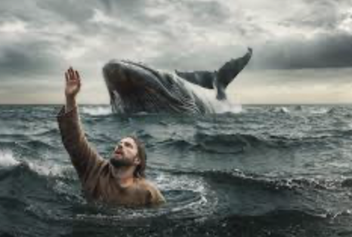
Jonah 4 - The Great City Repents (and a Reluctant Prophet Sulks!)
Jonah – The Reluctant Prophet

Slide 2
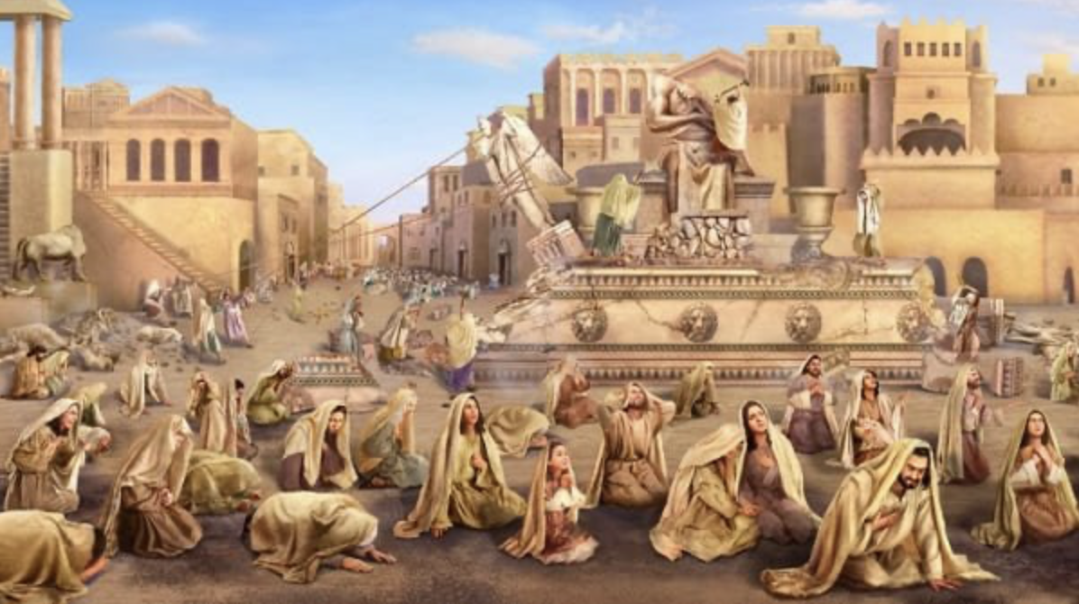
So Jonah has had quite a journey. After his journey by sea in the belly of a great fish, or whale, which God had provided to rescue and to transport him to shore, Jonah underwent an arduous journey overland – a journey of 100s of miles! We don’t know where the whale dropped him off on shore, so we cannot say with certainty how many hundreds he had to go after that! I think I had said 6-7 hundred miles, but it could have been less, and it could have been more. But, he finally arrived at the gates of “The Great City” of Nineveh, and began his days-long street- preaching campaign as he walked through the city, viewing its abject decadence first- hand, and declaring that the judgment and wrath of God was going to destroy the city in ```` 40 days! The results were completely unexpected! Even God seems to be taken by surprise – [3:10]! I mean, that’s the way the text is written. It does not fit our general understanding about the foreknowledge of God. I mean, Jewish and Christian theologians have long posited the idea that nothing surprises God because His knows the future intuitively - that He lives outside of time and can look down both on time past and on the future ! But then there are passages like this that put the situation in such a way as to portray God as being reactive, in other words, He can go one way or another based on Nineveh’s response to the message God had given Jonah to give to the Ninevites. Now, we can read our theological predispositions upon this passage and explain it away as “Well, of course God knew what they would do! He knew before He even sent Jonah to them! He is God! He has to know!” But, again, that is reading a preconceived theological notion onto the passage and it is exactly what we should not do! We should take the text at face value. What does it say, rather than what we think it should it say? “When (that is a specific point in time) God saw what they did, He relented and did not bring down upon them the destruction He had been planning” Now, I do not presume to know what God knows! Being certain of the inner workings of God, is an exercise in folly! To say that we know that He has to be this way or that way, is not smart, but dumb! We don’t actually know what God knows, or how He knows, or when He knows! There are texts, usually prophecies, that indicate that He does know the future, and there are texts like this one that indicate that He is reacting in the here and now, to what is happening in the here and now. All we have is the text, inspired by God’s Holy Spirit! The text says “When God saw what they did…”, He CHANGED what He had planned for the Ninevites! They had not reacted the way that men have almost always reacted! Uniquely,.. lo and behold,.. they repented - and so, instead of killing the populace, or having them carted away into slavery, and decimating the city structure itself, God forgave them their many sins and did not bring down upon them the judgment and wrath He had planned for them in a month! That is the way the text is written, and that is how we should treat it! We will leave the unanswered questions up to God Himself! What we don’t know about Him, we should be okay with. A God that we have figured out and nailed down with theological dogma is a God we have diminished/reduced, in my opinion! ~But one thing we can be confident that we know about Him is that God knows what He is doing! Nothing is beyond His control! History is being funneled by Him down to a single moment when everyone understands – and when that happens “every knee will bow (from the living AND the dead), and every tongue will confess that Jesus is Lord, to the glory of God the Father”! Before that time, history will have a lot of strange and unexplained twist and turns and we will not know why! But what we will be able to do is to trust Him implicitly!

Slide 3
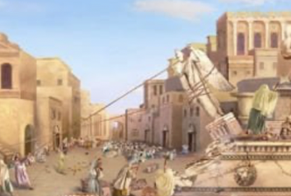
Let’s talk about the message of Jonah for a few minutes. The message, of course, would have been to repent. Jonah would have told them that they had offended the One True God by worshipping other Gods. They honored a polytheistic view of religion – they acknowledged many gods, and chose a handful of main gods to worship. They had built a beautiful temple to Artimis, who was probably the city’s most popular god. She was the goddess of both love and war! The god Assur, the god of the state, was considered the head god in the Assyrian pantheon of gods. Then there was Dagon. Some say he was the fish god, but that is disputed. He was, supposedly, the father of Baal – the lead god of the Canaanites, who were under the judgment and wrath of God. Dagon’s role was to be in charge of fertility and of vegetation – so the farmer’s crops. Anyway, you get the picture of how this went. There were a number of other key gods - Nabu and Ninurta, and Nisrock, who was the favorite god of the great King, Sennacherib, and others. Now, the Assyrian empire had taken some major hits during this time in their national history – they had been weakened by natural disasters such as droughts/famines, and earthquakes, plagues,… and there were political problems such as revolts, and costly wars with rival powers. It must have seemed to the Assyrians that their favorite gods had abandoned them! Then, too, right around that time, we know from unearthed records that there was an eclipse of the sun that mystified and greatly alarmed the city and its king! Into this scenario comes Jonah! It seems that the city has been prepared for Him and His harsh message! Now, to their credit, the Ninevites did not respond as Pharaoh and the Egyptians had responded to the great and miraculous plagues, 10 powerful disasters on a national scope – disasters that God used His servant, Moses, to bring down upon their great, but wicked, nation. Pharaoh had refused to recognize the historical God of the Israelites, and finally when he was ready to cave to God’s demands and let his slaves go, God wasn’t done with him and hardened his heart for the last three great judgments upon Egypt! However, it took much less to move the hearts of the Assyrians. There is no question that Jonah quoted to them from the Law of Moses, that God said that they must not put any other gods before Him! [Ex. 20:4,5] Idolatry was at the center of Jonah’s message – I am certain of it! In the picture I chose for the previous slide, you can see the artist’s depiction of the people of Nineveh pulling down the idols stationed across the city! ~To truly repent, they had to come to God the way that everyone has had to come to God since the beginning – in humility, acknowledging that we are not God and that we have treated the real God our Creator wrongfully/shamefully! Repentance includes admitting, with genuine sorrow, that our ways have not been His ways, and that we have wronged Him terribly by the crime of theft – identity theft! We’ve stolen what He wants and deserves most – ourselves! We’ve denied Him His rightful place in our lives, and we’ve assumed His throne! I mean, He gives us life, and sustains our every heartbeat! But we try to act as if He is not even there! Instead, we act like we are little gods in charge of our own life! Then, generally, we do as we please, and thinking we are free to do it our way, we do the dumbest things - rotten attitudes, overblown emotions, and destructive/foolish viewpoints and ideologies, that all lead to behaviors that destroy our marriages, estrange our children from us, that get us fired from our jobs, that lose us extended family relationships and friendships – all because we do the dumbest things, personally and relationally, when we think we are in charge and calling the shots!

Slide 4
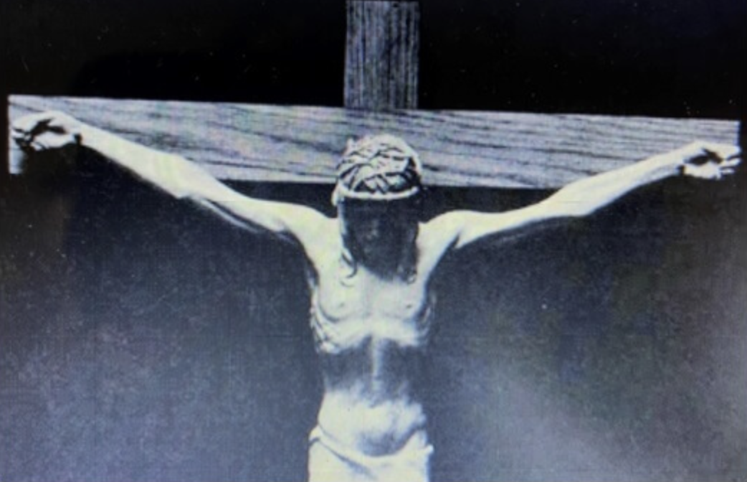
So, the wicked city undergoes wholesale repentance – top to bottom – king to pauper – and don’t forget the animals. They wore sackcloth too! Don’t know how they kept it on them. Jonah was angry! He tells God that He KNEW this would happen! God responds that He is concerned for the 120 thousand people in the city! He didn’t want to kill them! He WANTED to forgive them. He wanted them to repent and change their ways so they could be allowed to live! His admonition to the city to repent (through Jonah) was genuine! Jonah had given the city a choice between alternative futures. Repent and live! Do not repent, and die! Quite a simple choice! It is the very choice that God gives all people! ~We are all under the judgment of God! [Rom. 11:32-36] And in Christ’s mission that took Him to the suffering of the cross, Christ took on the sins of humanity. He didn’t take them all. He provided the means for people to have a choice! ”Believe in me, and live” was His message, ”and live eternally with me! Conversely, if you chose to not believe in me, you will remain under the judgment and wrath of God, and there you will suffer an eternal death, separate from me! He said “I am the Way, the Truth, and the Life! No one comes unto God the Father except through me”. He is the gatekeeper! You go through Him, or not at all! You have heard it said out there that there are many paths to God. Don’t you believe it! There is One Way! Jesus said that, and either that makes Him a lunatic/liar, or He is laying the truth on the line! The miracles that He did daily, in the sight of 10s of thousands of witnesses, many of them hostile witnesses who could not deny what they saw, speaks to the idea that everything He did and said was supported implicitly by God the Father! Yes, He was God the Father’s plan to offer salvation from His wrath to a world of sinners! ~Jonah hated that God was giving the enemies of Israel this respite, this drawdown of His wrath against them! [vs. 4:2] So, He retreated from the city a safe distance and sat down to begin a vigil. He wanted to see whether God might change His mind again and wipe them out anyway! Perhaps they would slip back into their old ways soon enough to wreck this ceasefire! He could only hope! So he sat back to watch the fireworks! He knows it may take awhile. Then God plants a gourd/vine that grows up miraculously fast! It grows up, and to Jonah’s great pleasure it is fully grown in that place, and it must have big leaves as gourds often do, to block the blazing hot rays of the Middle Eastern sun! Jonah is immensely pleased! But in the next night, God brings in a burrowing worm, and it kills that nice vine; it withers away, and the nice shade is gone as quickly as it came! Then that particular day proceeded to become excessively hot, the sun became stifling, and Jonah becomes very distressed over the loss of his shade! And God confronts him for his shallow thinking! “You are thinking about this all wrong! It is much better to save these people than to destroy them! [Rom. 10:8-13]

