Slide 1

The Proper Fear of God!
Malachi – Another Angry Prophet

Slide 2

Why is it that prophets always seem to be angry in the Bible?! They seem to mostly carry messages of doom and gloom – divine judgment and wrath! The prophet, Jonah, carried such a message from God to the wicked Assyrian city of Nineveh! It was, perhaps, an uncommon thing for God to send a prophet with a warning to a people that were not His own people. I mean the Ninevites knew of the God of Israel, but probably didn’t know much about Him. They still got a warning from Him – and as we learned, the warning was the prophet, Jonah speaking for God - “REPENT, or my judgment and wrath will crush you! You have 40 days to decide!” ~But the prophets of Israel generally delivered their messages from God against their own nation, a nation that God had adopted as His own! He had said from the very formation of this nation, in what we refer to as the Abrahamic Covenant, that He was going to use them to accomplish His overall purpose – that they would some- how “bless” the entire world! They mistakenly got the impression that this meant that they would dominate the world with a Hebrew empire/theocracy that would stretch around the globe to dominate all the other nations. But they had been carefully built into a nation that was to be the vehicle through whom the Creator would bring the Word, 2nd member of God’s Tri-unity, would take on human DNA/flesh, with Abraham’s genetics, and enter the Hebrew culture at around 0 BC, as the Son of God and Son of Man – not half man and half God, but all man and all God! And the Word of God became the Son of God, and when He did, He was a Jew – a descendant of Abraham! [Heb. 1:5] – “…today you have become my Son” It was for this purpose the Hebrew nation had been chosen and kept on track by God when they wanted so desperately to go off-track, and stay off track, to follow the world - following the moral depravity of the nations that surrounded them! But God, the True Creator-God, would not let them stay there! He planned to have the Word, 2nd member of God’s Tri-unity, enter the human race as His own Son, actually begotten by Him - and this Son would bring to the world an offer of salvation from God! It was God who had chosen that particular nation, chosen as the vehicle through which to bring it all about! So, over the centuries, as the Hebrews would wander off on their own and dive headlong into the excesses of depravity and decadence, Yahweh God would send an angry prophet to deliver a message! Malachi was one such prophet! In fact, his name means “my messenger”! But names had meanings back then so “Malachi” could also be his actual name, rather than just a title. It is believed that Malachi could have been a contemporary of Nehemiah’s toward the tail of of his time. Nehemiah was an important official of the Persian King, Artaxerxes. He had been a former slave, of offspring of Jewish slaves, had worked his way up into a position of power and authority in the highest echelons of the Persian empire! It was he that the Persian King sent back to Jerusalem to rebuild it’s walls and begin rebuilding its temple! Oh, by the way, for context on the historical timeline, the Neo-Assyrian empire (911 BC – 609 BC) of Jonah’s day had been conquered and replaced the Babylonian empire (626 BC – 539 BC) who had been conquered and replaced by the Persians (550 BC – 330 BC) of Malachi’s day! Each one of those empires had overrun Israel, or parts of Israel, in rather rapid succession!

Slide 3

So, the Babylonians had leveled the Jerusalem temple, and one of the first decrees that Cyrus the Great, of Persia, made in the first year of his rule, was for a Jew name Zerubbabel to take a caravan of Jews back to Jerusalem to rebuild the temple. The enemies of Israel, who had taken up residence in the city and surrounding areas, persuaded Cyrus to stop the work, warning him that when construction was completed, the Jews would be nothing but troublesome to the Persian empire. The work order was resume by the order of King Darius 15 years later so that Zerubbabel’s temple could be completed. Decades later, Nehemiah was sent with another wave of Jewish re-settlers, by the Persian king, Artaxerxes, to rebuild the walls of Jerusalem – which they did. Malachi came along, more decades later (there seems to be a lot of disagreement among the “experts” on the timeline) and he is the last of this very active period of prophets. There will not be another true prophet for a 400 year period – until the time of Jesus, the Christ. Then John the Baptist appeared on scene to announce the coming of the Promised One, the Messiah, and pointing to Jesus as the very One! As far as we know he wrote nothing down, He was “a voice crying in the wilderness – to make straight the way of the Lord”, so the only record we have of his message was what was recorded in the gospel account of the 3 ½ year ministry of Jesus the Christ, and that was because John was a part of the story. ~But,.. back at Malachi,.. this last of the Old Testament prophet appears on the scene with a serious message from God who has assessed His own people to be possessed by a great spiritual malaise throughout the land! The people, the people who are most likely by this time the descendants of the people that returned from captivity to rebuild the temple and the walls of Jerusalem,.. well,.. they are just going through the motions of religious rituals in Jerusalem. To their credit, they had not gone hog-wild into shameful worship of idols, but neither had they continued the worship of the True God with any real degree of enthusiasm, or authenticity, or dedication! Their religion had devolved into what was mostly an outward show! So God sent Malachi to Jerusalem to confront this terrible cultural/religious development! They had developed a detestable/repulsive spiritual malaise in the eyes of God! If there is anything more disgusting/insulting to God than human apathy toward Him, we do not know what that might be. The scriptures reveal that He takes great offense to that human foible in particular! It seems that He would rather have a person be an absolute degenerate than to be a phony – and we will see that in a few moments! So, God speaks to them directly through the written word of the messenger/prophet, Malachi! ~If you read this book, you will see that God actually speaks to the people – asking a series of questions that the Jews could and should have been asking (but weren’t), and receiving first hand answers from God Himself! [Rev. 2:2-5 – Ephesus / 3:14-18 – Laodicea]. As you can tell from these passages, God thinks that apathy is the worst/most offensive human reaction of all toward Himself. He hates religious posturing and hypocrisy! He opposes the proud – even the religiously proud, who do the proscribed religious things, but who do not - truth be told - love God in their hearts. [Matt. 23:27-28; Luke 18:9-14]

Slide 4
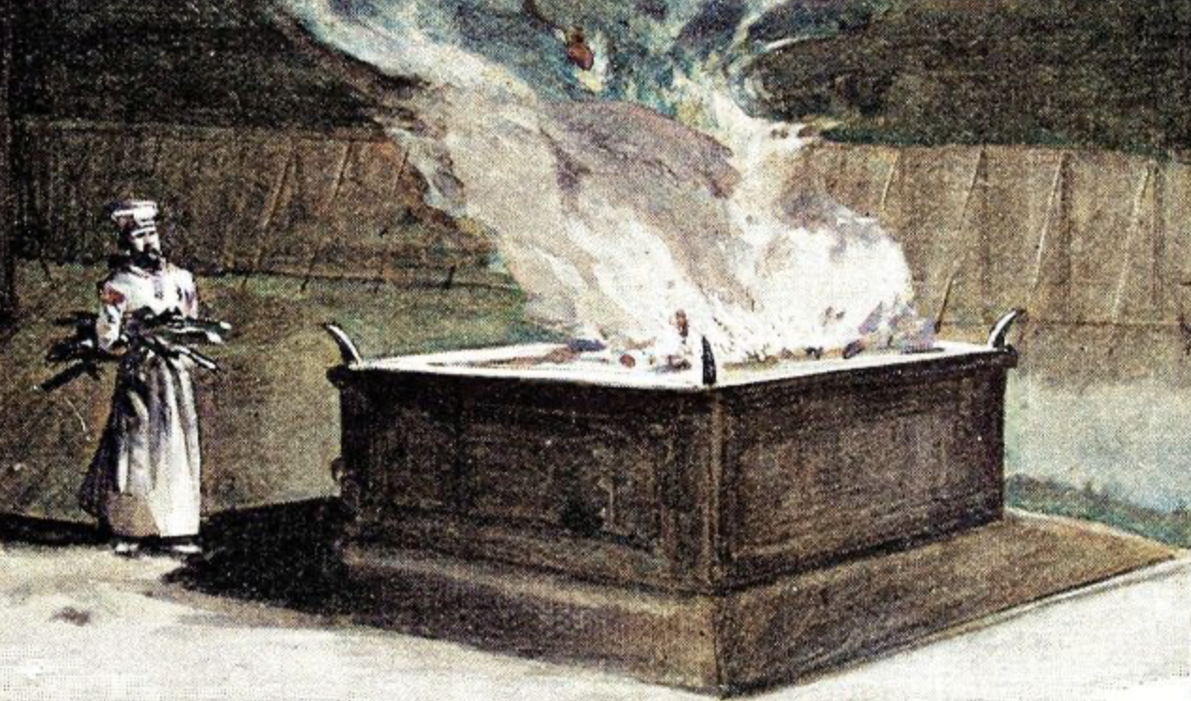
Jesus tells His disciples, as well as His religious enemies, that loving God with ALL our heart, soul, and might, is important enough to be the top command of God! It is a personal relationship that God is seeking with people! ~Vs. 2,3 [1st question] – God states that He has loved His people, Israel. Their general response to that statement is “How have you loved us?” Implied in that question, is the judgment of God exacted upon His own people! *50 years of being forced to struggle in the desert, on hold, just stuck in a holding pattern, until all the people older than 20 have expired /were dead and gone! So God’s people were asking the obvious - how was that love? Or how often had the land been overrun by bordering countries and tribes, who were exploiting Israel’s obvious political weakness, especially during the time of the judges? Every generation, or every other generation, it seems, were subjugated, exploited, and enslaved because they had not been faithful to their God, but had been unfaithful to Him by worshipping other Gods and by becoming as wicked, or even more wicked/depraved than the people groups around them. Then, of course, in recent memory, there were the captivities of the Assyria, Babylon, and Persian empires where their resistance had been brutally suppressed and all the best and brightest in Israel had been hauled off into exile and slavery to their captors. “What kind of love was that”, they asked? Well, when His people went off course so radically, God loved them by not letting them stay there! He warned them through His prophets each time He was going to stop protecting them, and they had never listened to Him until it was too late! It was the hardship and humiliation of estrangement from God that shook them awake each time and brought them to their knees in repentance and renewed faith. But here, it was happening again! They weren’t particularly decadent, but they were evil in their religiosity and hypocrisy! Everything was done for appearances / for how they looked to other people. Bringing a sacrificial animal to the temple to be sacrificed was a time for truth – for humbling oneself before God – for introspection – for an honest assessment of one’s ways! But here they were, bringing their worst animals – blind, lame, diseased - for sacrifice, instead of their best animal! It was a cost savings to them! They were going to put the defective animal down anyway, so why not get some use out of it? It had become common practice. Everybody did it! And how disgusting to God it was! It told Him everything He needed to know about how much He was actually their God! They did think He even knew or cared about their dishonesty, so they did not honor Him by bringing their best to His alter. ~ Zerubbabel, who had rebuild the temple, 60 - 100 years before, had started with the alter, offering sacrifices before the walls and roof were built [Ezra 3:1-6]! Then, the way I read it, he proceeded to build the temple structure around the alter! Now, there was a man who thought enough of God to honor Him – to give Him what He wanted most - the humble worship and the sincere service of His people! But first, sin had to be admitted and atoned for! Zerubbabel knew that God wanted people who desired more than anything to please Him! The last thing He wanted was someone who was trying to look pious, while ripping Him off - and thinking that He did not care! ~Is this only a problem back then? No - of course not! This is human nature! And when there are enough posers/fakers in the church - any church - the church becomes a disgrace both in the eyes of God, and in practical terms! Christians who are Christians in name only will go for many bad teachings, and cultural trends. They are easily led by false teachers into bad doctrine, aberrant teachings, and inconsistencies stacked upon hypocrisies. These are the “double-minded” that James talks about in his book! People without true faith, says James, cannot expect anything from God! Likewise the people of Malachi’s day! God tells them that their prayers do not get past the ceiling! No – it has to be real! God does not engage with “hearers” of the word who are not also ”doers” of the word! That is a prophetic word from your pastor! Be real! Be real!

