Slide 1

My Name Will Be Great Among the Nations
Malachi – Another Angry Prophet

Slide 2
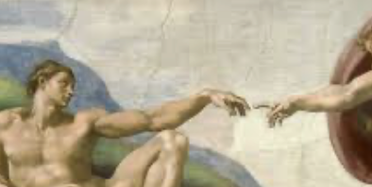
The Plan!
Coming to a head by Malachi’s time!
God was going to become a man – and not just for novelty’s sake!
Sacrifice and Savior!
God had to do what we could not do for ourselves!
The trust issue settled at the cross!
Malachi – a transition in the plan - “I will be known across the nations!”
The original knowledge of God lost purposefully!
Unwanted - a holy God!

Slide 3
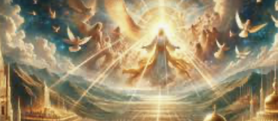
“Men loved darkness rather than light”!
A preference for evil, with evil human-like gods presiding!
A track record - consistently contrary to His image in us
The impersonal law of “cause and effect”!
Divine intervention vs non-intervention
Who is really to blame?!
Known – God draws all to know/come! [John 12:32]
His plan - coming to judge!
Victims will win /victimizers lose!
A thousand years of PEACE!

Slide 4
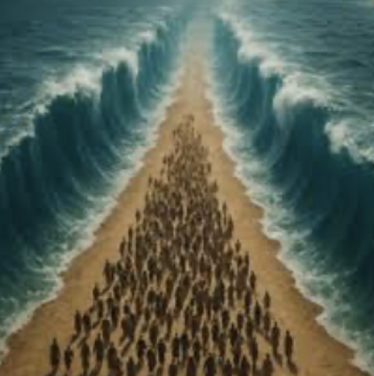
God’s self-revelation to friend and foe alike! His Even enemies were pre-warned of judgment!
God spoke to Abram and made promises “Abram believed God”; acted on the promise
  His nephew, Lot - warned to RUN from Sodom!
Jacob wrestled w/God - earned a name [Gen. 22:22]!
Egypt – waves of super-judgment! A most Supreme God!
Canaanites [Josh. 2:8-13]! (Even past acts of judgment used to show future mercy!)
Malachi – God’s stated intention was to be know world-wide!
  Jesus! [Col. 1:15-20]

