Slide 1

The God Who Knows What You Did! “Will He Accept You?!”
Malachi – Another Angry Prophet

Slide 2
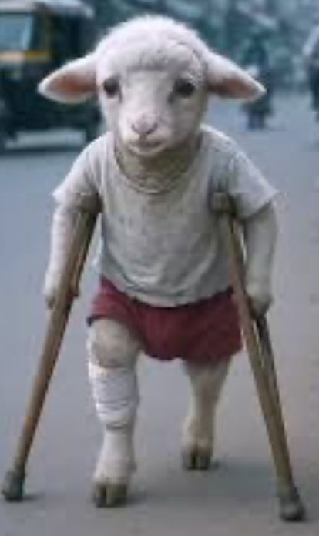
[Mal. 1:6-10] – [Prov. 29:18 - “Where there is no revelation/vision, the people cast off restraint”] Many stories have been written, and countless movies and endless TV programs created – from sitcoms, to detective shows, courtroom dramas, have all been created around some terrible secret that someone has that they don’t want anyone to find out. But of course, it turns out that someone knows, or someone finds out, which then creates a deeper web of lies and intrigue, and finally a motive for murder! But murder or not, by hook or by crook, the secret unravels, or is revealed. The entire story is about the lengths to which a person will go to keep their terrible secret, their skeletons -in-the-closet that are eventually revealed! It is usually a desperate, heart-pounding narrative of the protagonist desperately doing anything they can think to do, so that they can save themselves the humiliation/shame of discovery, or, to escape the justice they have coming to them! Christians are notorious for secrets. Either shameful things we did in the past that we don’t want anyone to know, or shameful things we continue to do in the present – kept secrets that if anyone knew, they would be deeply disappointed/heartbroken to know! But we all know that it is futile to try to hide our secrets from God. Yet we seem to perpetually try! Like if we don’t admit it to Him, He doesn’t see it! Perhaps many of us are rationalizing that God sees and knows everything about everyone, so He’s used to it. Out secrets are probably not as bad as the next person’s anyway, right?! So, we persist in our sin, becoming terrible hypocrites, which we, of course, try to keep hidden from our Church, or our Christian friends! We can be clever beings, and so there are a hundred different variations on that one rationalization, I’m sure. ~Here in the book of Malachi, God exposes a shameful but revealing practice that was going on at the temple of God… which meant that it was a national problem! Remember, the whole nation had to visit the Jerusalem temple at least once a year to offer sacrifices! By this time, we are talking about the second temple, the one called Zerubbabel's temple, which would have been fairly new at the time. The first exquisitely beautiful temple had been called Solomon’s temple, although Solomon’s father, King David, had accumulated most of the materials and drew up all the plans for the structure. But Solomon’s workmen had assembled it, so – fair or not - it got Solomon’s name, not David’s, attached to it - forever! Solomon’s construction crews started working on the project around 966 or 67 - it stood for approx. 400 yrs, but was destroyed in 586 BC., by Nebuchadnezzar ll, of Babylon, when they defeated Judah and annexed it into their empire. But, as I explained last week, after Cyrus the Great of Persia conquered Babylon, Cyrus had sent a Hebrew servant of his, Zerubbabel, back to Judah, with 50 thousand of his fellow Hebrews to reconstruct the temple so that they could pray for Cyrus to their God. Interesting! The temple they constructed was a far cry from the original. In fact, the text says that when it was unveiled, there was a deafening crown noise, half rejoicing wildly, and the other half, wailing and moaning because they were old enough to have seen the original, and Zerubbabel’s temple was so inferior that they were despairing! Perhaps, they thought, God would be insulted by the comparatively meager house they had hastily built to house His earthly Presence! It was only a few decades later that corruption and apathy had settled in, and worship, sacrifice, confession, repentance, had become a superficial, inauthentic form of worship, characterized by disgusting phoniness – in other words - cold, meaningless, corrupt religion! They said all the right words, but they brought sacrifices that were ill-fitted for such an occasion!

Slide 3

In Jewish culture, we see in the gospels that leaven/yeast, as well as salt, could be symbolic of sin. Well, during this time, a defective animal was symbolic of sin also. A healthy and flawless animal symbolized innocence and perfection. The Jews did not know it yet, but their Promised Messiah was also their God coming to become an innocent, perfectly sinless sacrifice for human sin – for their sins and for the sins of the whole world! These animal sacrifices pointed to the coming Savior! The Jews didn’t understand all of the whys but they certainly understood the explicit instructions of God to bring only physically healthy/ flawless animals to the temple to sacrifice as atonement for their sins. But here we have people bringing defective animals, and we have a new generation of priests who are accepting them! The priest were supposed to be the guardians of the process – the watchdogs of God, making sure that the instructions of the law of Moses/God was carried out to the letter! But here, at this time they were accepting defective and sick animals. Now, I don’t understand why this was acceptable to the priest class. When the day at the temple was done, the priests took home many of the animals that had been sacrificed, to be distributed to the Levite community. When the land was divided between the 12 tribes of Israel, the Levites had not been given territory to farm, or to raise vast herds of animals like the other 11 tribes. Instead, they had been set aside among the tribes of Israel to focus on the things of God. So, the Levites had been assigned to focus their energies upon the temple, it’s upkeep, and the practices that surrounded it – the sacrifices, the ceremonies, educating people in the Mosaic Law, in sin and salvation – and this generation of priest had become slovenly, apathetic, lazy – they did not care! They had no fear of God! Without the genuine fear of God, how could they inspire the people to aspire to the fear of God. ~Now let’s talk about that term. The fear of God” is a biblical term that does not mean strictly to be afraid of God. It means to fear Him as a child might fear their good father. What a child feels for a good father is a mixture of love, and respect, with an element of fear. The element of fear is there because the father represents the strength of discipline – the enforcement of a family code, and a father can use that to successfully fulfill his role . ~God had always relied upon His priest class to teach the people to have a healthy fear of Himself, teaching the history of the nation and their dealings with Yahweh! That would have put the fear of God into anyone! But, the problem was that for whatever reason, the priests didn’t have any fear of God either, and they couldn’t teach what they didn’t have themselves! Perhaps they just didn’t believe it! Maybe they saw it as myth, and fairytales! But here they were, accepting inferior animals for sacrifice – animals that the owners would have culled out of their flock to be destroyed anyway, because if they lived, they could pass on their defects to their offspring! So bringing defective animals for sacrifice at the temple (I’m willing to bet), was a secret, because people did not want to be known for being that cheap. What is astounding is that the priests were keeping people’s secrets like it was no big deal! ~Since the fear of God was absent in the land, God sent His messenger, the prophet Malachi, to call them out! The disregard of God that the nation was exhibiting toward God was not sustainable as far as God was concerned! People never stay in the same place. Societies never trend upward! Always downward! Terrible hardship placed upon them can cause a tick or two upward, maybe! But it is always a societal/cultural trend downward, toward moral deterioration and the breakdown of the cohesion of society! That is true everywhere, with every race of people that has ever been!

Slide 4
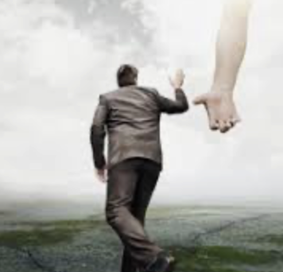
God knew where the Israelites were going if they did not stop right here and turn back! He had read their hearts and he had seen their behavior – their apathy and neglect of the relationship they had with Him. They did not take sacrifice seriously! Now, that’s a problem! If they were not taking sacrifice seriously, then they were not taking their sin seriously, or God’s reaction to their sin seriously, or God Himself seriously! And so God confronts their attitude with a telling question – “Would you try gifting a defective animal to your governor?” Of course they wouldn’t! They would At the very least, lose the governor’s favor! At worst, they could end up in a dungeon with the key thrown away! So no, they would never be so stupid! Which begs the question – “Then why are you doing this to ME –Yahweh/God, (from whom you draw your next breath, and from whom you get your next heartbeat!)” ~Now let me stop right here to bring this home! If there is any problem that is bigger than this in the church in western civilization, I don’t know what it is! APATHY! Going to church, playing the appearances game, going through the motions of taking communion, but not taking it seriously! The personal secrets continue unchecked! Playing church continues, and we think no one knows – and we already know that God knows, but He must not care because He seems to be silent about it! But is He? Doesn’t he stand back and let our secret sins erode our life! Our heart become less and less accessible to Him or to anyone! Don’t we become more and more false?! We always have to remember to stick with our Christ-following alter-ego, while we become darker inside, harder, yet overall weaker somehow! This happens when we know our character is very compromised – when we know we are stuck in a sin trap and can’t get out – and yet are okay with living a double life! And if we don’t know it, so much more the tragedy! That is a narcissistic trait – when a person cannot even see their own evil, sin, hypocrisy! They are all of that in spades, but cannot see it! And God still fights to bring us back! *You know the story of the one lost sheep, and how the Good Shepherd leaves the ninety-nine to go after the one, to find and bring it back! That is who the good shepherd is and what He does! But let’s say that something unexpected happens! What if the wayward sheep were to run and hide further and further afield whenever the Good Shepard gets close?! That is actually more common than we might think! But, Jesus said, “My sheep hear my voice and I know them, and am known by them.” The followers of Jesus follow Him – they run to Him! They don’t run from Him! If they do, (and, to be honest, most of us have probably run from God a time or two) but if we are truly one of His, we soon know that we have made a terrible mistake, and we come back to Him on the run! There is nothing so desperately, vacuously empty as feeling that we have estranged ourselves from our Lord and Savior! When He calls us back to Himself, we must go! Our secrets become an agony to us that must come tumbling out in sorrowful confession to our Lord – and like demons being painfully, forcefully, torn from their attachment to our soul , the Lord pulls them free of us! No longer will they be allowed to suck the life out of us! That is what someone who belongs to Jesus must do! The air, apart from Him, is without oxygen to us, and we can’t stay on outside with our secret sins and hypocrisies! We are suffocating without Him, so we must come bask and come clean! As we go to the communion table this morning, I want us to concentrate on our own apathy. Where have we become complacent about God and about His role in our lives? How is this compatible with the reality of Jesus on the cross, suffering for the very sins we should be suffering for? [John 1:29]

