Slide 1


Keeping Faith
Malachi – Another Angry Prophet

Slide 2
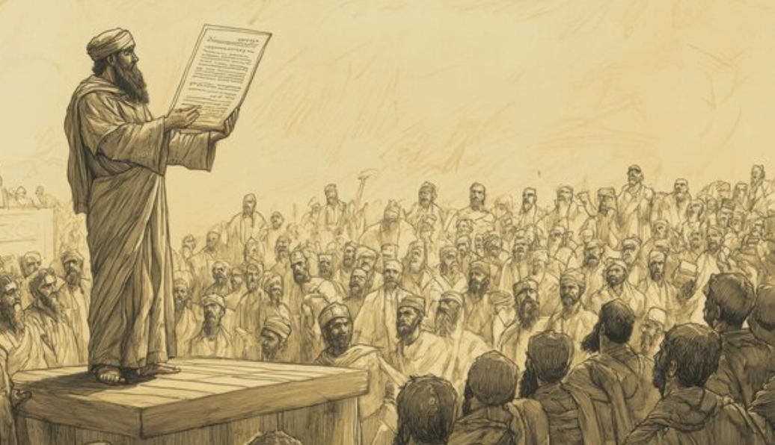
In our journey through the book of Malachi, (Mal-aah’-chi if you are Brian Becker, or if you are Italian), you’ve noticed that the prophet takes on some difficult/problematic issues. He had to have been an unpopular man with his contemporaries! He begins with attacking Israel on their pride. ”Sure, you can rebuild (and they just had – both the temple and the walls surrounding Jerusalem) but under the present conditions that YOU have let happen, from here on in, what you build up, I will destroy! I will not let you flourish until you clean this up”!! That would have been a VERY unpopular message in that day. These people were proud of their achievements, as well they should have been. But pride erodes reality. None of what they had accomplished would have happened without the approval and power of God being leveraged on their behalf! Now, a decade and a half later, they had forgotten God’s indispensable part in their national resurgence! They had generally taken the credit from Him, and now God was just window dressing – and they were treating Him with contempt in God’s own temple. They did this by bringing lame, blind, or diseased animals for their sin-sacrifices! So they were not taking God seriously, nor their own sin! But it had become a popular thing to do, evidently on a nation-wide level! ~Secondly, the prophet goes after the priests. The priests were all from the tribe of Levi, whose descendants, in the time of Moses, had proven themselves to be utterly loyal to God! But this generation of Levites were more intent on pleasing the general populace than they were thinking about pleasing God! They had allowed this epidemic of sacrificial defilement to grow and flourish! Now it was a part of the national culture, and the question now was, how do you stop it? ~At the end of chapter 1, God admonishes the Levites (contemporaries with the book of Malachi), that they should be more like their early forefathers, who had faithfully carried out their responsibility to speak truth to the perpetual failings of the Jewish culture! This strong, corrective message was supposed to have been carried on by the Levites to each successive generation of God’s people! The Israelites needed the perspective of God and the values of God re-emphasized/refreshed in the minds of each new generation of Jewish young people! That was the Levite’s job – a job that they had consistently neglected over the centuries! The Kings of Israel, and the people were often completely ignorant of the law of Moses, and the temple had, at times, been unused – a catchall for expensive junk and old scrolls! So God and the Levites had a history! As the Levites went, spiritually, so did the kings and the nation, and, unfortunately, it appears that, most of the time, the Tribe of the Levi was no better than the other tribes of Israel! So, if you remember, last week we saw that God vowed to, from here on in, turn their priestly blessings into curses and to humiliate the priests the way that they humiliated Him! They were an unfaithful tribe that spawned unfaithfulness in the whole nation! ~So then in this 2nd chapter, the messenger with message from turns to another VERY unpopular topic! The topics of faithless marriages, and divorce! Now, it is a problem to speak to this issue because divorce is so common in this culture, and all too common among Christians in the church! I cannot condone divorce. Sometimes I would like to,.. but I do not have the authority to do so! I cannot put God’s stamp of approval upon it because I know that He takes a hard stance on it! He does not do it to bring us sorrow but to bring us satisfaction. However, I do understand it in under extenuating circumstances. But - human’s being human - in every divorce, one spouse or the other, or both, claim extenuating circumstances!

Slide 3

There are two circumstances where I personally will agree to preside over a re-marriage of someone who has been divorced. A situation where a spouse committed adultery tops the list [*Matt. 5:32; 19:9]! Second, and last, is a situation where a non-believing spouse brings real resistance against a Christ-following spouse, not allowing them to worship or freely associate with fellow-believers – or if they leave them because they are a Christ-follower – and I based my stand on this upon [1 Cor. 7:12-16]. Paul uses the term “not bound” here, which has a connotation in the original language, of being released from the marriage contract as if the other person had died! But it doesn’t end there. Now-a-days, I have to include when spouses turn sexually weird – suddenly turning to same-sex attraction – or cross- dressing, or thinking themselves an animal. Evidently the perverted internet has really boosted the numbers of such occurrences. I’ve seen were couples have multiple children before one of them – I don’t know – snaps, I guess you could call it, and goes off into bizarre-land! There is also when a spouse is truly verbally and physically abusive, manipulative/ controlling, or violent - then I often (not always) counsel separation while the offending spouse has a chance to amend their ways (if they are so inclined)! Separation incentivizes the offending partner to take a good look at themselves and the damage they have done to their wife or husband. Separation says “this is not acceptable behavior, and I will give you as much time as you need to get your head together! If you cannot get your act together, you will lose me!”. Now, if bad behavior that is not named in the Bible is the cause of the divorce, that person is not given permission to re-marry! They can divorce, but cannot remarry without God’s disapproval! They can remarry, but cannot expect God’s blessing upon their next union. Jesus made that clear in His teachings on divorce! He calls remarriage in such instances, ”adultery” in they eyes of God! ~I want to say here that I understand the misery of a bad marriage! There is hardly anything worse! But God does not let us out of the contract we signed on our wedding day! It is intended to be ridiculously hard to break that covenant – even harder than staying together and working it out until a bad marriage can at least be better – where the intolerable things become at least tolerable, even though perhaps a bit miserable! I will say, before I’m done, that from my understanding, when a person comes to Christ in faith, their personal history begins at that point. What has gone before, sins and mistakes, is gone from the remembrance of God – our record cleared by the shed blood of Jesus! ~I cannot go into all the nuances of divorce and separation this morning – plus it would seem to be too directional toward people that have suffered through divorce, and experienced remarriage, and I am not trying to do that and offend this morning. But the topic needs some teaching on it for the sake of everyone, especially the younger generations, or I would be guilty of exactly what God is confronting the priests for in the book of Malachi. “I hate divorce” says God! It is a message directed to our very heart – our core being! It pierces through our rationalizations and our excuses when we want to break our covenants! In marriage, this knowledge brings us back to our covenant with our betrothed! First of all and foremost is that fact that any covenant is a covenant not just with another person, but with God! He tells us that if we align ourselves with Him, He obligates us to keep our word with people! When we say the words in our marriage promises/vows, “for better or worse”, God stands behind that promise and reminds us to remember our covenant in the midst of the ”for worse” times! Marriages always have the “for worse” times, and they can be awful! But with God standing behind us, we find our way through!

Slide 4

Now, I must go back to extenuating circumstances, where a marriage simply cannot continue, and those circumstances are more than we might think. God is not unsympathetic to unthinkable circumstances in marriage *I remember the horror of hearing that I man I thought I had been friends with had molested his two daughters! They grew up and, of course, told on him! That unexpected discovery by his wife was a legitimate reason end to that marriage! There are some things that there is just no coming back from! But there are other nightmare scenarios. Violent paranoia! Constant fits of jealousy and rage! Political obsession/derangement (it’s common now)! The cruelty of physical violence! Also verbal violence - terrible threats and Intimidations, awful cursing and insults/humiliations! Controlling behaviors where one thinks they own the other and can control them – (imprisonment)! Withholding physical intimacy is also a breach of the marriage contract! Now, this is not an exhaustive list, certainly, and there are others, but, only in the most extreme forms of these should there be divorce! By extreme, I’m referring to spouses that are habitually, consistently out of control! If it is occasional, then it is NOT extreme! It is hard to live with someone where one feels they must walk on eggshells all the time, but in many, if not most cases it should not end in divorce! In some cases it should, of course! ~Let me finish by saying that “Falling out of Love” is NOT a reason to divorce! That is the lamest reason of all, yet really the most common, and I think that this is what God is mostly referring to here in Malachi! Easy divorce – the desire to start over with someone “better”. I know that people want to feel love again, and to feel like someone really loves them. Let me just say this about that - ALL marriages lose the excitement, exhilaration, the luster of first love. Almost all marriages lose respect for each other at some point! So I can and must say this. If you are patient, and show some strength, something good/deeper/more substantive can take the place of that first love. First love is more intense but also more superficial. It will not last in that form! It must change into the next stage! You must look for reasons to love despite the things you dislike! Usually these things can be worked on and people can change, usually enough to make it easier to be together, and then more change occurs in time. Marriage is an exorcize in patience – often extreme! As Christ-followers, patience is one of the key fruits of the Spirit listed in Gal. 5;22,23! Marriage is our training ground and our proving ground for patience. Patience, forgiveness, kindness, thoughtfulness are the qualities of Christ that we are working on to grow and develop His character in our own lives! ~So,.. Karen and I have been married for 50 years,.. since Friday! Everyone that we have told this news to has smiled and offered their congratulations, and have said that 50 years of marriage is a great milestone. They seem to think that our love must have been special – a match made in heaven so to speak! But I’m here to say that it wasn’t! Marriage has been the biggest challenge of both of our lives! There have been a great many wonderful, euphoric, fulfilling times throughout these last 50 years, but the years have also been filled with times of misunderstanding, and of frustration! The battle of the sexes is real, folks – and I know that most of you know what I am talking about! But, the longer you are married, with following Jesus as your central goal - the better marriage becomes! It will NEVER be easy, of course, but it will be increasingly “good”! There will be more times, and times of longer duration where we do not experience the frustrations with misunderstandings that we have had in the past – where we are becoming better companions and friends with each other. We still have to work at it, and practice patience, and it is still not easy! But it is easier, and we have come to love each other dearly and need each other greatly! Christ is still central. If it wasn’t for the fact that He tied our original covenant with each other to our commitment to Himself, we might have broken up already before the 5 or 10 year mark! Our best advice is to remain grounded and growing in Jesus. Don’t try to improve and change yourself. Just follow Jesus ever more closely. He will do the changing of you! If you follow Him faithfully, it is inevitable! You will become a walking, talking testament to His reputation! May your life be a great miracle! Jesus as you pursue being like Him! God hates divorce, but He loves good marriages

