Slide 1

Mourners? Malachi 3:13-15
Malachi – Another Angry Prophet

Slide 2

So God has another accusation against His own people. Let’s see – so far, in Chapter 1, God has asked “Where is the honor (and respect) due me? Is it not wrong for you to offer me crippled or diseased animals?” In chap. 2, He asked “Why do you profane (break) the covenant I made with you and treat each other badly/dishonestly?” He also asks “Why are you divorcing your wives with impunity and breaking that covenant? I hate divorce!”. He ends that chapter saying “Why do you ask, ‘Where is the God of Justice?’”. And finally, in chap. 3 God asks “Do you really think you can get away with robbing me and not bringing in the whole tithe that you owe me? Test me in this,” He says, “and see if I won’t throw open the floodgates of my blessings”! [Jer. 7:9-11] ~Today, we are looking at 3:13-15, where God accuses them of saying “harsh” things about Him - and I would add to that, untrue things/ unjust indictments against God! The prevailing cultural wisdom had the average Jew going about with the mentality that they were just unlucky in their national and personal choice of gods – that there was no advantage to claiming this God as their national God! The age-old rap on God is that He doesn’t DO anything. *I don’t know how many times that I have seen some very inept, very careless, or very dangerous driving, and I have remarked “Where are the police when you need them?!”. When I do something really stupid behind the wheel, I take a quick look around and blow out a tense breath and thank the Lord that there wasn’t any police around to see what I just did! Well,.. The people of Israel were asking a similar question. “Where is God when you really need Him?!” They had a very sick child – “where is God? How could He just watch this suffering and not intervene?! A mother or father of young children tragically dies, and we imagine that God just stood there and watched that tragedy unfold before His eyes, without doing anything – or so we conclude! There is torture, and abuse, and terrorism, and people creating mayhem in the streets! There’s politicians that order the police and judges to look the other way! There are people being badly deceived enmasse, by good liars! There is the bad guys winning against the good guys, and the stakes are so terribly high! And we might tend to cry out “and where is God?” Well, this kind of thing was happening in Judea in Hezekiah’s day. People had medical emergencies then too – except that,.. for most everything, there was no remedy! A person either recovered on their own, or they didn’t! Calling in a doctor most often made it just that much worse! They would administer concoctions and techniques that had no basis in medicine! People in that day were also being deceived by dumb political and false religious ideas, as we are today, and ideas have REAL cause-and-effect consequences! I mean to point out that this is the perpetual state of mankind in his fallen nature and in a fallen and dangerous world! *If someone tells you to ingest gasoline to cure your stomach pain, and you trust them, and you follow through and ingest that poison, that is a bad idea from a bad or dumb person with some real consequences, for you, right? But acting on bad ideas actually happens every day, with people accepting someone else’s bad ideas, and suffering from it for the rest of their lives! Even we Christians have our false teachers passing on their terrible ideas! They are amazingly clever! They sound so authoritative! They twist and tweak, and redefine God’s word based on their own or someone else’s bad ideas! And the best of the worst are amazingly successful! And people flock to them and drink deeply from their poison - and in many, their faith, love, joy, enthusiasm… dies! Very real and substantial consequence, because bad ideas cause bad problems. Try building a house on the formula that 2 plus 2 equals 5, and you will create a crooked, unstable house that very well may fall in on you and your family at the first hard wind!

Slide 3

Some said in Malachi’s day, and some still say it today – ”It sure seems futile to serve God. What advantage is there?” – implying that we get nothing out of it! Well, some people in probably every church feel that way. It is a short-sighted, narcissistic perspective, and utterly intellectually and perceptively bankrupt! I have often thought that if Jesus is not risen, and all that I believe and have spend a lifetime teaching people about is not actually true, I believe the Christian belief system ingeniously leads to the best life that a person can possibly have on this earth! You are protected, and helped greatly to flourish under Christian precepts! *I get so disappointed with teens who complain that their parents don’t let them do anything! I mean, parent can be controlling and too restrictive, but most of the time they are just parents doing the things that they are supposed to do – like saying “no”! God has placed them in your life to protect you! Parents have usually experienced the dangers of making bad decisions, especially when they were younger - and often they have made the same terrible mistakes that their children are now so intent on making - mistakes that will affect them negatively for the rest of their lives! Their parental job is to try to stand in the way of their child being their own worst enemy! From the moment they can crawl headfirst off the bed, or fall down the stairs, to the time in their teens when they can choose to hang out with the wrong people, or form a close bond with a dangerous or exploitive boyfriend or girlfriend! Or for misusing the car, or for staying out too late, or being caught on the internet, going in places you should not have gone, or chatting with people you should not ever have been talking to! Parents are there to protect you from your own youthful naivety and stupidity! In the same way, the principles of life found in the Bible are placed there by God to protect us! The 10 commands are there as a framework for successful living – for doing well. They are not a restrictive device to put shackles on you to keep you from doing what you really want to do! They are like assembly instructions. You need those to put together a unit that will work when the last nut and bolt are tightened! They are necessarily restrictive – but without those restrictions, you will undoubtedly mess it all up – building something that looks bad and works badly, if at all! When I was young, I hated instructions,.. but after a few disastrous creations, I began to look for the instructions first, because anyone that has done a lot of assembling knows that there are good instructions and bad ones! The more complicated the work, it seems, the more obscure and impossible the instructions are to follow! Well, anyway, God is the Creator, and He gave us the manual in the Bible, of what it means to be human, and to do it correctly! We can follow it, or just go by our own instincts, making up our own rules or playing it by ear! History is a sorry-looking record of people going by their own instincts – and I mean sorry-looking! The mayhem, the injustice, the suffering and tears. ~So, when people ask the common question or what we gain by serving God - the answer is that we gain everything! When a person actually asks this question, either they don’t know God, or have not been listening to Him! They have not been very observant. I heard of a pastor that I had greatly admired when I was young, who, sadly, in his elderly years contracted a terminal form of cancer! The doctors could do nothing more. Thousands prayed for him in faith and with great hope of a miracle of God. He cried out to God for healing, but it soon became clear that a divine healing would not be arriving for Him. After a lifetime of faithful service to Jesus, he was gong to soon die. In his last weeks on earth he became bitter and resentful toward God and even God’s people – his friends and admirers who had fervently prayed for Him.

Slide 4
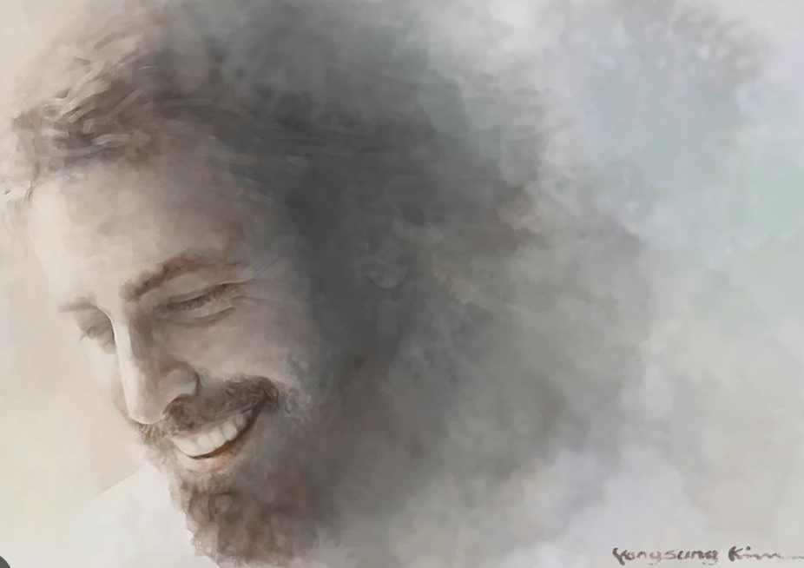
Now, when I heard that, I was disappointed. We all have to die sometime, in some way, and there’s not many good ways. I think his short-sighted question was – “Lord, I have served you all of these years, and proclaimed you tirelessly. What have I gained from my faithfulness to you. You won’t even listen to my plea for a healing that you could effortlessly give me so that I could go on to serve you more” - and he died, angry at God. I would have liked to have been there to heard his next conversation with God! Now,.. it could be that in his infirmity, his disease affected his ability to think properly. His response to the later stages of his cancer was definitely NOT like him at all! But I was reminded that even the best of us can lose our perspective and lose our way! But when it happens, it’s ugly every time! [Ps. 32:8-10] - God’s harsh assessment. ~Life in God is such a place of security! I’m not right, but He is! Bank on it! [Ps. 1:1] Now,.. what we tend to lose is our memory of God’s great many goodnesses/blessings to us through- out our days! It opens us to rejoice in God and to trust in Him! This is why the Bible emphasizes gratitude the way it does! It’s basic – beginning with the joy of the warmth of the morning sun on our faces, and at night, the multi-colored horizon of a sunset, reflected in the lake! Spectacular! The relief of a nice rain after a long dry season! Having our needs met throughout our days – food, solid shelter, soft beds, work, play. The precious love of family, and the easy satisfaction hanging out with friends! I never forget to thank God for anesthesia at the dentist’s, or doctor’s! Then there is the undercurrent of God’s benevolent Presence in our lives. I can’t tell you how comforting that has been to me over the decades of my life! He is my God! He knows me! Through faith in His Precious Son, Jesus, He loves me, attends to me, hears me, knows me! I’m so proud that He is my God! His kindness covers me; His goodness perpetually encourages me! His courage and heroism displayed at Golgotha on the cross, blows my mind! And that,.. THAT is my God – the One who is with me at all times! There is no better way to live than to lean on His strength, depend on His wisdom and guidance, to subscribe to His ageless truth – the truth of His written word, the Bible! And finally, to fully sign on to His earthly purposes. The Creator/God’s intent is literally to save the world to Himself! To sign up and be a part of the effort of God in this is so utterly fulfilling! Now I am engaged in something of substance! Now I don’t just have a cause (cuz anyone can have a cause) but, to have THE cause – the only one that we can take with us when we die! That is a “calling” upon my life – to persuade/show/assist, and win people to believe the Gospel of Jesus Christ that they might be reconciled to God through faith in His Son – and be saved! My further purpose is to live in such a way that I stand out like a beacon – calling people to the love and grace of God! This is the life! This is the joy of life! God-lovers don’t go about with long faces! No one can laugh like a Christ-follower! I mean that! There is the special mirth in our hearts. We see the humor in things – especially everyday things, because our heart are really at peace! The distraction of anger, rage, and malice that fuels the culture’s mentality, is not there in us! We are crucifying the self so that there is room for Christ to live and rule inside of us! Authentic Christian do not go about with long faces! There is a smile in our heart that climbs into our faces! How could anyone say that there is no advantage to following Jesus? ~Now, of course if you are going to follow Him, it is all in! You’ve bet everything! You cannot pursue Him half-way – maybe you’ll obey Him and maybe you won’t – depending on how you feel in the moment! No – that is not Christ-following! That’s meandering in a faith-eroding pattern between following and constantly getting lost! [Gals 2:20]

