Slide 1

The Great Scroll of Remembrance Malachi 3:13-15
Malachi – Another Angry Prophet

Slide 2
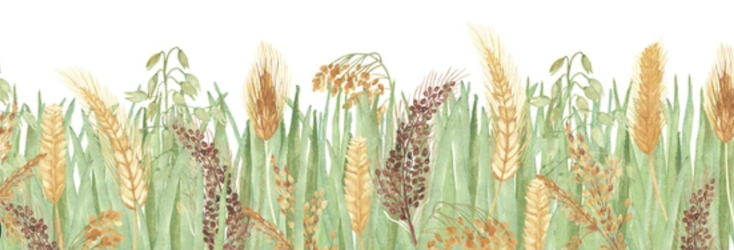
So – now we are nearing the end of the book of Malachi. The Lord had leveled his charges against His people – 1 - corrupt worship practices 2 - profaning the covenant with tribal conflict, 3 - as well as divorcing the wives of their youth. 4 – Questioning God’s justice, 5 – stealing from God what was His by not bringing in the whole tithe to the temple - and lying about a partial tithe being the full tithe, and 6 - questioning the advantage of following the God of Israel and passing the false rumor that the idolaters around them had it better than they did! All of this combined to make for a populace that was becoming increasingly apathetic toward God, and negligent toward His temple and His priests. Of course, His priests were in on it and a large part of the problem! Looking forward, seldom will a group of people improve upon the trends their leaders have set, and Israel was no different! ~But after all of that, our text says that it got at least some people thinking about the critique of God through His prophet – people who were taking it seriously, and talking together! It the most fundamental level of humanity, people break down into two key categories – just two. Now-a-days, people are most often classified by superficial categories such as ethnicity/racial features – what color their skin is, or what continent their ancestors came from. Another category might be religious categories – Christianity at 2.3 billion; Islam next, at 2 billion; Hinduism at 1.25 billion, Buddhism comes in at 540 million, and ”various folk religions” at 400-450 million people. The other 2 billion, roughly, would most likely be humanist secularists who proudly proport to have no religion. And people categorize others based upon their religious identification. Some people break down the populace into political categories – Republican (MAGA right, moderate right, or Rhino – liberal right) or Democrat, (liberal - left, progressive – far left, Socialist, which is usually unabashedly Communist now. Once people place you in one of those categories, they think that they have pretty good handle on who you are, and that would probably be true in most cases. But more basic than those are those who have listened to God’s indictment of humanity, and those who don’t! Now, there are all kinds of factors that can keep a person from taking God – the Creator/God of the Bible – seriously. Someone might say, “Well, I’m a Moslem. I only listen to Allah”. Or, “I’m a Hindu – and I believe in all kinds of gods, but I don’t believe in the Christian God!” Or I’m Buddhist – where there is no person of God, and therefore nothing personal Him, Her, It,.. but just a cosmic consciousness! They will certainly not take anything He is purported to have said as worth taking seriously!” But in the end, God – in His role as Judge of the Earth – will separate all people into one of two categories – those who believed Him, and those who did not believe Him! He will not care about any of the other categories! It will boil down to just two! ~[Matt. 13:24-33] According to Jesus, there will be a time when even people in the church will be separated… like a wheat crop where the enemy has sown tares in the night! A tare is a weed that grows up with the wheat, looking like it, but not being it, especially when the tops tassel out with grain. The tare doesn’t bear the same grain-fruit! So, the farmer at harvest time, will have to separate the real wheat from the weeds that have grown up with the wheat and have masqueraded as wheat throughout the summer. But in the end the farmer has his workers going through the sheaves of wheat, pulling out the tares and then the weeds are “burned”. Their seeds will not be able to infiltrate next year’s crop! There will be some tares every year, but not one will escape the winnowing-out process in the end, because the farmer knows and is never fooled! Of course it is an illustration of how God will separate people in the end, specifically the people in His church – divided by those who listened and consistently applied the word of God to their lives, and those who didn’t!

Slide 3

In our text today, it says that God listened and heard people’s conversations about the message His prophet had delivered to the people! HE LISTENED IN! He saw the difference in the conversations of those who listened! They were excited to hear from God. Their attitudes were not soured when they heard God’s rebuke, but the opposite, because then they had something specific to go on! They were more than happy to see their offenses to God – offenses that they had not seen before. *Have you ever gone to pick up your house when you know someone is coming over, and you are looking at your home with THEIR eyes! Suddenly you see the cobwebs up in the corners of the room, and those spindly light-colored spiders that seem to blend right in unless you look close! They didn’t suddenly appear, but have been there for some time, slowly accumulating, and you are embarrassed to know that you never even noticed until now! So you get busy - the broom or the vacuum, and suddenly you see more things that you didn’t see before, and a little job turns into a big job! Am I right?! But you don’t resent seeing these things! You are glad to finally be aware of them so that you can roll up your sleeves and remedy the situation! But there are those that don’t want to know! They resent seeing, and hate hearing. But Jesus differentiated his audience members between those ”with ears to hear, and eyes to see” and those without “ears to hear, and eyes to see” - to see what He was talking about/pointing out, which was most often hard truth! To those who resented His words, their blemishes/mistakes/sins are just fine with them, and it does not bother them in the least to live with them! It bothers them more when it is pointed out that their flaws are there! ~In the church, the two different reactions to Divine confrontation most often are a reflection of where a person is at with Christ! As we practice our Christ-following, we should always keep that in mind, and examine all things carefully to see if they are true. “Do I have the right values? Do I have the right priorities? Do I have the right motives? Do I have the right attitude in my life – especially as I serve Christ – but also in all the activities of my life? If the attitude is not right, we will know it deep down, even if we do not like to know it, and can accept that the reprimand and the the inner unrest it generates in our heart about that (those) issue(s) is most likely coming from the Spirit of God! Anything true of us – even the stuff we find unpleasant to hear, should be welcomed and, ultimately, treasured [Prov. 27:5,6]! ~The stuff that is not true, and we know it is not true of us, can be passed off. “It applies to someone, but not me”. That particular thing is not my particular sin problem, and I therefor I don’t have to be offended by it! Maybe someone else can welcome that truth as a needed part of their journey!” But God is not trying to humiliate us or put us down when this happens. If we humble ourselves before the Lord, and acknowledge before His Spirit that we have been wrong, He says that He will lift us up! That is always His purpose. Sin hurts us and disables us like a bad leg! God is simply trying to do some surgery for proper healing, that we might represent Him better. [Heb. 12:10,11] ~ “… and the Lord listened and heard!” He gave the people scripture containing a reprimand on specific dishonest activities surrounding their temple worship, and their lives together - and some people really took it to heart, and because they took it to heart, it entered their conversations together, and God was listening in! Usually in matters like this it is a small minority who really take it seriously enough to make it a topic of conversation between themselves and God – maybe 10 percent or so, even of Christians in any given congregation! In other places in the Old Testament, they are referred to as ”the remnant” – those who remain faithful – those few, percentagewise, who God had quietly observed who were still worshipping Him exclusively – and who had not gone with the frolicking crowd to worship idols and indulge their fleshly lusts! [Rom. 11:2-6] Here, Paul refers back to the Old Testament to prove a point that Israel was under the judgment of God, but that God had not rejected Israel entirely! Although as a whole the nation had rejected Jesus as their Messiah - like the “remnant” of old, there were a small percentage of Jews who had heard the Gospel of Jesus and believed! In fact it was these Jewish converts, Jews of diaspora, in gentile cities around Asia and Eurasia, that had been the backbone of the church startups beyond the borders of Israel, for at least couple of decades!

Slide 4

Then the prophet of Malachi records an astounding thing – a glimpse into that great and mysterious place that we call “heaven” - and the fact that what happens on earth is recorded in a great book there. Now why God would need a book to remember anything, I have no idea. Or maybe this is not a literal book/scroll, but imagery to create a familiar picture in the mind of the reader/listener – and image they can relate to. Whether this description is literal or figurative, what we can gather from it is that there is a record in heaven of who are actually in the possession of God, and who are not! There is a ”day” – a time and place – when the people will be gathered, and God will recognize those who are His own – the remnant – the listeners – those who “feared” God – in other words, loved and respected Him while on this earth!
[Rev. 20:12] Here the Book/scroll is referred to again, and not for the first time! It has a name – “The Book of Life” – and in it are the names of those who are “the redeemed”, and the redeemed will be judged by what their Savior, Jesus, has done for them, and the unredeemed will be judged by what they have done for themselves – and NO ONE can stand under such scrutiny! The redeemed will have their sins cleansed and purged from the record, and the unredeemed will have all that they have said and done while on this earth r [recorded in the annals/record books of heaven! [Rev. 21:27] - The full title of the book is actually “The Lamb’s Book of Life”, because it is only through the finished work of Christ on the cross that anyone can be saved – even those of God’s people who lived back between creation and the cross! There is no question in my mind that before Christ, people were saved by Him. The sacrificial system of Mosaic Law, where innocent lambs were slain and their blood shed on the temple alter for the sins of their owners – that was all pointing forward to the ultimate single sacrifice of Jesus, Son of God, on the cross! So the effects of the cross stretched backward to creation, (as even Cain and Able offered sacrifices to God). and forward to the great and final judgment of God, to save those who “feared God and honored His Name” (Mal. 3:16) I am reminded of what Jesus said in John 14 – “I am the Way, the Truth, and the Life. No one comes unto the Father, except through me”
We will return to this all-important topic next week as we begin to close out the book of Malachi!

