Slide 1

Treasured Possessions! Malachi 3:16-18
Malachi – Another Angry Prophet

Slide 2
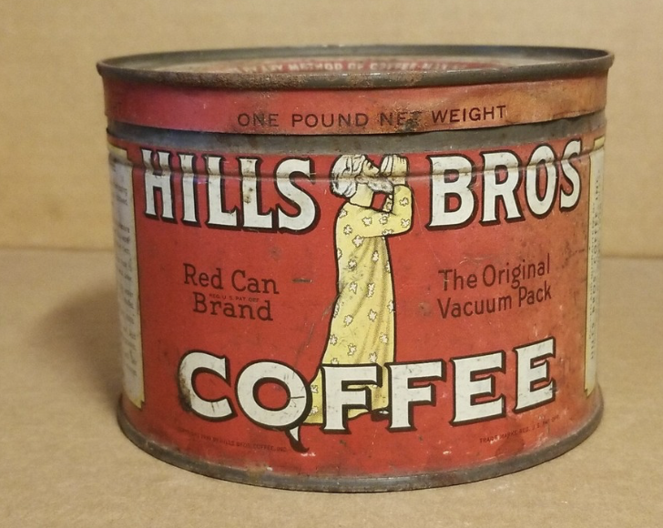
When I was a kid, I had an old half-gallon coffee can that held some of my favorite things in it. It wasn’t anything much, but it was my stuff! I don’t remember exactly the items that I had collected, but if I know me, it would have been things like a weathered brass 30-30 shell casing that I might have found on the ground out in the country, or a plastic toy I had paid for in excruciating fear and pain at the dentist’s! It would have been a few of my favorite baseball or football cards, or some Coke-a-cola bottle caps that had pictures of Green Bay Packer’s players printed on the underside (and that would have been during their three-year championship run back in the 60s, so it was a big deal!), AND I do remember that I had maybe five dollars in quarters in that I had saved from birthday money, Christmas money, and snow shoveling money that I had saved up! One summer, I even had the big idea of burying the can in our bad yard at one point, because the thought of buried treasures appealed to me, as I had quite an imagination! I remember that it gave me great pleasure and satisfaction for a time, to know that I had that secret stash of favorite things squirreled away. I had the sense to dig it up before winter when I knew that the ground would be too frozen and hard to do that! I remember that I did not bury it again. [Mal. 3:16-18] ~In the end of the book of Malachi, chapter three, God is answering the spurious charge leveled by a much-too- large portion of His people, that there was no advantage to obeying the God of Israel and living by His requirements [3:14]! It was a charge against God that had evidently become a popular complaint. You know how these types of ideas get passed around and can grow a life of it’s own among the general populace. *We have certainly seen this phenomenon up close and personal with the advent of the internet and social media where people can get lost in internet rumors, and click-bait, and conspiracy theories, most of which are out-and-out lies sent out into a public forum to earn money for those who seem to have developed an uncanny, diabolical understanding of human nature, and who use that knowledge to create clever lies so that the eyes of a lot of people will fall on that click bait byline, and be compelled by curiosity to click on the story - and they will make money in this way! The more clicks they get, the more money! The more outrageous and provocative the title and “teaser”, the more clicks and “likes” they get – so exaggerating and even total fabrication, is incentivized! The ones that are really good at this are getting fabulously wealthy by it! It doesn’t have to be true to become a popular belief! Well, human nature has never changed. They didn’t have social media in those days, but they had gossip, and rumor, urban myth, and trolls/evil-doers who loved to deceive and cause unrest. But God was the target this time and He wasn’t having it, not without a response! First, in vs 16, He says He hears it all, everything that is said, and that those who listen to Him and to His messenger/prophets are written into a permanent record in heaven – a “Scroll/Book of Remembrance”! It reminds us that one of the advantages of sticking with God, is that He will always remember that you stuck with Him! “And they will be mine in the day that I gather my treasured possessions! “, *Again, as a child, I took great delight in my little treasures – cheap toys, small memorabilia, small objects that I had run into that I thought were unusual, or special in some way, and then a few dollars in coins! How human of me, finding such pleasure in things of no consequence, because that is what humans do! But the Creator/God collects PEOPLE and takes pleasure in them! How about that! He finds his satisfaction with people! We treasure our comparative trifles of homes, draperies, appliances, or cars, mowers, and tools. We prize our computers, games, and phones. We take pride in our clothing and our footwear. But God treasures people!

Slide 3
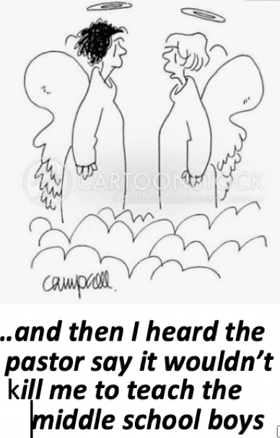
The Bible states that “God so loved the world”! But the ones in His Book of Remembrance He is able to treasure, even as they treasure Him! He draws near to them and is their God and they are his people, His treasured possessions! If they are not in His “book” of names, and are not interested in Him, He can only love them generally – giving them sun and rain – providing them with calves, lambs, and babies! Most of all, He provided a Savior for all! The Creator/ God, Yahweh, went through a great deal of planning, effort, and frustration with His “chosen” people. They were chosen to be the means by which the Word, second member it God’s Tri-unity, would enter the world from His place in heaven, where He would condescend to take on full humanity,.. to literally become genetically human! But before that could happen, God’s chosen people did just about everything they could do to sabotage that plan and delay it. Not on purpose, mind you, but simply because for 2000 years they kept choosing darkness over light stupid, mythical, immoral idolatry over the worship of Yahweh/God! That angered God repeatedly and triggered Him to curse their land and open them up to marauders from neighboring nations to come in and steal from them and subjugate them! All of that was to humble them and bring them back to their senses, so that they might turn back to the True God, Yahweh, and get back on the path. But with each new generation, it was a challenge for God to educate the new crop of people (every 20-30 years or so), and keep them tracking in the path He had ordained for them. His class of priests did not seem to be much help to him in this! ~This is exactly why we work so hard and expend so much volunteer energy on teaching the Bible to our children here at Bethany. We don’t want our children pulled off into the latest chaotic wind of cultural nonsense, or the sectarian wind of false biblical doctrine! If they just know what the authority of scripture says, and they are interested in listening to God in His word, they are much less likely to go astray! Now, this is important – and I know that in our children’s programs here at Bethany, Jack Hodges, fearless leader of our children’s program’s, works very hard at teaching the children entrusted to us. On our first day of Sunday School, for the new Sunday School year, we want to acknowledge the excellent guidance he has provided in this regard, and the passion he has for the children to be taught the truth of God’s word! Because we believe that for every bit of the knowledge of God that gets through to impress itself into the mind of our kids, the less of a problem they will be to you, now, and in the future! Why? Because knowing God, and the biblical truth of God, makes them smart – where they cannot be fooled, manipulated, coerced, confused, and turned around by the bad ideas and influences of people! The Bible says that “the knowledge of God is the beginning of wisdom”, and we are trying to raise kids in a way that they have EVERY opportunity to be wise and to avoid the snares and pitfalls of this world, and even of Christianity itself. I mean, Prov. 22:5 says “Train up a child in the way they should go and when they are old, they will not depart from it”. It is not a guarantee in every instance, but a general principle/ a rule of thumb. In our family life and in our church, we are to properly do everything we can to give our children the tools to be wise people with uncommon common sense! Today, the main means to be wise for a person - child or grownup – is for them to give their heart and their live to Jesus and to walk in harmony with Him for all their days! To live one’s life for the glory of the Creator/God rather than the glory of self is a beautiful thing! To live with honesty, and with a pure heart, and with love for all people is a wonder to behold – and this is what a relationship with God does. A person still must fight their corrupt human nature, but in Christ we are given the tools to do so!

Slide 4
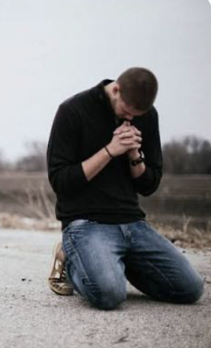
When they give themselves to Jesus, their names will be included in the Book of Life! Now that is the most thrilling moment that a Christian parent can possibly imagine for their beloved child! ~Now,.. the bad rap on God, to the majority in Israel, was that there didn’t seem to to be any practical advantage to having Him as their God! Those outside of Israel seemed to be doing as well or better than the Jews were within the borders of Judea! But God sets them straight here! He says that it may seem like that, but one essential advantage is that He will remember those who remain loyal to Him/who serve Him only, and He states that they will be His “treasured possessions”! Now, that is an eternal status! That is a BIG deal! The Bible says that God made mankind in His own image, but did not specify what that means exactly. I would speculate that part of the meaning of being created in the image of God is that He created us with eternal souls, like His own life – giving us the whole of eternity- future to be with Him in His heaven, and there to remain forever as His treasured possessions! Can anyone think of something better, richer, more desirable than that?! ~We should note that God says in vs. 17, that this group of people, those who are His own, and who He will remember, will be “spared”, and that begs the obvious question,.. spared from what? Well – spared from His ultimate rejection! While His love is eternal to those who have made Him their one-and-only God during their lifetime on earth, His rejection of those who haven’t is eternal also! Let me explain, just to make sure, because this is All-important! This earthly lifetime is God’s gift of a chance – a “window of opportunity” – the moment of “NOW”/ the present, given to all people with eternal souls – a crack at eternal life, given to even the worst of us! But to those who miss that window during their lifetime on earth at the start of their eternity (or what we call “today”) - by neglecting or rejecting the Savior, Jesus it’ll be bad [Heb. 3:12-15]! Jesus is the eternal Word of God who became the Son of God in Bethlehem. From eternity past, He has always been the 2nd member of God’s Tri-unity, who God sent to earth to provide humanity with a way of escape from the wrath of God/or to phrase it as Malachi phrases it here - for God to “spare” them - from His eternal wrath/rejection! ~I will conclude with the words of Malachi ending chapter three. “…and you will again see the distinction”. In other words, if you can’t see the difference now, between the believers/followers and the non-believers/non-followers, just wait! That distinction, that separation between those who are God’s treasured possessions and those who are not, will become very apparent on the day that he separates the people between His treasured possessions, and those that have gone into eternity without Christ! If you think there is no real advantage to following Christ, you must think again! One day every knew will bow and every tongue confess that Jesus Christ is Lord, to the glory of God the Father! Scripture say exactly that! Right now, while it is called “today”, to bend the knee to Jesus and declare His greatness and supremacy and your own need for His salvation is to belong to God from this moment on! Now this will happen, sooner of later. To be forced to kneel and proclaim Christ as King of Kings and Lord of Lords after this life is over - on the day that God separates everyone - is only the initial humiliation part of the punishment - just the beginning of suffering! But one way or the other, everyone will have to do it. Better to do on this side of life, don’t you think?

