Slide 1

The Coming Day of Wrath! Malachi 4:1-3
Malachi – Another Angry Prophet

Slide 2
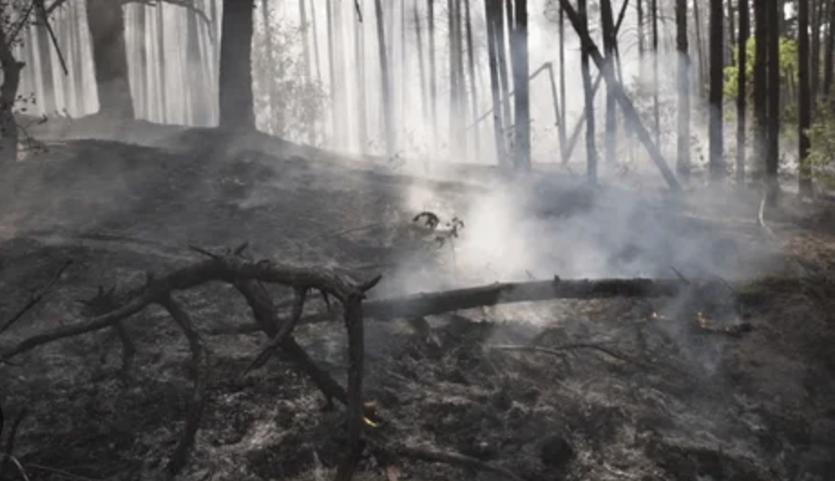
Two weeks ago, I concluded with these words: ~”I will conclude with the words of Malachi ending chapter three. “…and you will again see the distinction”. In other words, if you can’t see the difference now, between the lives of believers/followers and the non- believers/non-followers of God – just wait! That distinction,.. that separation between those who are God’s possessions and those who are not His, will become very apparent on the day that he separates the people into the haves and the have nots! If you think there is no real advantage and therefore no need to follow Christ, you must think again! One day “…every knee will bow and every tongue confess that Jesus Christ is Lord, to the glory of God the Father”! Scripture says exactly that! Right now, (while it is called “today”), to bend the knee to Jesus and declare His greatness and supremacy and to admit wholeheartedly to your own need for His salvation, is to belong to God from that moment on! At any rate, the bent knee will happen either sooner or later. To be forced to kneel and proclaim Christ as King of Kings and Lord of Lords after this life is over - on the day that God separates everyone into those two groups – again, those who are His, and those who are not - is only the initial humiliation part of the punishment - just the beginning of suffering for those who are not! But one way or the other, everyone will have to do it! And I finished with “It is much better to kneel before Christ on this side of life, rather than in the next ~Now, the question, still at hand in Malachi 3:14, is – “What is the advantage of following a righteous and holy God if those who do not know or follow Him seem to be doing better and are having more fun than God’s people are?” But in the next and last chapter, God switches to a new reason why it is to a person’s great and overwhelming advantage to remain loyal to the Lord God! And here’s why! First, God hears and remembers how people react to His instruction and His warnings. Those who listen to Him and take it to heart have their names written in His great “Book of Remembrance”! Believe me, you want your name in that book! But then, in outlining key reasons why it is good to stick with Him, God brings up “the day”! The prophet asserts once again, like so many of the other prophet in the Old Testament, that they foresee a day – a day “that is coming” where “the proud and arrogant”, the unrepentant “evildoers”, will be subject to the unbearable heat of God’s wrath – a heat that they cannot/will not survive! Most of the major and minor prophet explicitly point to a day of reckoning for this planet! Understand that this is a cursed earth, in rebellion to their Creator, and so, what remains to the eyes of God is a masterpiece of His that has been soiled, defiled, and ruined over and over again by its human populations! Now,.. we know that the earth has amazing recuperative powers. *A fire sweeps through a forest, charring it black and dead. But ten years later that same area is teeming with new growth – trees saplings everywhere – some already 15-20 feet tall, and there is thick undergrowth that feeds a flourishing variety of herbivores (plant eating animals like rabbits, and deer) which feed a flourishing population of carnivores (meat-eating predators – coyotes, wolves, big cats, bears). The recuperative powers of the earth are absolutely amazing! When mankind destroys each other - when nations destroy rival nations - the landscape is charred and pockmarked! Handsome and orderly cities are reduced to chaos and rubble! The victims number in the thousands, even millions, and their cries of agony, and groans of death last only for a brief time! In the next 20 years, the survivors clear the streets, haul away the rubble, and build new buildings on the foundations of the old. The pockmarked land grows a thick carpet of grass and forests to obscure the battle scars of where even the largest battles once ravaged the area. But, if you could see the whole earth as God sees it, you would see that the earth heals itself! And humans rebuild! But mankind is always destroying other humans somewhere on this planet! And the Creator has been subject to this unspeakable and reoccurring tragedy throughout human history! Can you imagine having the viewpoint of God - knowing all the terrible plans of psychopathic people in power in this world – plans concocted in secret rooms – and then to know of every cry of their every victim! What about the actions of sadists, and serial rapists, and serial killers? What about the cries and prayers of their victims? What about the tortures of people like the infamous Nazi, Dr. Mengele who experimented on people! What about their cries? What about all the Christians that have been tortured and killed over the last two millennium – usually by another Christian faction? God is especially aggrieved by this! And He promises that the offenders will pay! His rage will finally reach the boiling point and spill over onto the surface of the earth in real time!

Slide 3
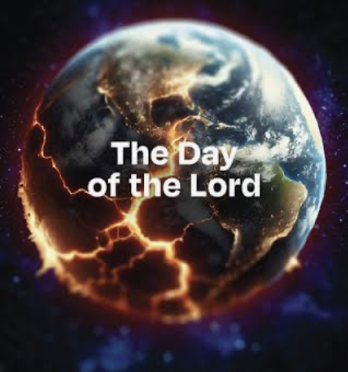
Men have also harmed God’s representatives – His prophets/spokesmen – throughout history! They have been hostile to God by-en-large, and murderous to most of those He has authorize to speak for Him, and this trend culminated in the horrific, torturous death of His beloved Son by His own people none-the-less It has also continued to follow Christ’s church through the last 20 centuries. Nowhere in the world has there not been a terrible persecution of Christians by Communist governments, or by Muslims, or Hindus, or by so-called Christians themselves! In fact, after the so-called “Great Reformers” escaped the persecutions of the Roman Catholic church in the 1500s, they themselves turned around and perpetrated a great persecution upon the anabaptists, which was a variety of Christian movements, and ultimately the predecessors of the evangelical movement of today. In fact, the Evangelical Free Church in America was formed as people fled the persecutions of the state Lutheran churches in Europe! In fact, from what I understand, this church in Clintonville was the second Evangelical Free Church ever to be formed and incorporated here in America, way back in 1892! Now there are approximately 1,600 EFCA churches in America! ~Today, none of us have known persecution of any kind! But those days are swiftly being left behind as societal hostility toward Christianity is becoming increasingly extreme, especially in the bigger cities, and especially among the youth! Indications are that we Bible-believing Christians will not be able to hide behind civil law indefinitely! One day – and probably soon – like in Canada and Britain today – the law will be re-written and used against us! Maybe then we won’t feel like being so forgiving to our enemies, but can understand and get behind the vengeance of God [vs. 9]! ~But the prophet-messengers of God in the Bible, say over and over and over again, in both the Old and New Testaments, that there is coming a day, a day of retribution for God to go against the world! The scripture refer to this time as “the Day of the LORD (Yahweh)”. Now this is an actual prolonged study in itself! There is a huge amount of material on it in the O.T. – especially in the Major and Minor Prophet – in books such as Malachi, but there is plenty of it in the New Testament also! The biblical content regarding this topic is huge! It is a depressing topic for us in America, to say the least, but that is purely because we have never truly felt the evils of men directed at ourselves or our loved ones - like confiscating our land and homes and bank accounts! Like confiscating our children, imprisoning us, and ultimately killing us! They do it right now in communist China all the time! And now, Marxist communism is knocking at our doors in the USA! People are VOTING for it! But when it happens, (not if it happens) we will not be as sad about the arrival of the day of the Lord when all who oppose God and persecute God’s people will receive the retribution that they have coming, and they will receive it on this side of life! We KNOW they will receive it in the next life, but in the day of the Lord, all of God’s pent up wrath against His enemies since the fall man in Eden, will be justly poured out upon a single generation of His opposition! He will wipe out all opposition that rises up against Him! Amazingly all His foes will show up in the end for a showdown with God! They hate Him more than they care about preserving their own lives! So nation after nation will form a coalition against God until they all bring up their armies! And in that final day, God fights back! The result is a foregone conclusion! All scriptural portrayals of that day are apocalyptic in nature – horrific descriptions of the wrath of God being fulfilled on earth. Not after earth – not in Hell – but on earth! John’s vision is perhaps the most linear account and easiest to visualize while still remaining mysterious, as all the terrible apocalyptic passages are! [Rev. 19:11-21]

Slide 4
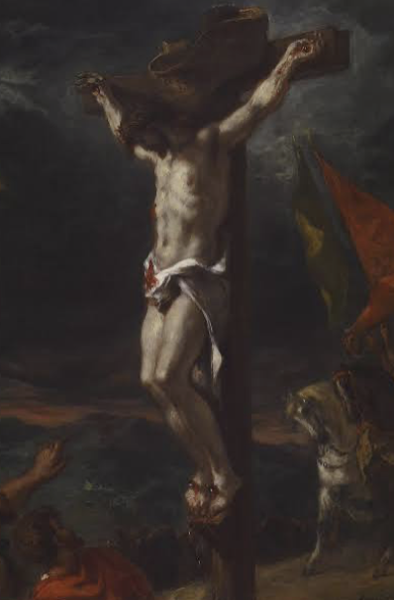
Of course, Jesus Himself weighed in on this topic too – [Matt. 24:9-25]! Nothing will be left to the wicked says Malachi! Now,.. the wicked have a form of eternal life in that they procreated, have children, and on it goes, generationally! They themselves die, but their gene’s traits continue being passed on to future generations. Here, in vs. 3, even that form of continuing life will be “cut off” on that terrible day, as NOTHING will be left to them! Their genetic line will be ended! As for God’s people – those who “revere” the Name of Yahweh/God – and in the New Testament, who revere the Name of Jesus, they will experience the ”day” very differently. They will feel the weight of oppression being lifted off of them- selves when they will see righteousness “rise like the sun”, with healing for the remaining population of the earth! God’s people will rejoice that the power of Satan upon the earth and upon its nations and tribes, has been broken! And everywhere Christ-followers will be free and unhindered – able to worship without fear! It says that we will leap like calves when they are let out of their pens after having been penned up for too long,! And then is says in vs.3, that after the tide of evil has been turned and has receded – certainly accomplished by Christ Himself – we will join in on the triumph over evil and over Satan’s evil influence in the world – because, Rev. 20 then tells us that Satan will be bound and confined for 1000 years, ending his reign of terror! God’s people will join in the “trampling” the dust of God’s enemies, reveling in the freedom we have gained (vs. 3)! But those who still will not acknowledge the Supremacy of Christ from the heart, will then be dominated by God’s people rather than the other way around, as has happened all through the ages! ~The effort of God is to include more people in His Salvation, not less! “He is not willing that ANY should perish”, said the apostle Peter in 2 Peter 3:9! So to that end, God sends a messenger/prophet with a prophetic warning in Malachi! “The Day is coming”, He says,.. and He always means what He says! It will either happen when we die, or it will happen at a specific time toward the end of our cursed-earth’s history! Either way, the wrath of God will catch up with all who will not request for themselves the substitute sacrifice that God has provided for our sins! Listen - He provided it at an immense personal cost to Himself! The Son had to suffer the indignities, the shock and pain of a the torturous trial, beating, and crucifixion! What is less appreciated is that The Father had to sit there and watch His Beloved Son suffer! In my experience, there is no pain that compares with watching a love one suffer! God the Father had all the power and more, but somehow restrained himself from intervening. I cannot comprehend how He did it,.. but I know what was at stake! Your life and mine – in fact – everyone’s lives were in play at the cross! He did it to rescue us! By the power of His love He carried through! And finally, there’s the Holy Spirit! Surely He was hovering about the vicinity of the cross! He who led the Israelites in a cloud by day, and protected them in a pillar of fire by night! He whose fire consumed the thrice-drenched alter of Elijah. He who possessed the body of Sampson so that he could catch the foxes, and break a wrapping of new ropes, chains, and tear free and carry on his shoulders, the huge city gate and its frame, a quarter mile where he perched it at the top of a hill. And finally, who provided the power of Jesus behind every great miracle! And HE stood by and did nothing to make it easier for God’s beloved Son on that cross! Now hear me! To reject Jesus is to reject the colossal suffering of God on your behalf! Do do that is not only just horribly wrong, but will bring down the colossal and eternal wrath of God upon you, and upon every head that has the audacity to spurn the combined sacrifice of the Triune God! Listen, get that target off your back! Listen to the warnings of God. He will take notice if you listen! Join the winning team!

