Slide 1

Intro to: Titus 1:1-3
“…That Leads to Godliness”

Slide 2
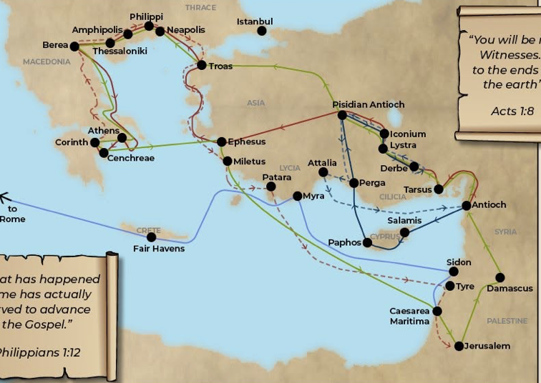
~In introducing the book of Titus to you, some information is needed to build on, as a house is built upon a foundation. It is a letter to a man named Titus on the Isle of Crete, in the Mediterranean Sea, about 120 mi. off the tip of Greece . We know The Apostle Paul is the writer. Titus had been on of Paul’s many companions and colleagues in starting churches all around Eurasia - mostly in the European arena. They had served in the trenches to expand God’s Kingdom among the gentiles. Titus, a gentile himself, had served with Paul in Corinth (2 Cor. 8:6,16-18) He served as a courier for Paul – ferrying Paull’s second letter to the Corinthian church to them and returning to meet Paul in Philippi with the good news that most of them remained loyal to Paul and to the apostle’s teachings. (2 Cor. 2:12,13: 2 Corinthians 7;6,7, 13,14:2 Cor. 8:17,24). A few years later, Titus was with Paul at the Island of Crete, 120 mi. off the tip of Greece, and was left behind to do the pastoral ministry of strengthening the church there. He was to ensure that they continued to adhere to the apostle’s teaching (“sound doctrine”) and to appoint elders in the towns with churches (Titus 1:5). Finally, when new help arrived, Artemas, and Tychicus, Titus was summoned to join Paul in Nicopolis, in today’s western Greece (Titus 3:12). Later, Titus was with Paul in his first imprisonment in Rome, and from there, was sent to present day Serbia/Montenegro (2 Timothy 4:10). It was often rewarding, but also beset by stressful and dangerous situations, as city leaders in various cities tried to stop their work by dragging them into court, jailing them, or whipping up the mob to shout them down, threaten, beat them, or even to try to kill them! [2 Cor. 11: 23-27] ~Again, let me emphasize that Paul did not go through all this alone. In fact, often, he was protected and whisked away from the rioters by his companions, leaving some of them to face the wrath of the authorities or of the mob! So, the companions of Paul were not on some sort of cake walk with him! To truly follow Jesus in that day meant to suffer great personal loss, or even to die for the cause of Christ! Christianity was not was more readily accepted by the gentile/non-Jewish world of Paul’s day than by the Jews themselves. But the secular world resisted tooth and nail! Christianity would not be accepted by the Roman empire for approximately 350 years! But the cause of Christ continued to bring “Gospel” to the world! From the beginning, God planned to have Himself a people who knew Him, and who were so impressed by what they knew – especially through revealing Christ! ~Now, the gospel appealed to mainly the poor at that time. The poor made up the majority of the world’s population at that time, and this was true all over the globe. Percentagewise, there were a relatively few very rich, and then pretty much everyone else… was poor – and when I say “poor”, I’m referring to the different levels of poverty, as there always are – from not having much, to being “dirt poor” – as in not having much of anything – especially food. But all “the poor” could much pretty be characterized by hand-to-mouth daily living, and in having little to no power – no voice in society. So, it was mainly the poor that were attracted to Christ and the church! In their various nations, they were on the lowest rung of their society’s totem pole because of their poverty, and when they heard the gospel of Jesus Christ, they were elevated! Their status and sense of self-worth “shot through the roof”, as they say. They had a God who knew and kept track of them – and who loved them enough to die for them! They could have a relationship with that God because it is what He wanted, and when life on earth was over, life was just beginning for them, and they would continue that loving relationship with God forever! For the first time, they had value, and for the first time they had hope! So women flocked to Christ and into the church, and slaves, and laborers, and foreigners! ~The Jews that converted to Christ were the first to come. Paul’s strategy in city after city was to begin by lecturing and debating in the city’s Jewish synagogue. Always, some would believe, and they formed a central first group with a firm foundation of O.T. understanding and of theology in the early church! Once their apostolic teachers walked them through the O.T. showing them Jesus Christ (Yeshua) in just about every book, and the progression of God’s plan from Adam to the cross, - and in particular ,from Abraham to the cross and beyond, these Jews were hooked on how it all made sense! They were given the key that unlocked the mystifying actions of God throughout their nation’s history and throughout human history! Now, with Jesus Christ revealed in the O.T. scriptures, it all made sense to them!

Slide 3
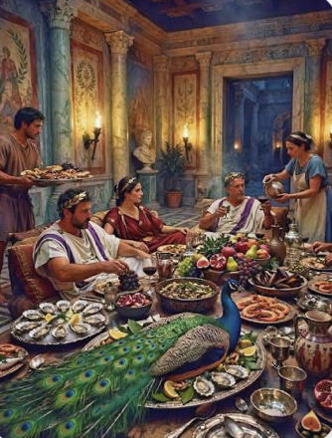
The Jews were also the wealthier members of any given congregation. As mostly educated aliens and sojourners in their adopted land, they had used their abilities to developed an ethnic tradition of adopting careers in the financial sectors - money lending, precious gems, and precious metals – all high-return professions. That way, if the people of their adopted land started to envy them, and the social tides turned against them, and their adopted society moved to oppress them (which has happened an amazing amount of times over the millenniums) they could gather their real wealth in a small box or a medium-sized satchel and flee the country without a complete financial loss they could not come back from! So, beside all Jews having exceptional knowledge, many of the Jews had wealth. But they had knowledge that none of the non-Jews/gentiles did! Unfortunately, these disparities in the two groups within the membership of the church set the church up for a pesky division that would plague church after church for the first 50-60 yrs or more, of the church’s existence! In fact, almost all of the apostolic writings that are included in the N.T. address/reflect this problem! The entire book of Romans was written by Paul to challenge the Jewish believers to get with the plan of God and accept the gentiles in their church as equals in every way, despite the fact that they, by-in-large, had great financial advantages, and advantages of heritage and tradition. Unfortunately, these advantages could lead to pride, and pride ruined relationships! [Rom.2:17-20] – I mean, some of them were being spiritually obnoxious, coming off as insufferably superior to their fellow Christians who did not know as much as they did, and who were on a lower social rung than their Jewish counterparts! James talks about this inequity in the church in [Jas 5:1-6]. Taking on wealth and power opposed all social norms of those times! But in the church, Jesus was the great equalizer! Having money and possessions has never meant anything to God! It’s not like anyone can take a pocketful of diamonds, or a rolled-up Rembrandt into heaven to bribe the guards at the gate! No one can roll out their certificates, and honors, and photos with important people that they have hung on their office walls! So, if we are to be consistent, none of that equates to an elevated status of anyone in the church today! Anyone and everyone is just another of our number – welcomed, even treasured – whether rich or poor, young or old, physically impressive or physically unimpressive, smart, average, or under average – but not because someone is rich - or poor for that matter! None of that matters. What matters to we who are in the church is what matters to God! It is whether or not one is following Jesus! Jesus is our everything! After that, it is the content of one’s Christian character, because this is what follows us – what matters to God! Did we follow the pattern of Jesus our Savior and Divine mentor, or did we follow our base instinctive selves? We saw at the end of our last series in Malachi that God sees and takes notice of those that are wholly loyal and devoted to Him and those who are not! Those who are, will be on the right side of things when The Day of God comes to confront this earth! It is a key/paramount thing to seriously consider when deciding to follow Jesus or not! We can laugh it off now, but then there is nothing left to us but terror on our deathbed! It is the mother of all nightmares to come to the end of one’s life and to come to the realization that because of your neglect, or your hard heart, you have fallen into God’s terrible anger and wrath because you ignored Him while you lived and breathed on His green earth! But in giving yourself to Him, He gives Himself to you. Put your faith in Him, and He puts YOU in Him, carries you, and you are made ready for the Presence of God! No nightmare of unpreparedness. Jesus Himself prepares you! You WILL pass the final exam - guaranteed!
Notes:
!

Slide 4
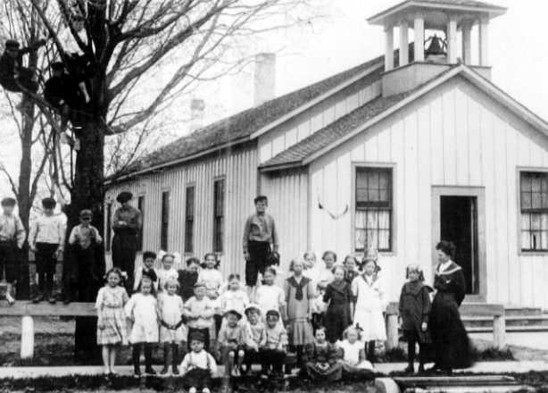
*It’s like having the most important exam of your life, and not studying for it! Have you ever had that nightmare? I have! In real life, I’ve never had an exam that I did not study for at all. I’ve had lots of them where I did not study adequately. But I’ve had a number of exams in my dreams, where I am absolutely caught unprepared! It was a genuine nightmare – a panicky, bewildering, scary scenario in my dream – as I knew I was unprepared, and knowing very little of what I was supposed to have prepared for! That nightmare will become a reality for a great many people as they come to the end of life and prepare move on to the next world! They realize that the opportunity to be prepared through faith in Jesus, has passed them by! They have delayed too long, and now they have to just wait and hope that what God has warned in His word is not true – just a figment of someone’s imagination! But their horror/terror will be earned through neglect or from pure hostility to God! They could have embraced the cross, but they passed it by, leaving Christ hanging from the cross for no apparent reason as far as they were concerned. But it doesn’t have to be that way - no nightmare of unpreparedness! Jesus Himself prepares you! You WILL pass the final exam- guaranteed! ~So Paul writes the book of Titus. He states his overall purpose upfront. He is writing to bolster the faith of “the elect”, and to give them an apostolic, authoritative understanding of the true gospel of Jesus and the will of God for the church and for their everyday lives! Already the official narrative of the apostles was being altered, twisted, and added to by various sects, cults, and false teachers! The only way to combat it was to inoculate people with the truth about what the apostles had actually heard and witnessed from Jesus regarding what it all meant! Writing it down on paper would preserve the accuracy of the truth for all time! I’m not sure that the Apostles had the compilation of the Bible in mind when they wrote these letters, but I am certain that the Holy Spirit did! The Christian movement could not survive without it! Unfortunately, there was a thousand years called “the middle ages” when the Roman church kept the Bible in a language that no one but scholars knew.. Then, when the Reformation began – and Tyndale translated the Bible into English, and Guttenberg invented his printing press. Tyndale, and 10s of thousands who read his translation, were killed by the Roman church in the most horrible ways, because reading the Bible changed minds and hearts completely! The Bible readers, called radical reformers, argued against the church’s position in many important theological areas as biblically indefensible, and they spoke out,.. and when the church authorities caught them, they were ordered to recant and return to the church’s traditional position, and they could/would not! They knew the truth,.. and could not deny it for fear of the God who wrote it! And they died horribly but with incredible courage in the flames of martyrdom! By the way, not only the Roman church persecuted and killed our evangelical branch of the reformation, the anabaptists, but the first reformers – the Lutheran church, and the Dutch Reformed church – did to the anabaptists what had previously been done to themselves – prison, confiscation of property, torture, and public execution! But It was the anabaptists who were the “readers”! They defied the authorities, to read, study, talk it over with other “readers” and come to their own conclusions about what it said. They met with other people who couldn’t read and told them of their findings! Eventually, they started schools so people could read the Bible for themselves! This was the initial rationale for public education – believe it or not! Have you ever noticed that the one-room schoolhouses were styled to look very much like country churches? / So – this is basic background. Titus is a short but good book, and certainly worthy our attention!
Notes:
~

